Slide 1

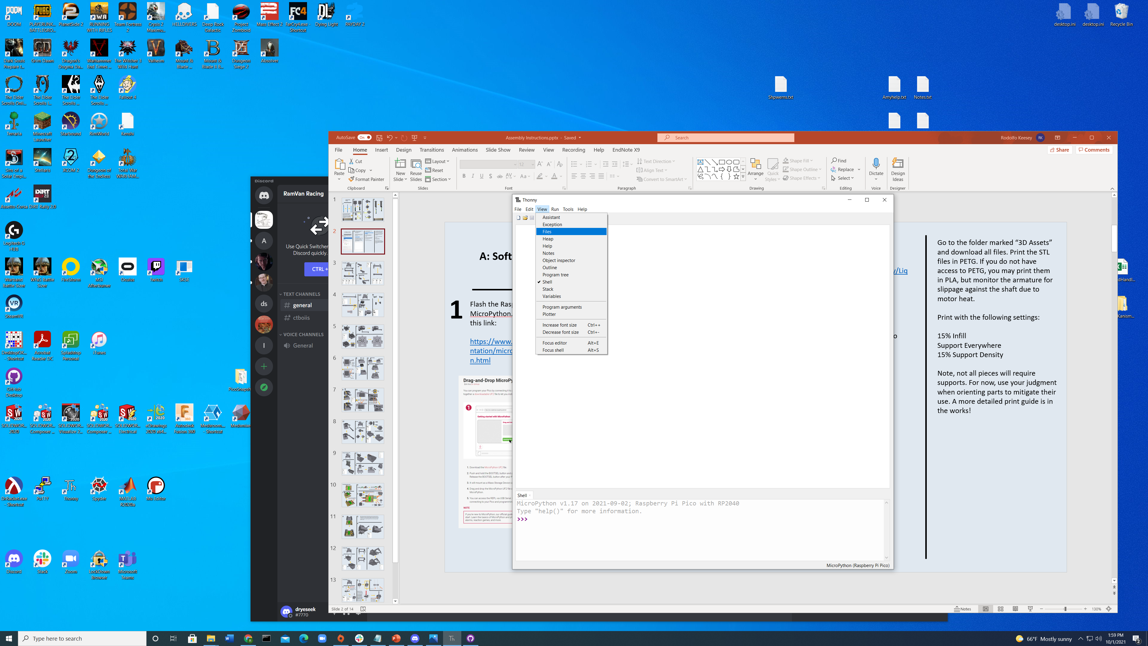
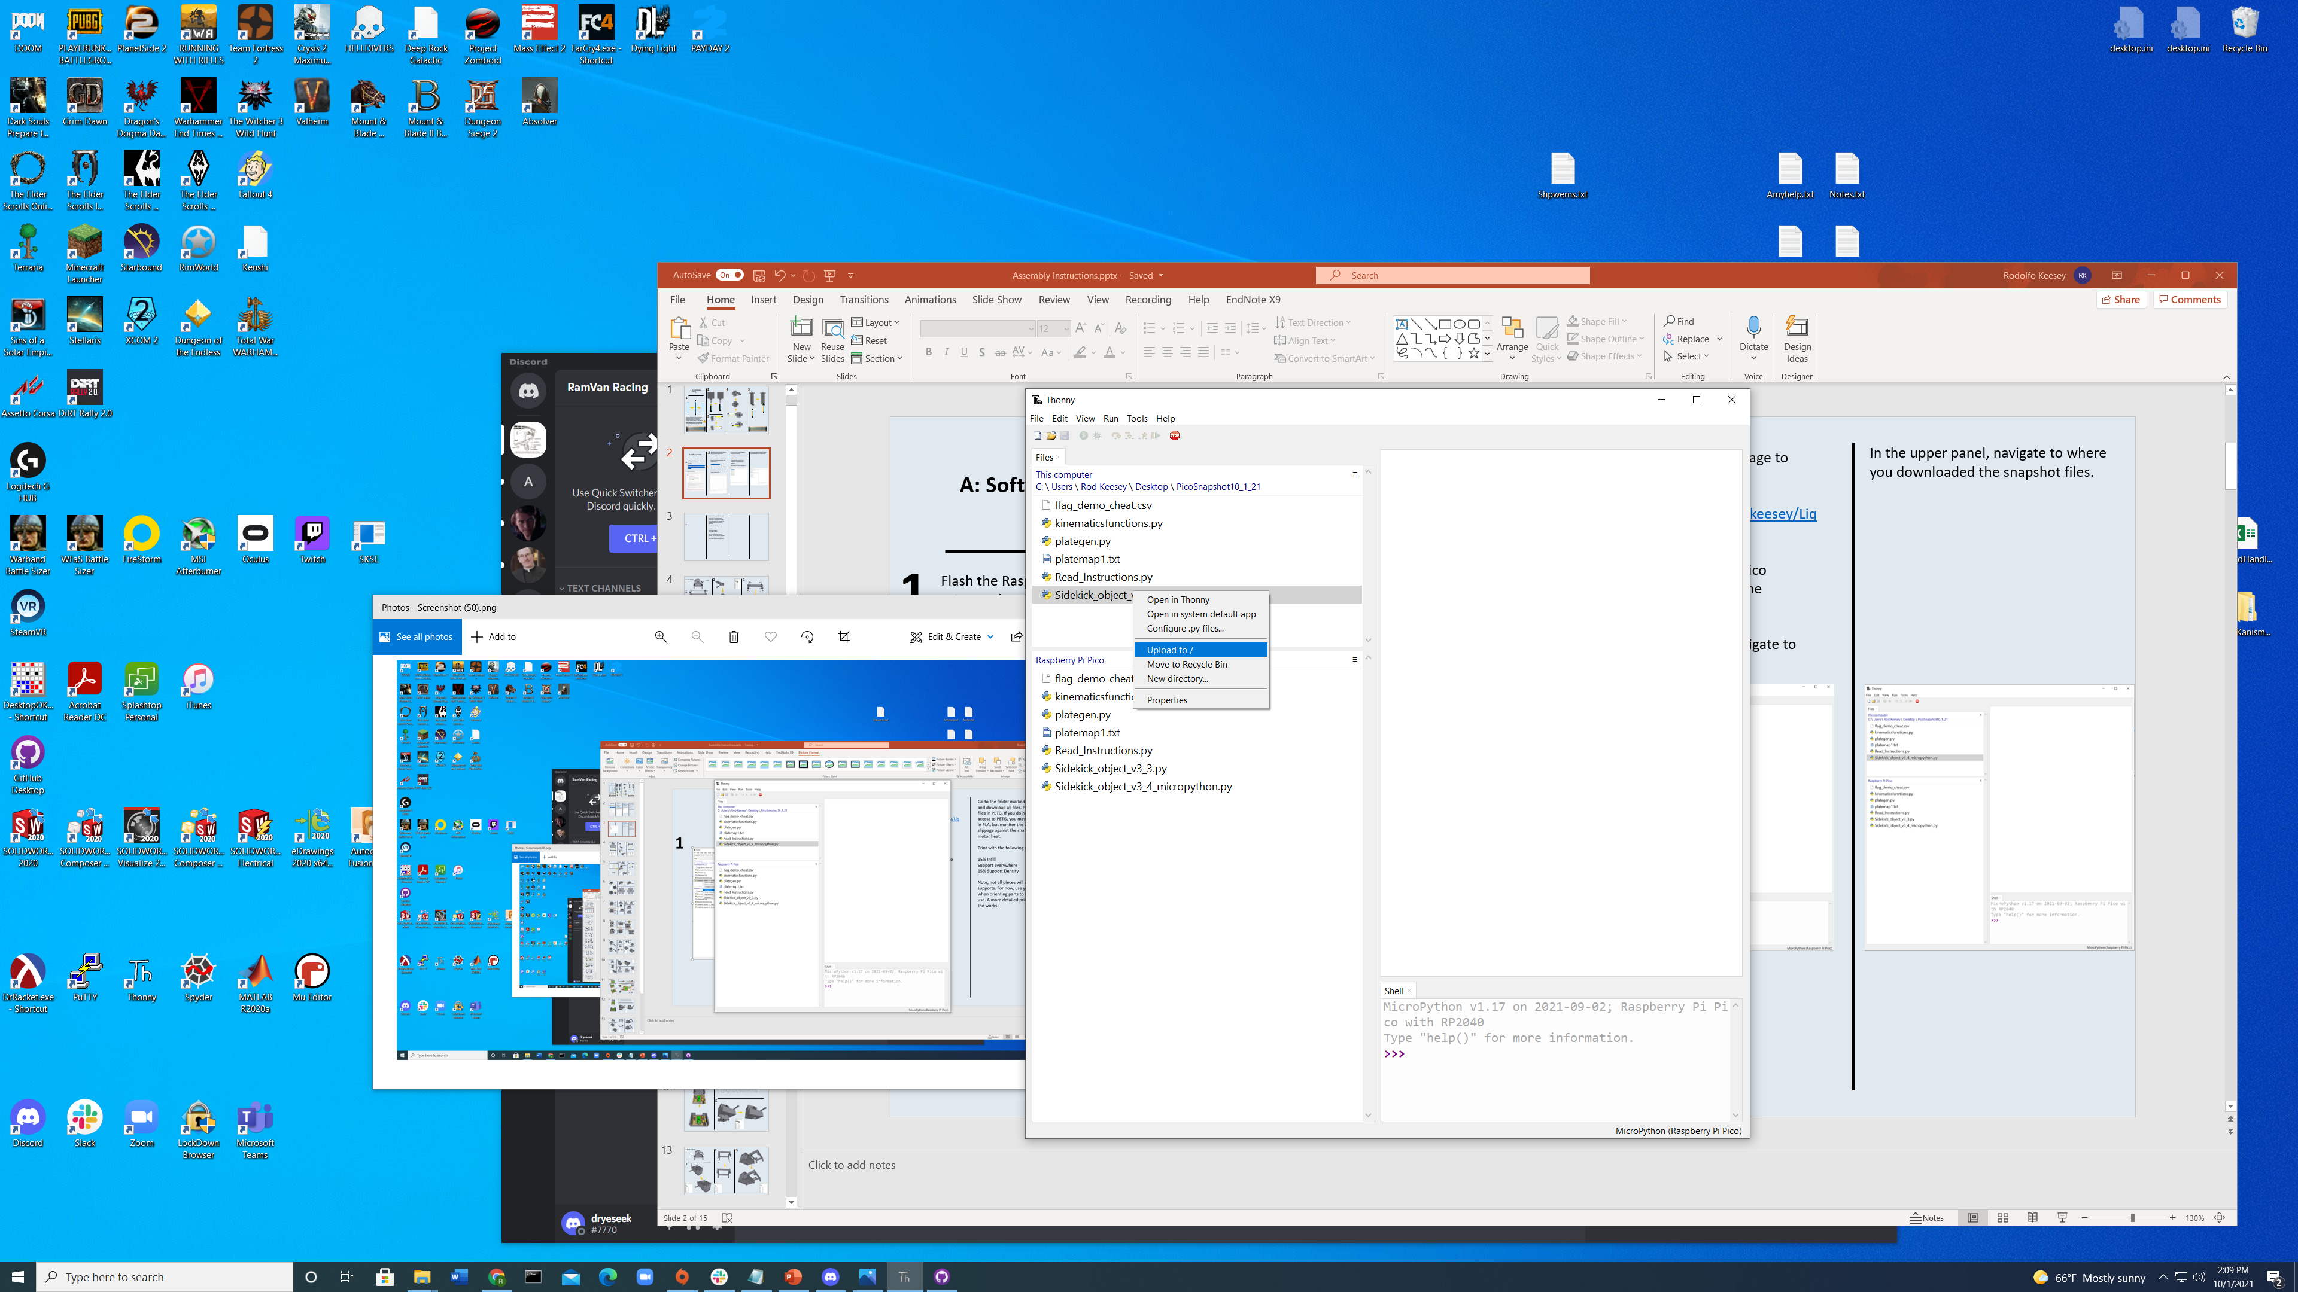
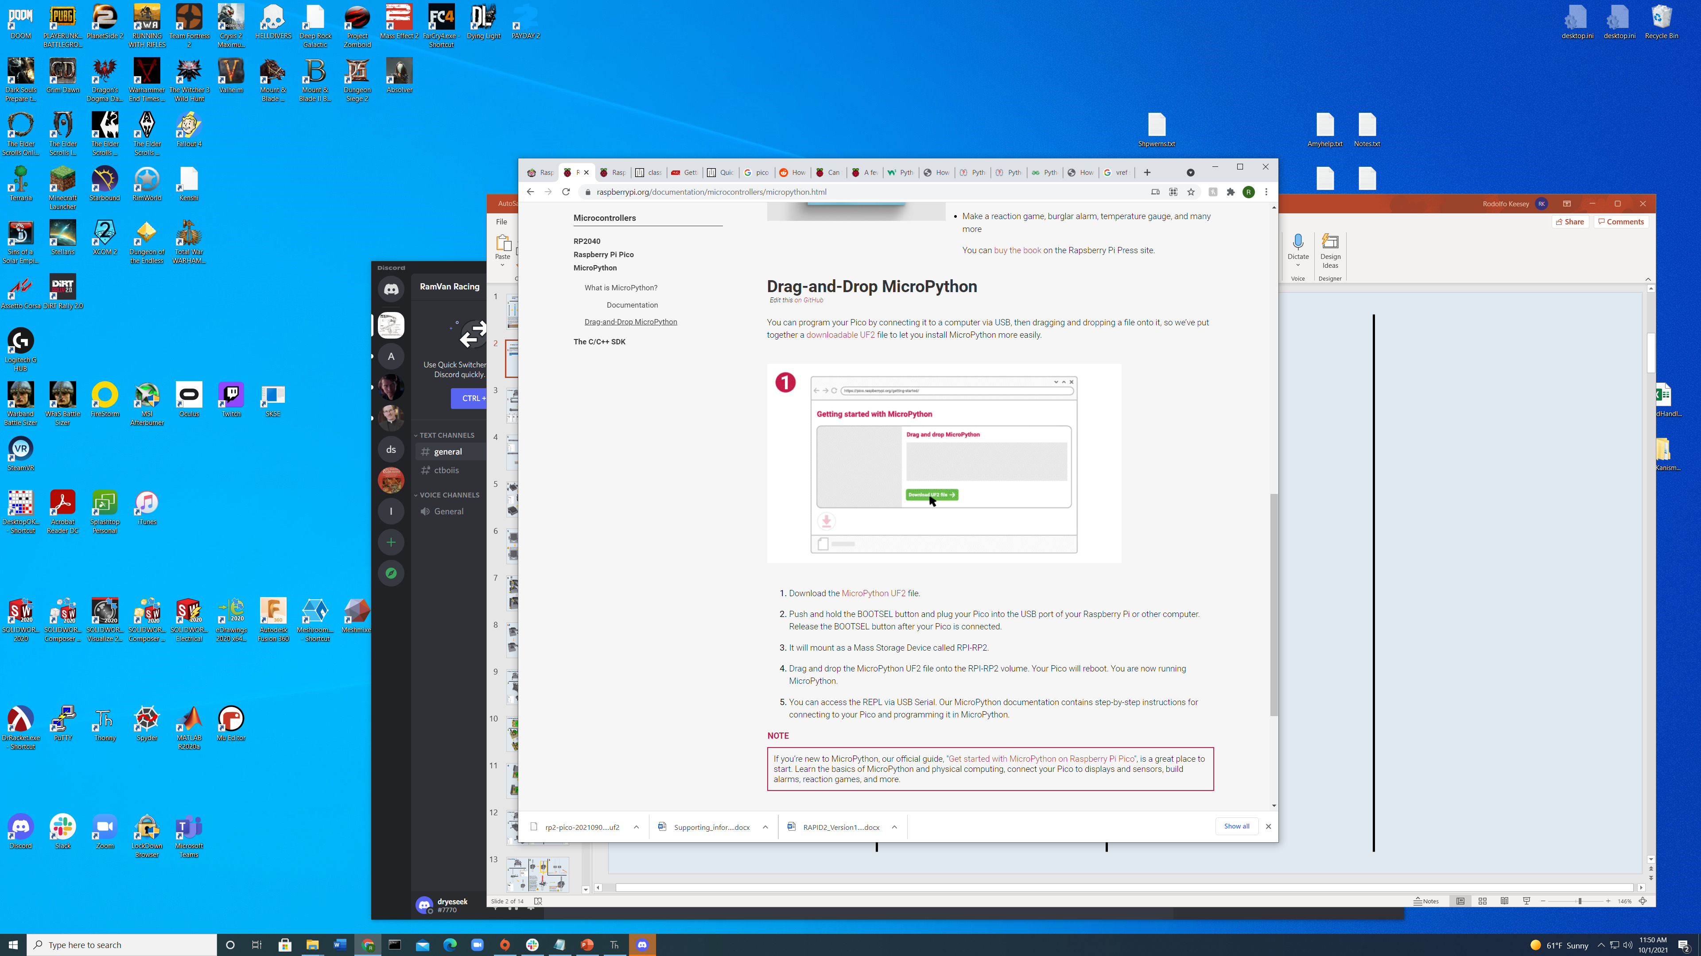
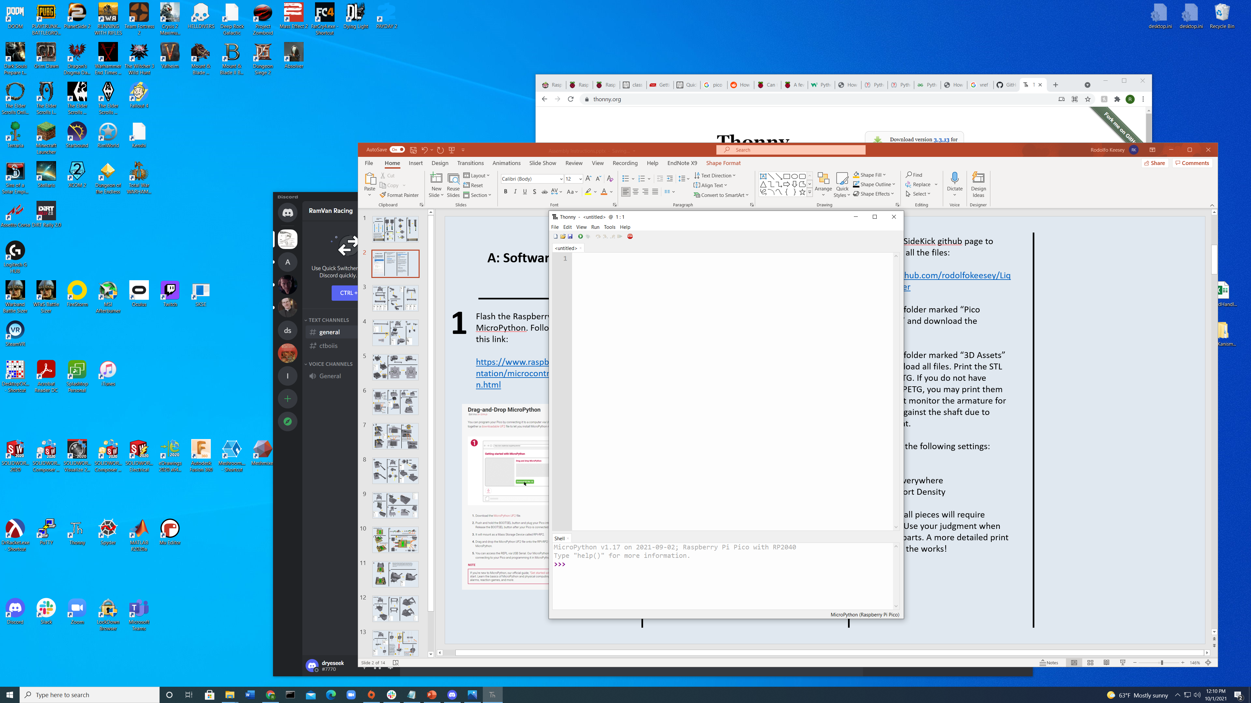
2
3
4
After flashing MicroPython onto the Pico, we need to upload the SideKick’s code to the microcontroller.
Download the Thonny IDE. This will be used to load the provided code onto the Pico.
https://thonny.org/
Once downloaded, install and follow the prompts for set up with MicroPython and the Raspberry Pi Pico. Once finished, your Thonny should look like this:
Go to the SideKick GitHub page to download all the necessary files:
https://github.com/rodolfokeesey/Liquid-Handler
Go to the folder marked “Pico Snapshot” and download the contents.
Now return to Thonny. Navigate to View -> Files
In the upper panel, navigate to where you downloaded the snapshot files.
On this machine its under:
C:\Users\Rod Keesey\Desktop\PicoSnapshot10_1_21
Then, right click on each item in the snapshot, and click “Upload to /” in the dropdown. This saves each of the files on the Pico.
A: Software/Hardware Set Up
1
Flash the Raspberry Pi Pico with MicroPython. Follow the directions in this link:
https://www.raspberrypi.org/documentation/microcontrollers/micropython.html

Slide 2
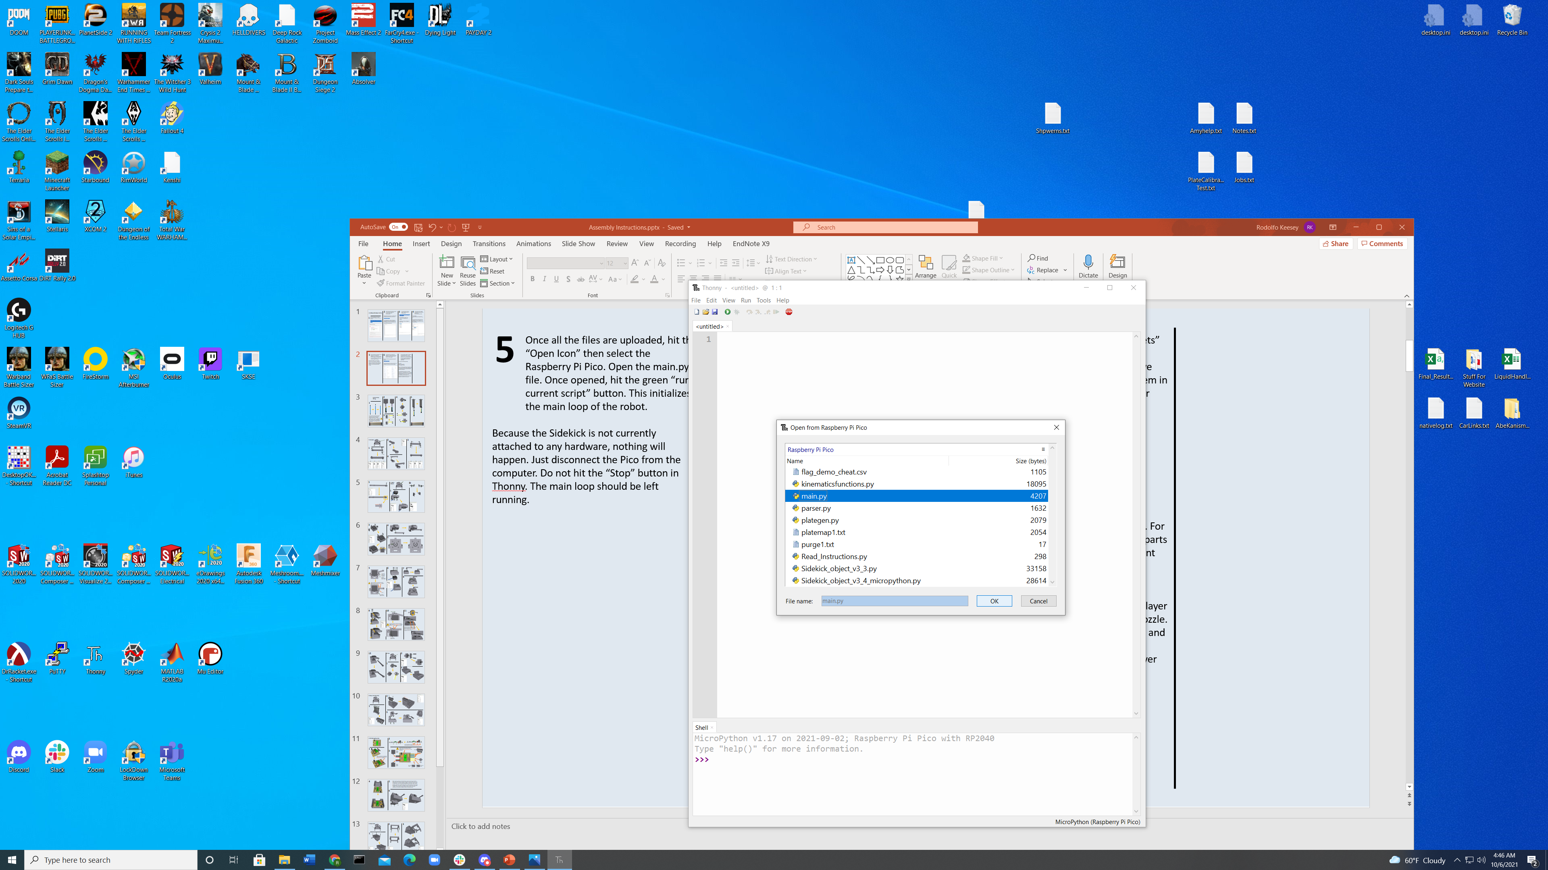
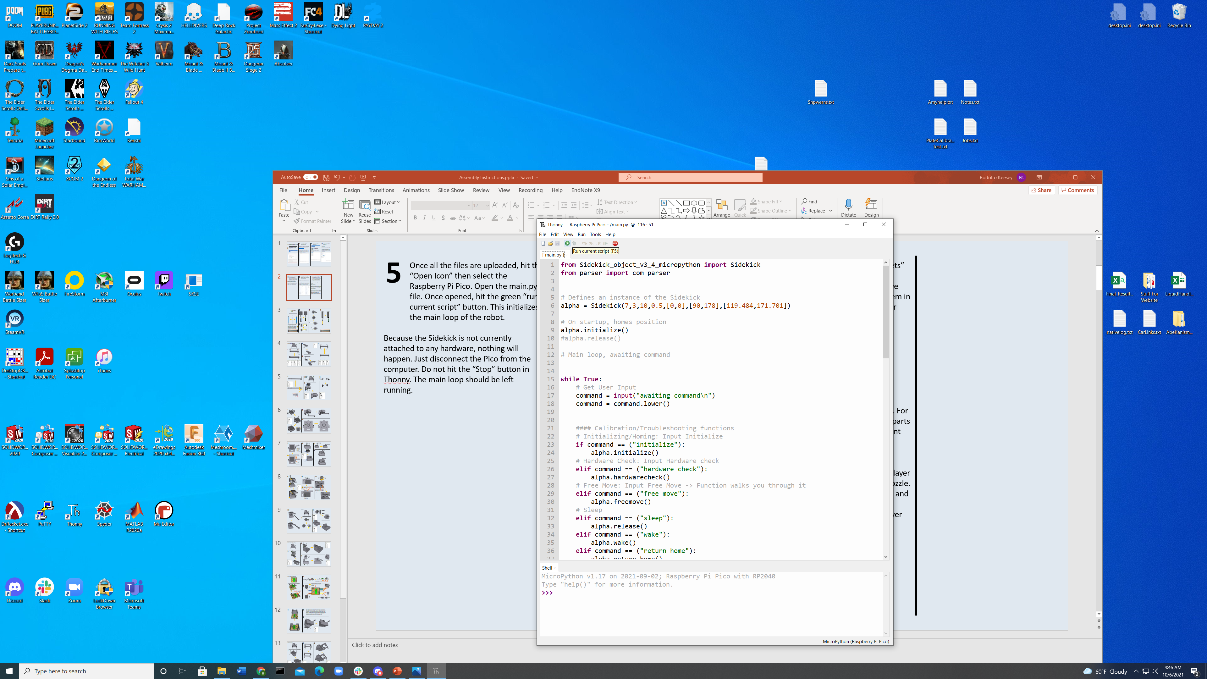
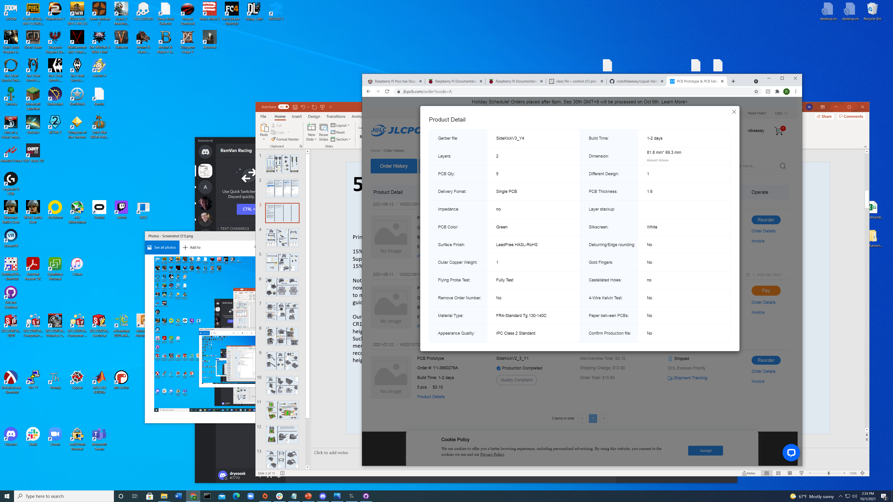
5
6
7
8
Once all the files are uploaded, hit the “Open Icon” then select the Raspberry Pi Pico. Open the main.py file.
Once opened, hit the green “run current script” button. This initializes the main loop of the robot.
Because the SideKick is not currently attached to any hardware, nothing will happen. Just disconnect the Pico from the computer. Do not hit the “Stop” button in Thonny. The main loop should be left running. The Pico is now flashed with the SideKick’s code.
The SideKick has a custom PCB designed in Fritzing. The files for the PCB are in the “PCB” folder on the SideKick’s GitHub page.
We used JLCPCB to manufacture a set of 5 boards.
https://jlcpcb.com/
Upload the SideKickV3.zip file to JLCPCB. The settings for the board are pictured below.
Go to the folder marked “3D Assets” and download all files. Print the models in PETG.
If you do not have access to PETG, you may print them in PLA, but monitor the armature for slippage against the shaft due to motor heat.
Print with the following settings:
15% Infill
Support Everywhere
15% Support Density
Note, not all pieces will require supports. For now, use your judgment when orienting parts to mitigate their use. A more detailed print guide is in the works!
Our prototype was printed on a Creality CR10S Pro V2, using Overture PETG. The layer heights were set to .42mm on a .6mm nozzle. Such aggressive layers are not necessary, and merely aided in rapid iteration. We recommend that you print with .2mm layer heights on a standard .4 mm nozzle

Slide 3
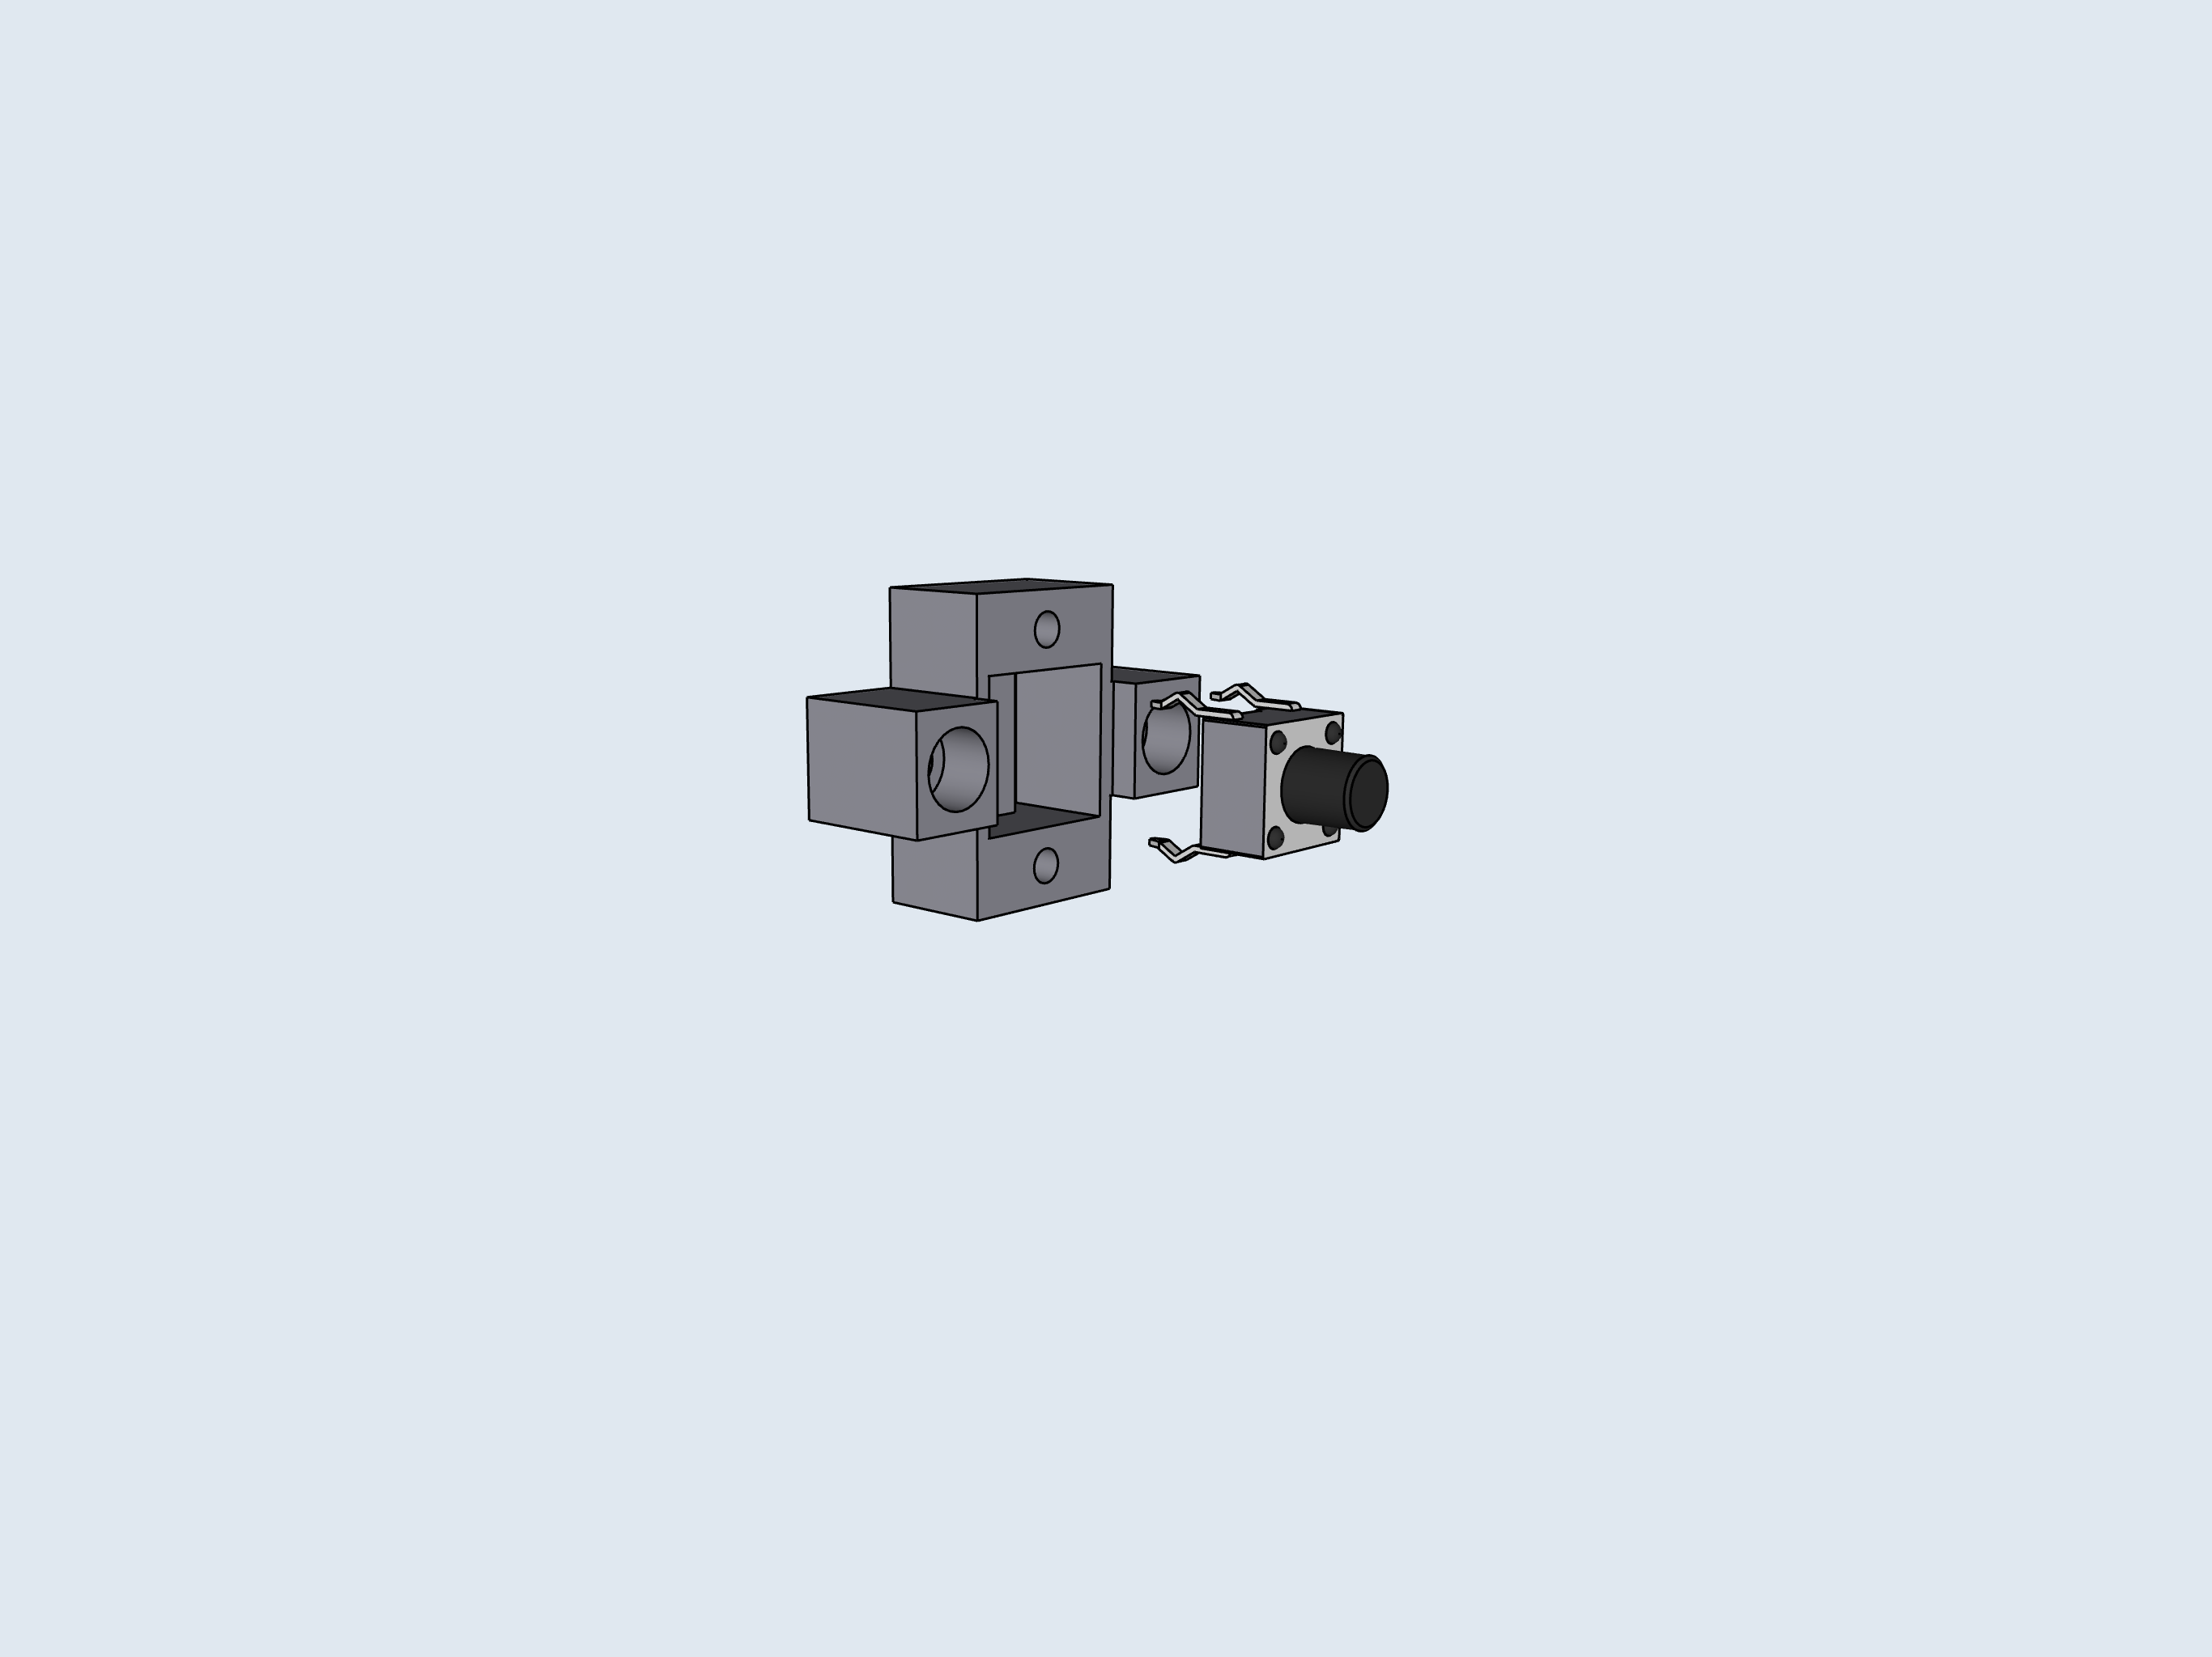
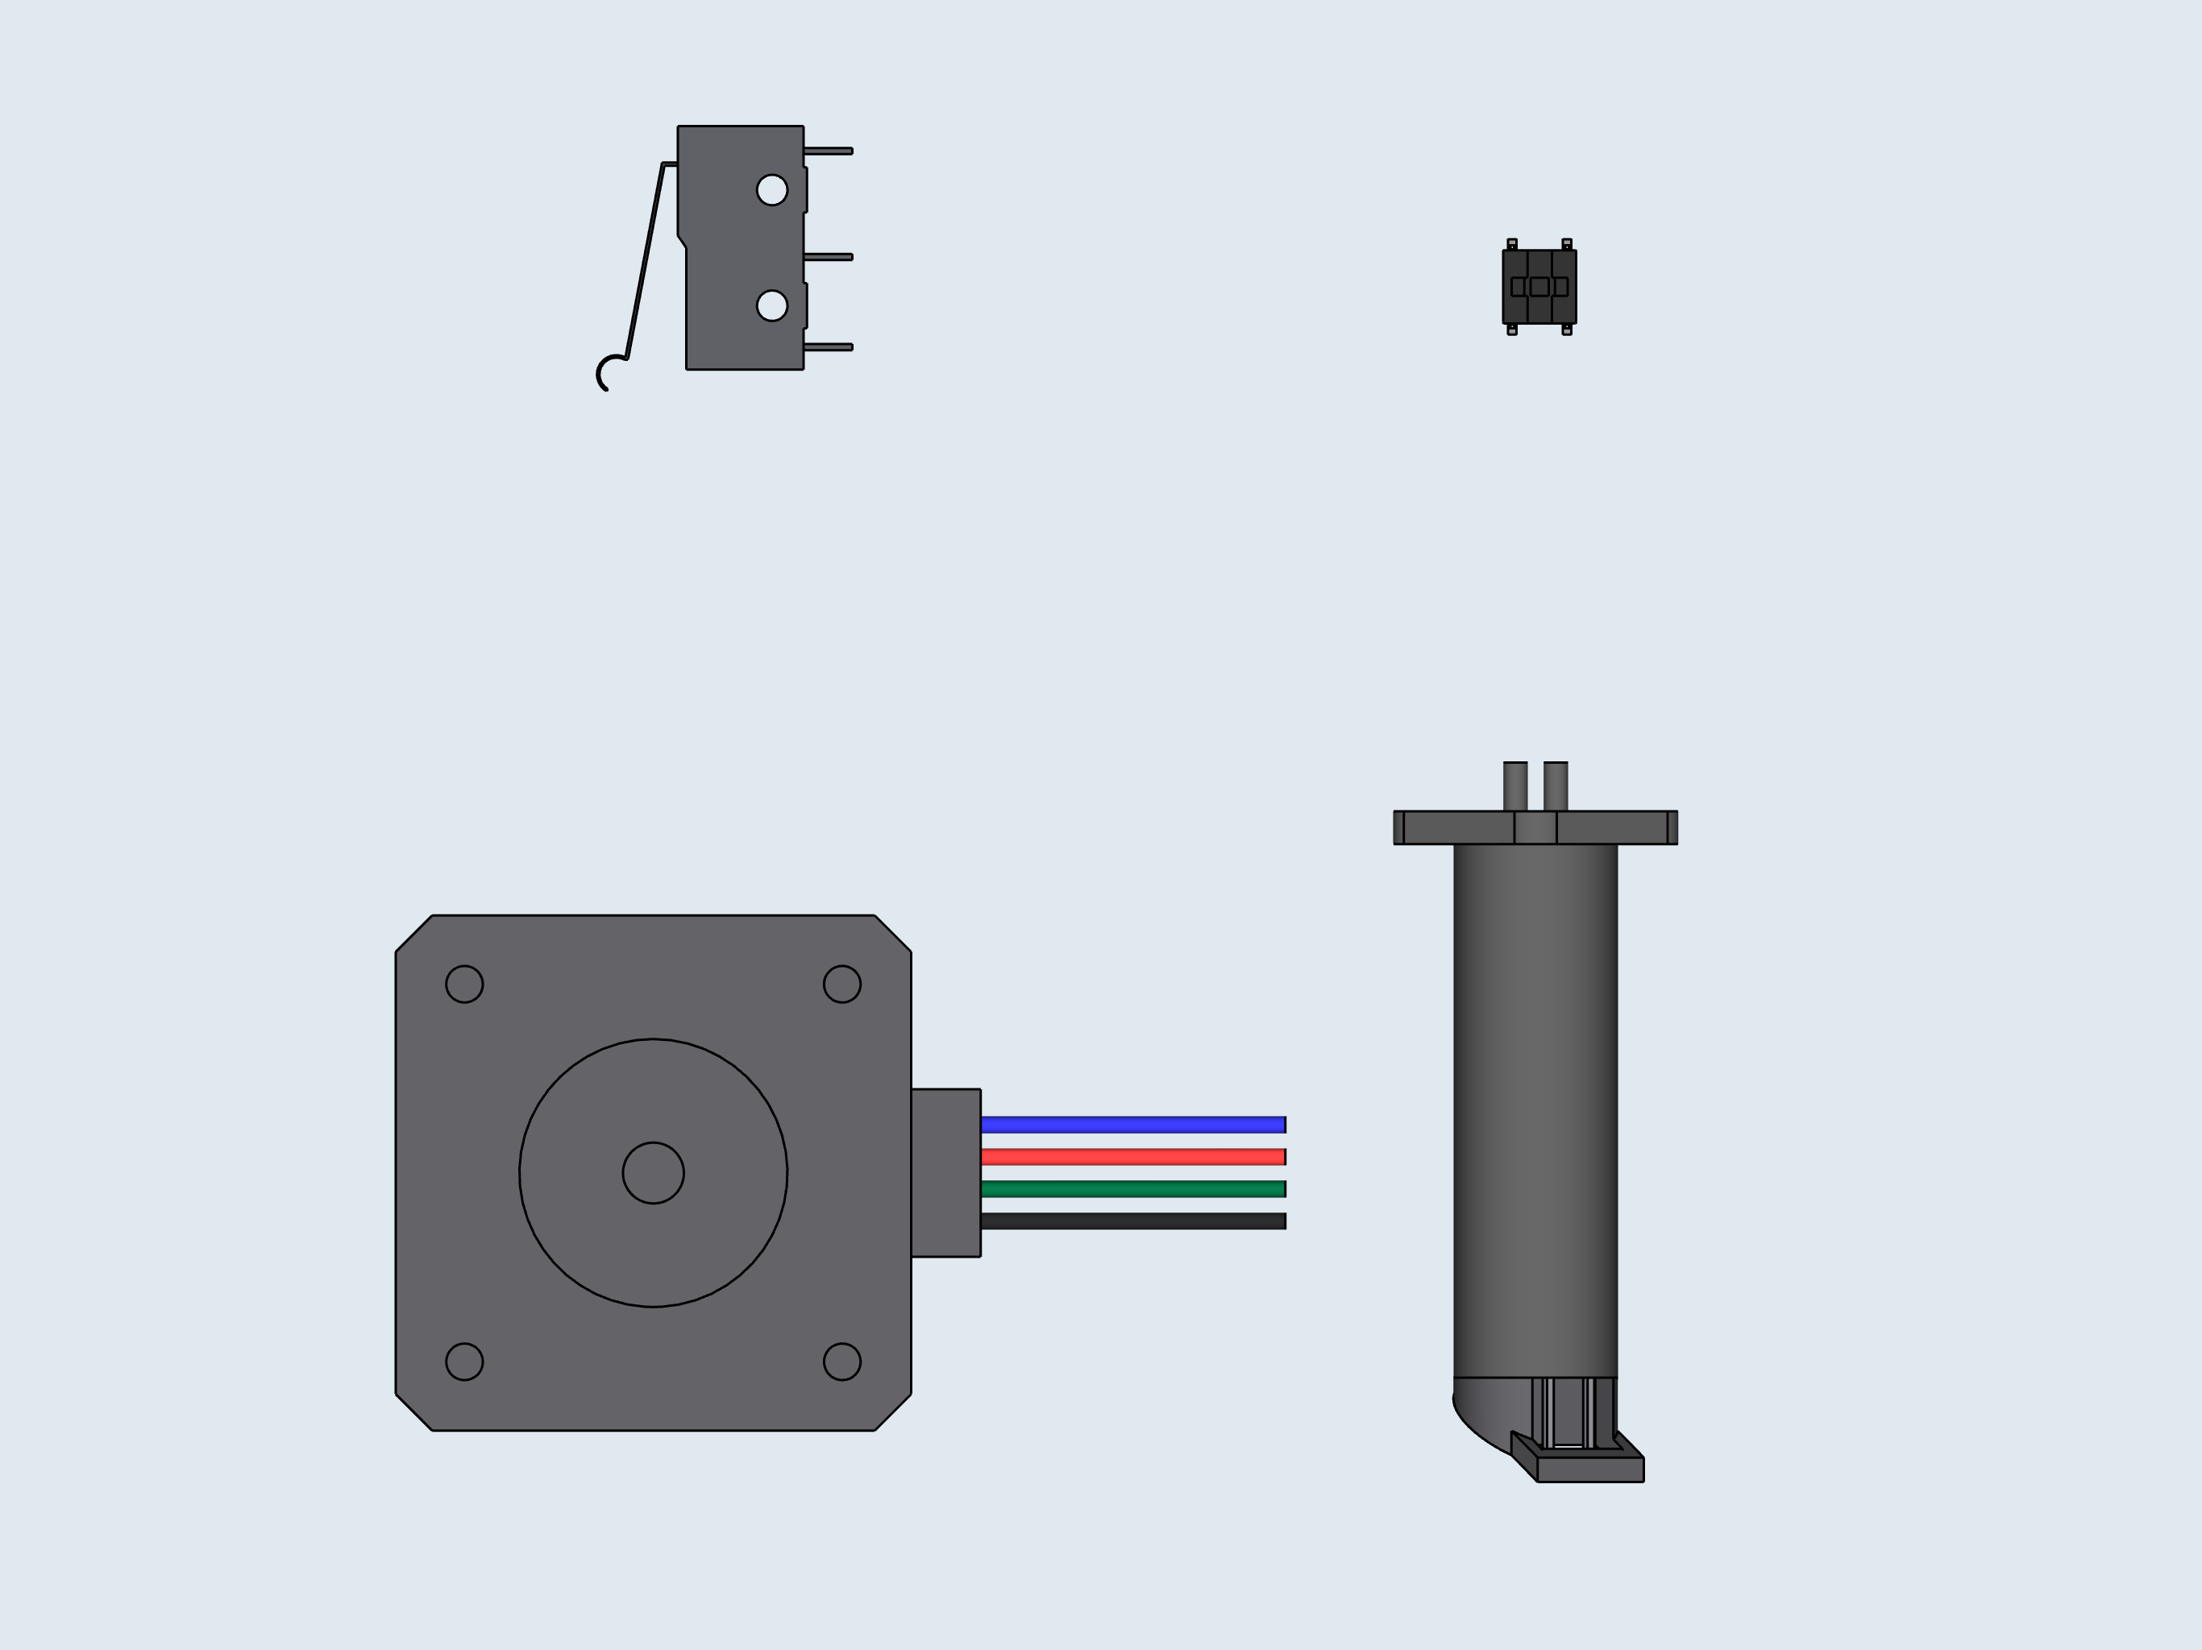
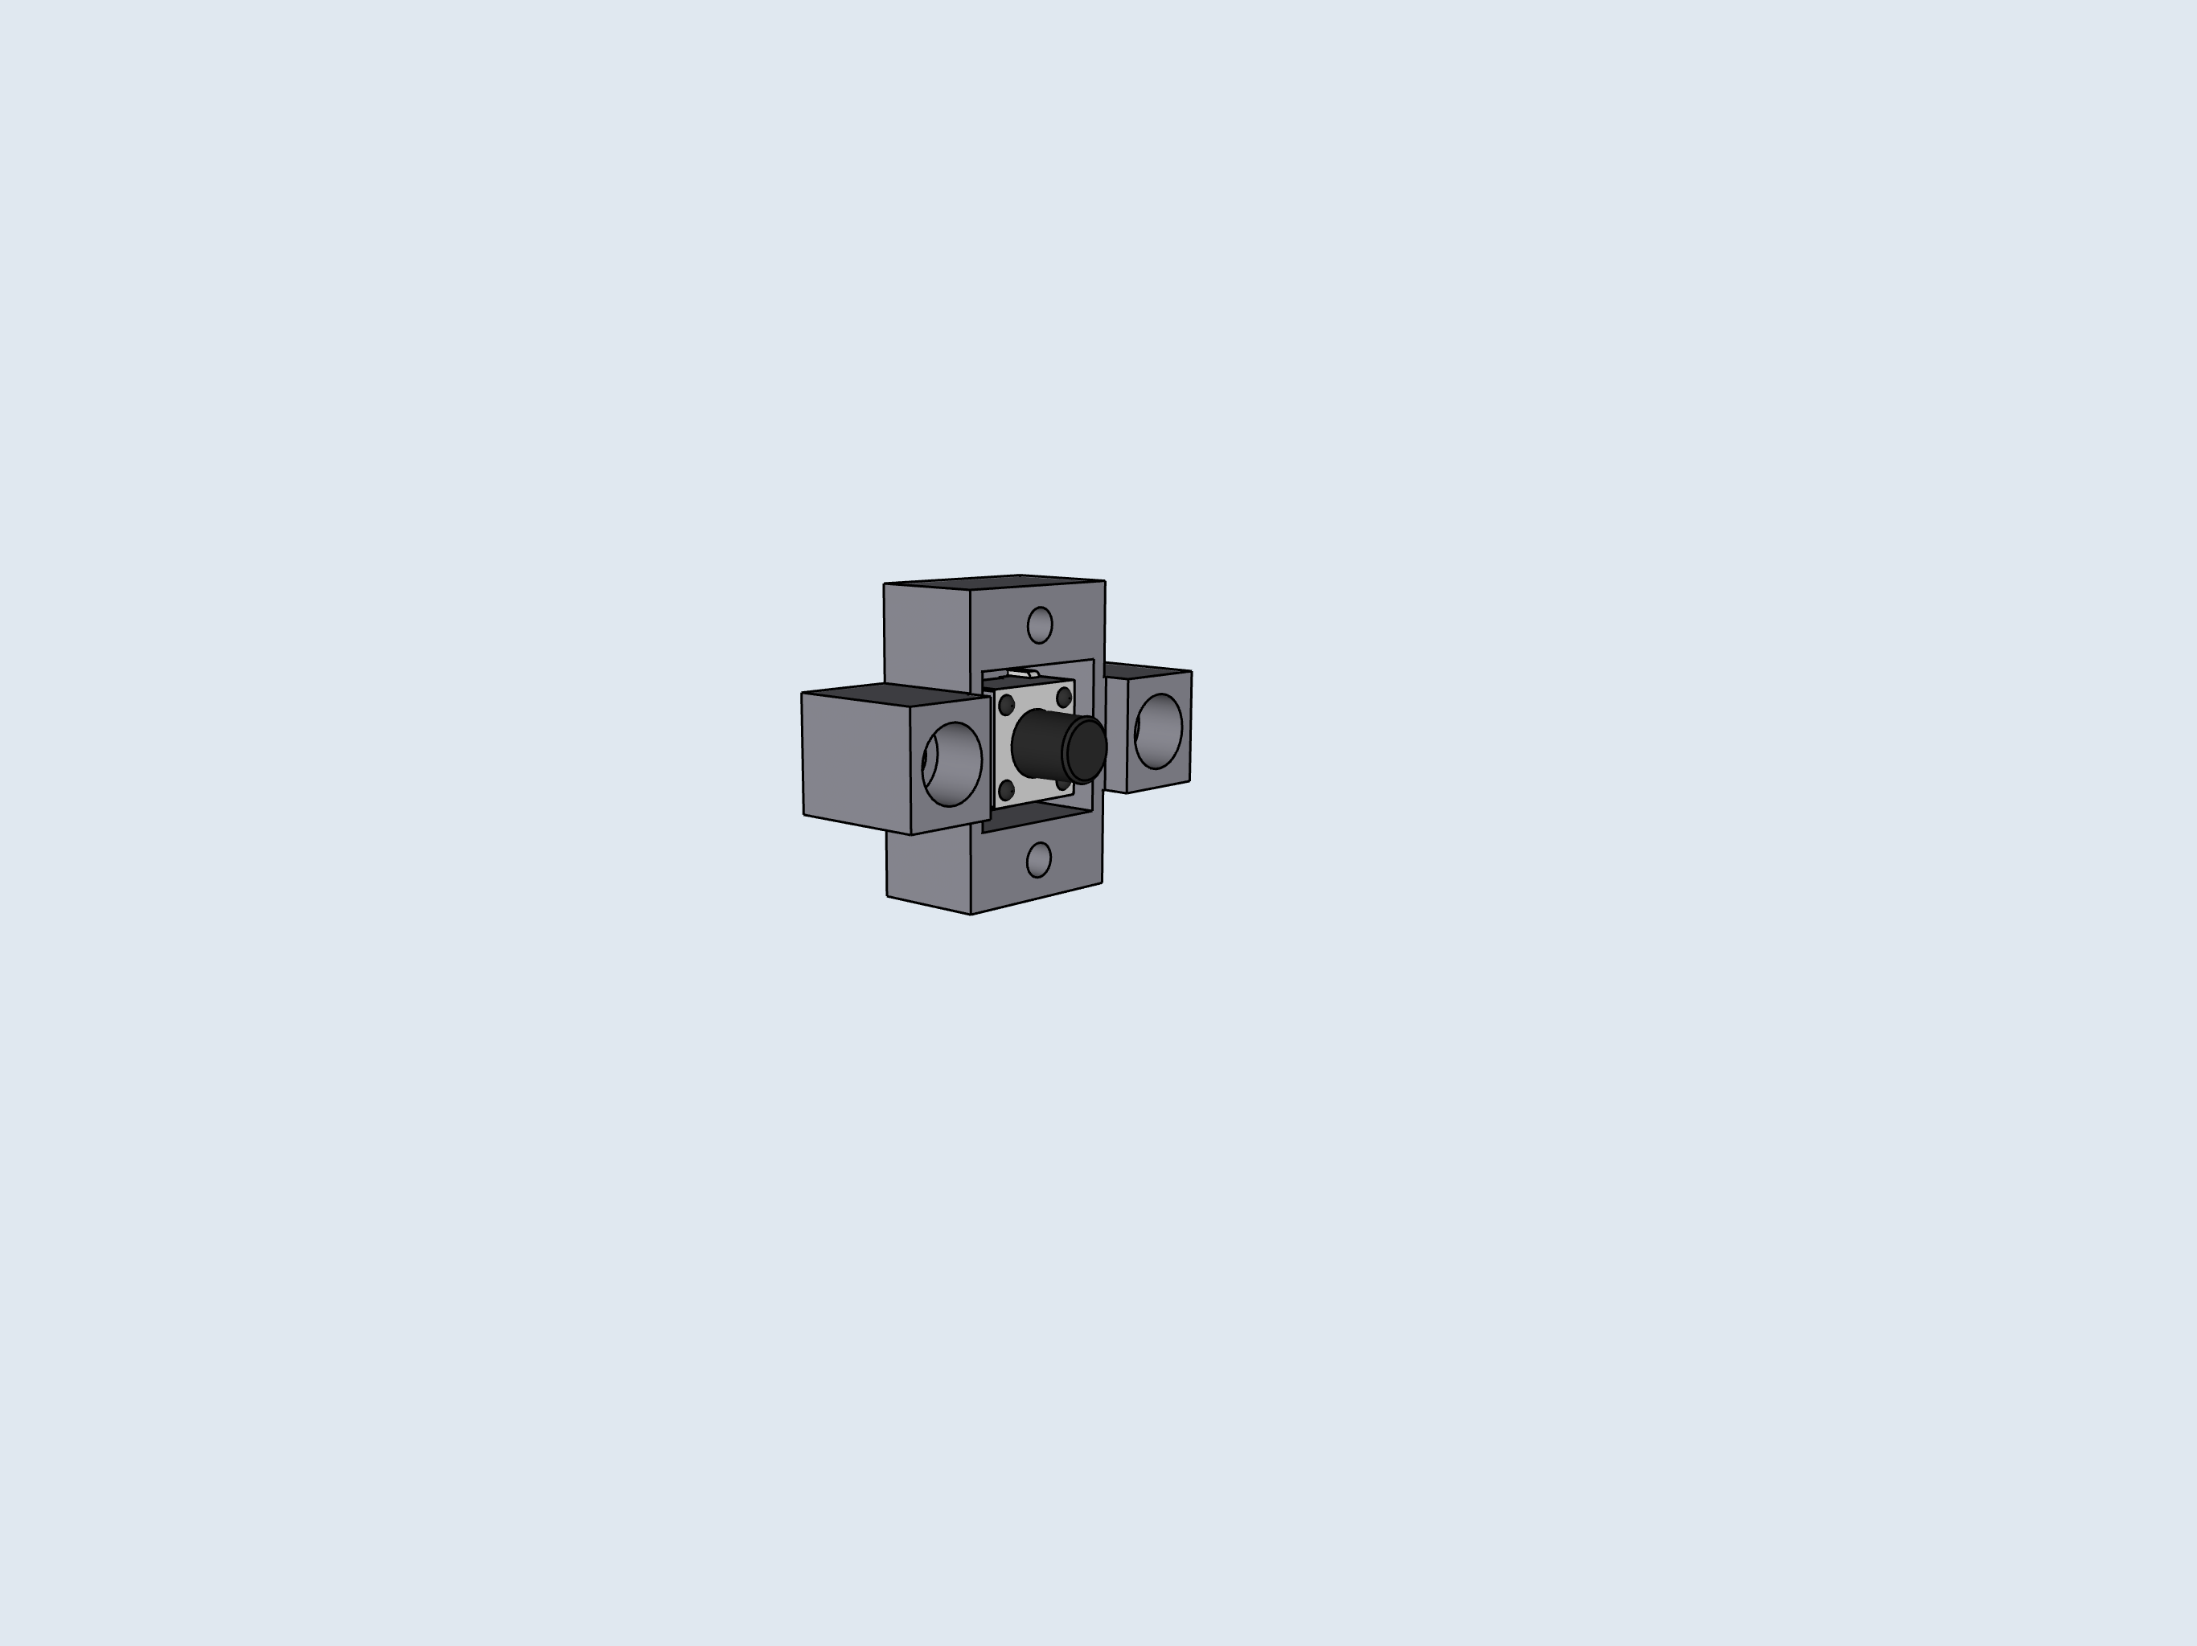
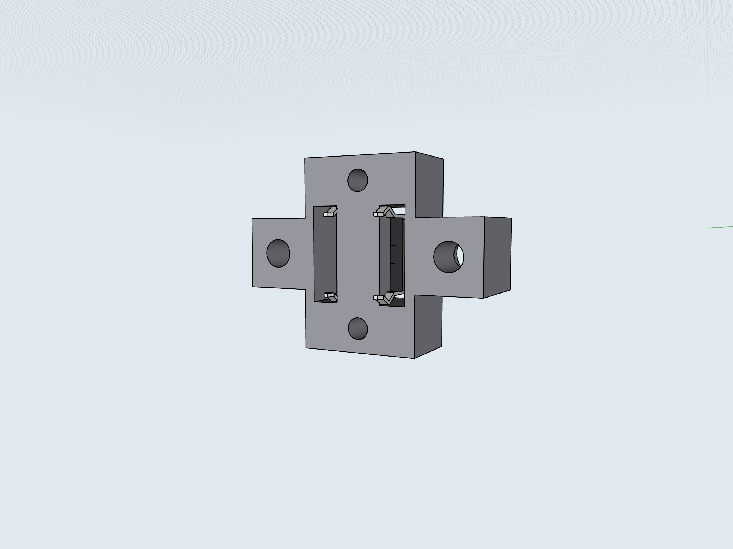
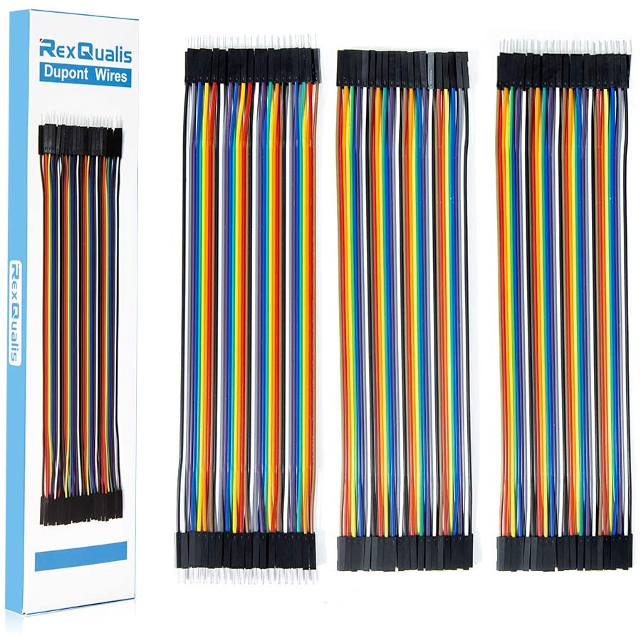

2
4
5
B: Preliminary
Wiring
1
3
Cut one of the ends from the Dupont connectors, then strip the ends to expose the bare wire. Use these stripped wires for steps 1-3. Be sure to match the wire colors in the diagram. This will allow you to easily follow the instructions for connecting the cables into the PCB.

Slide 4
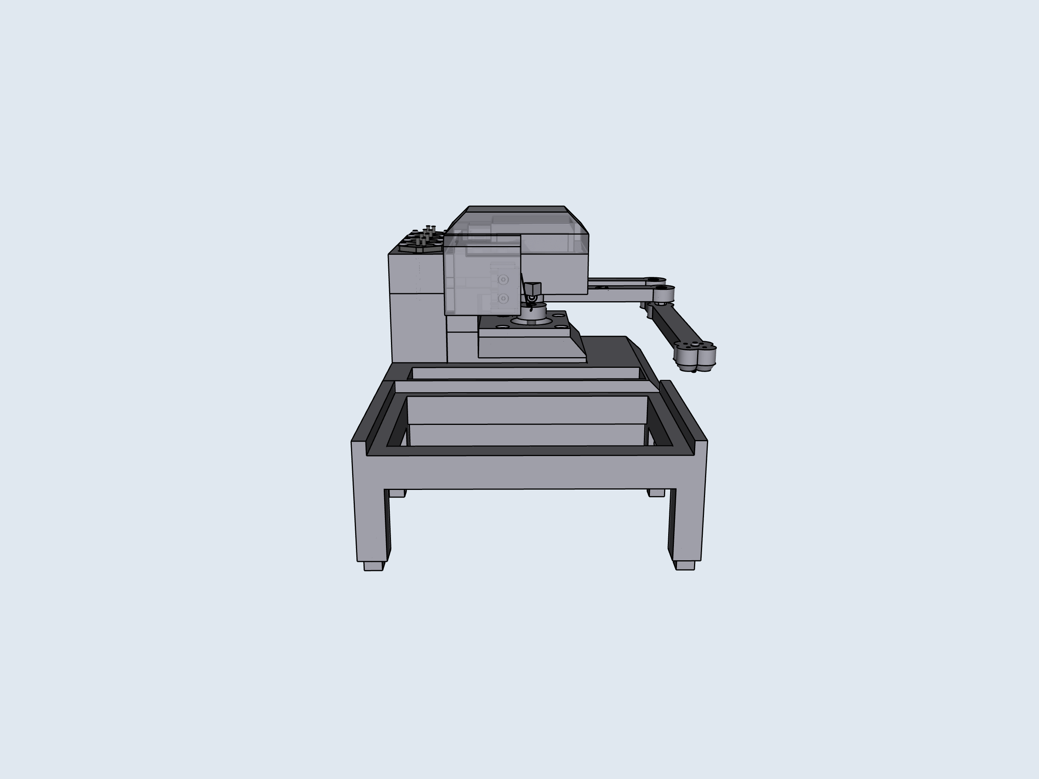
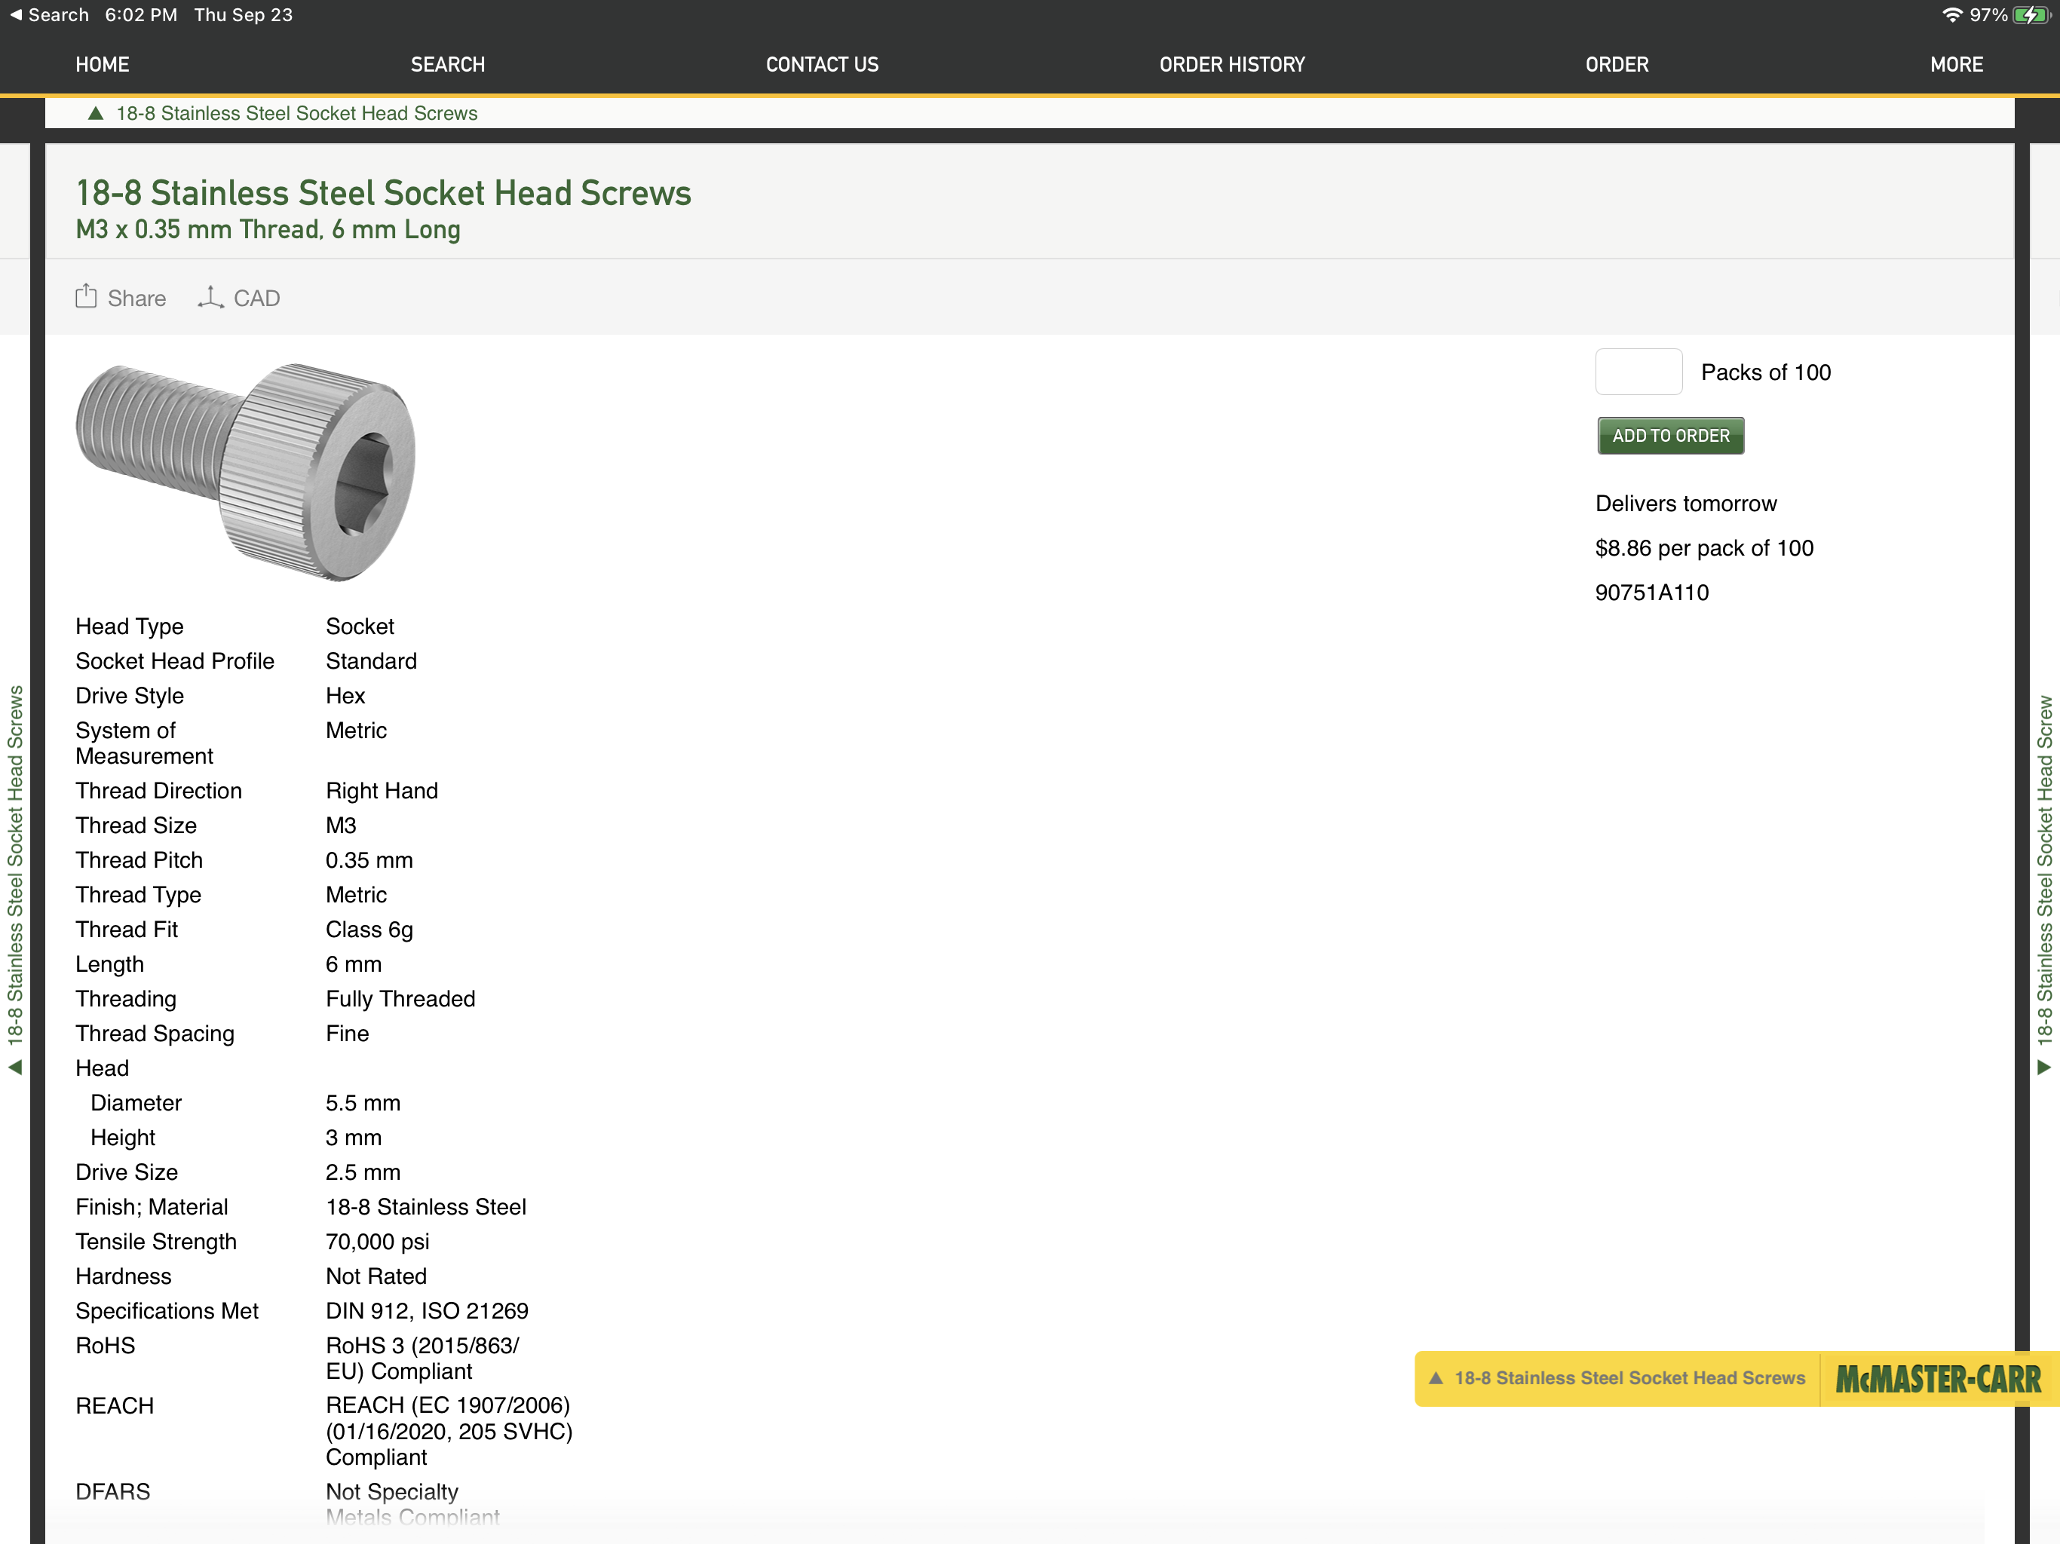
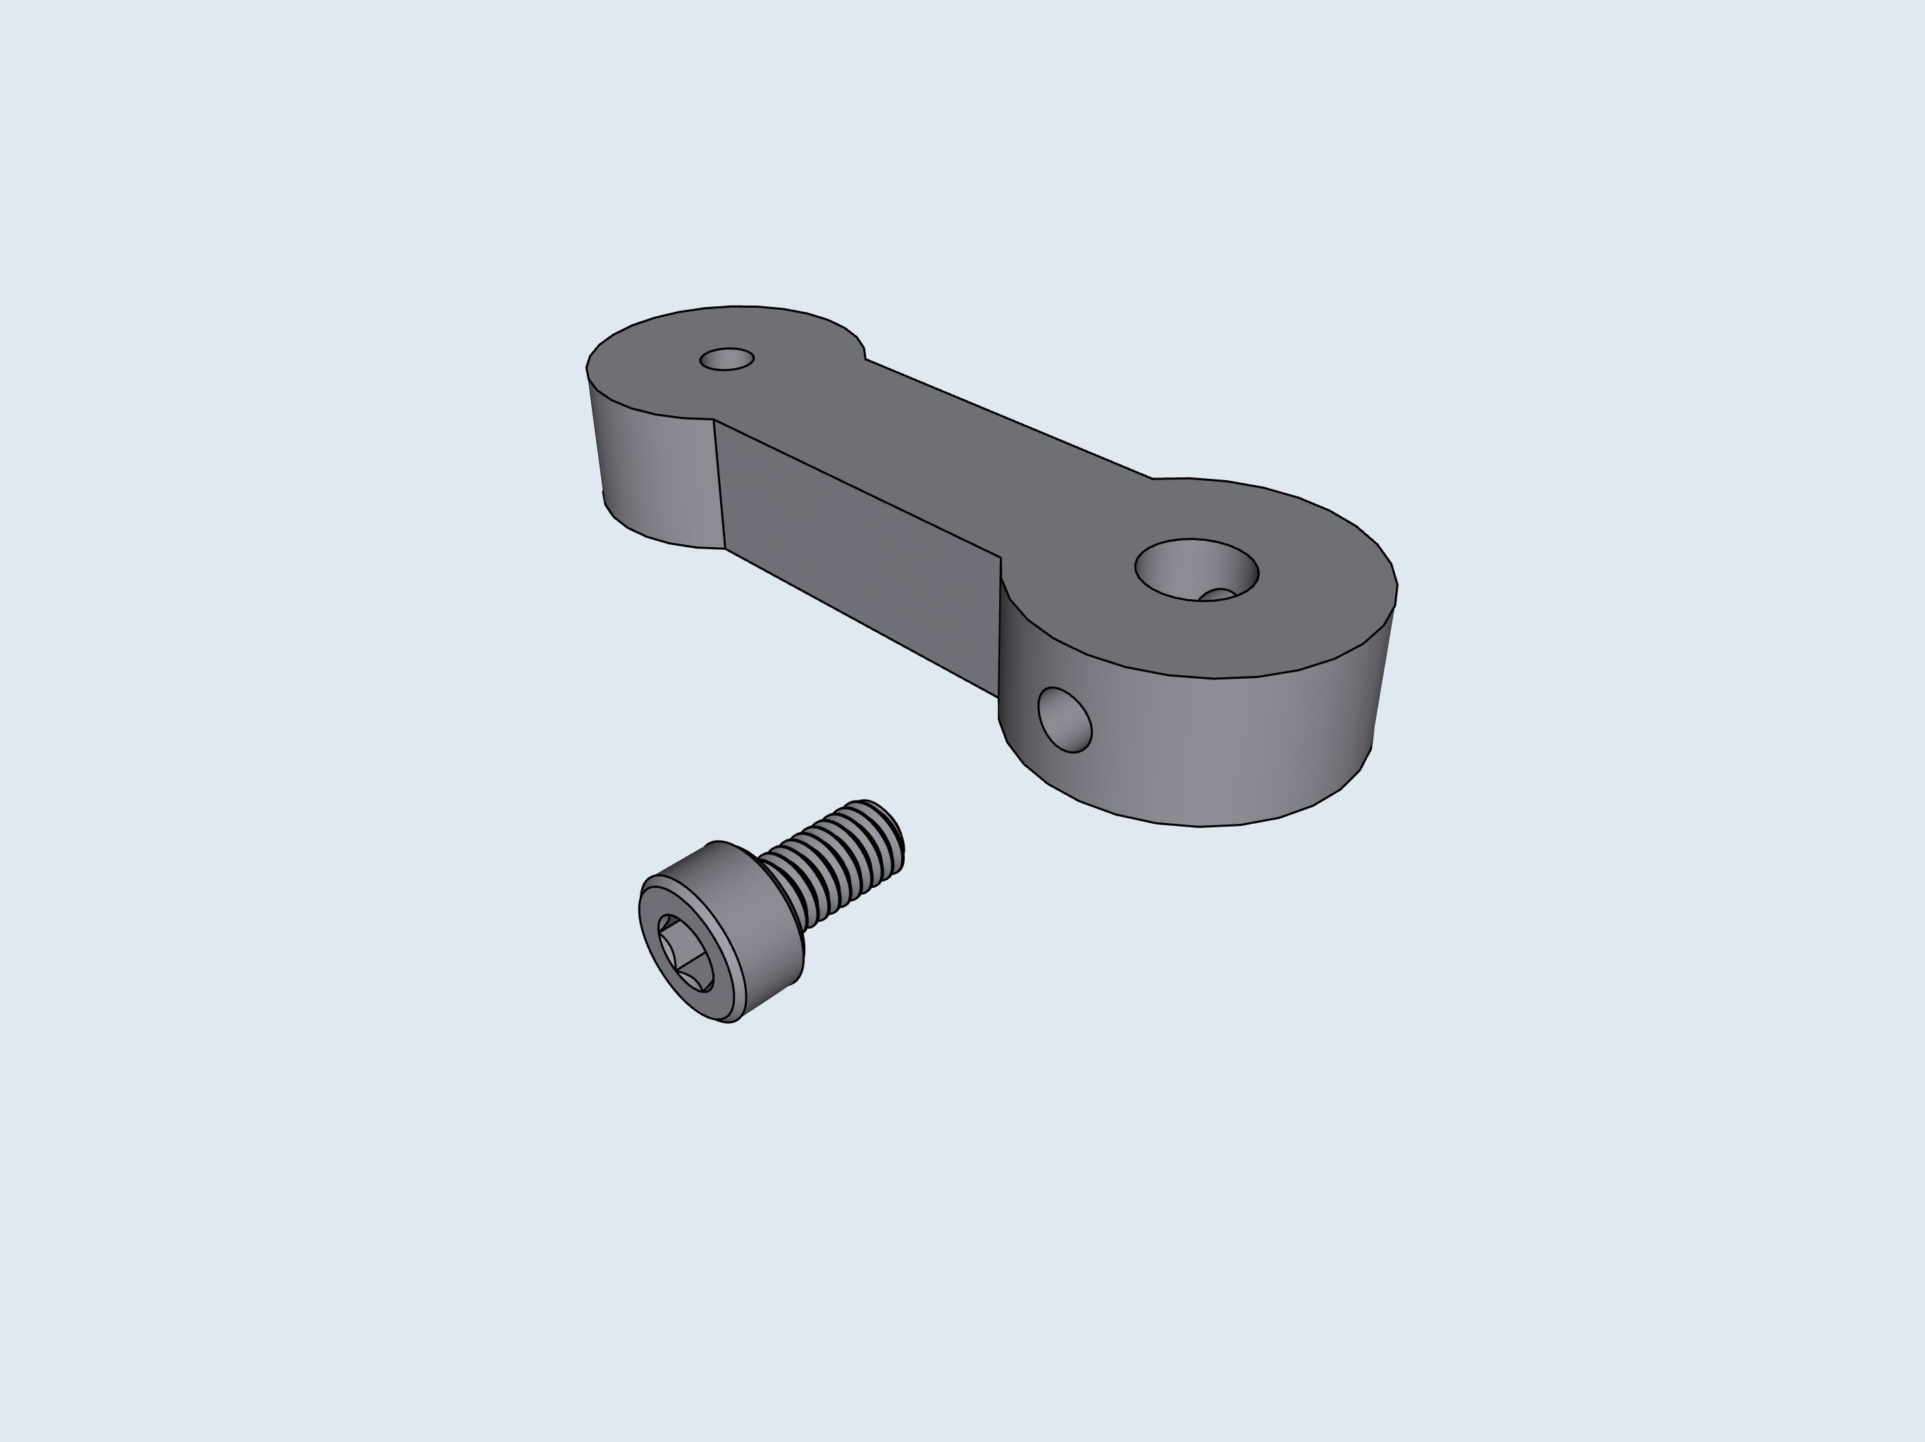
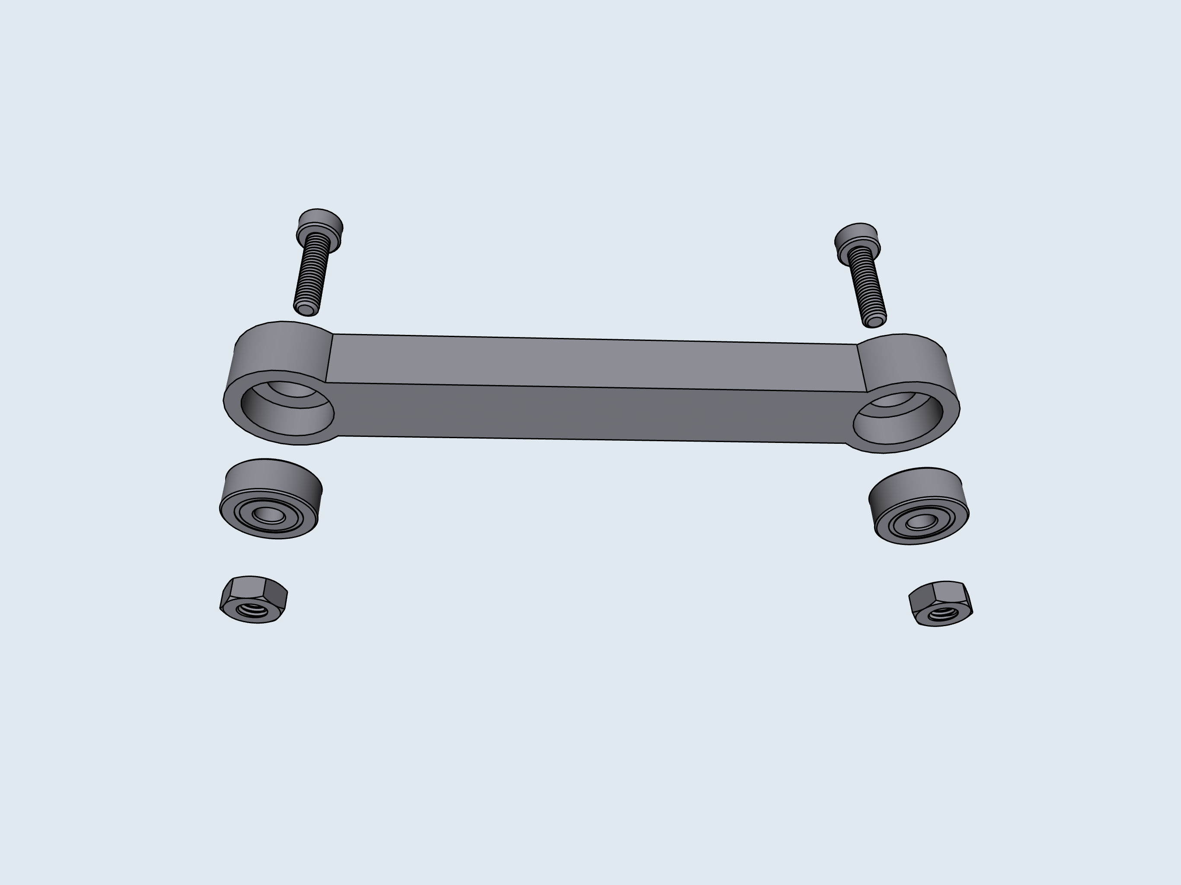
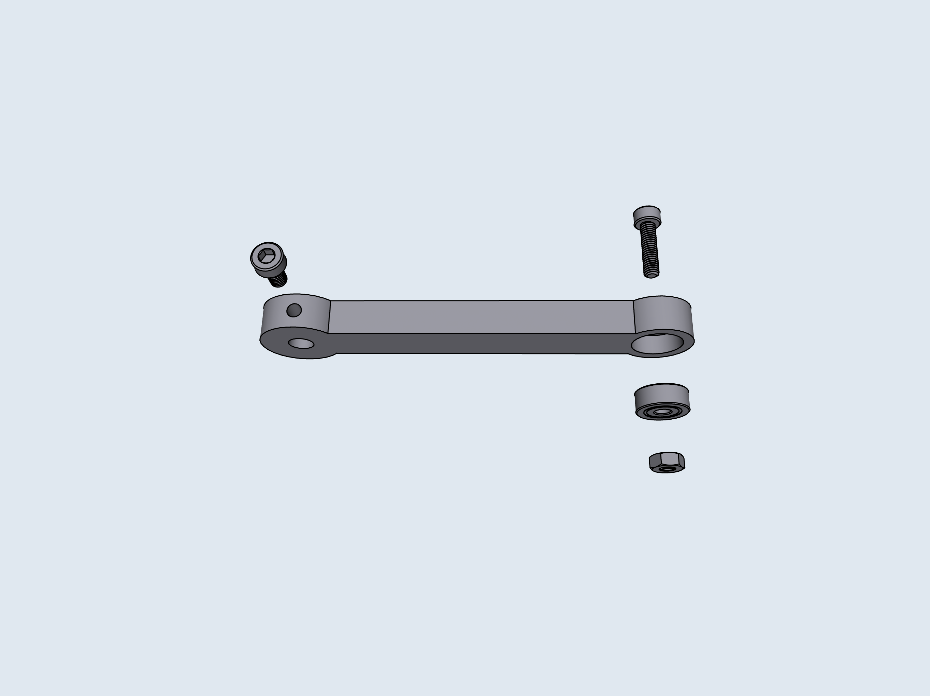
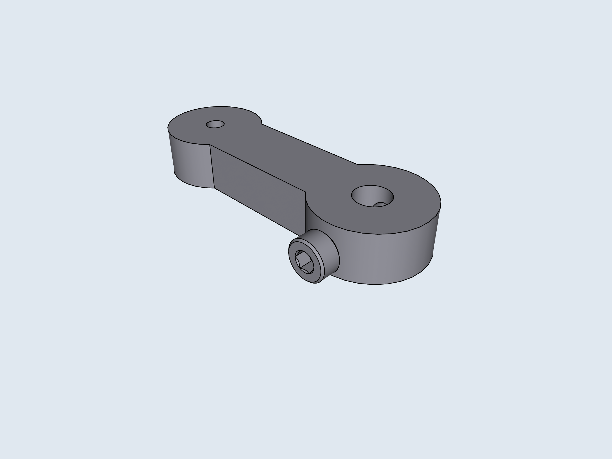
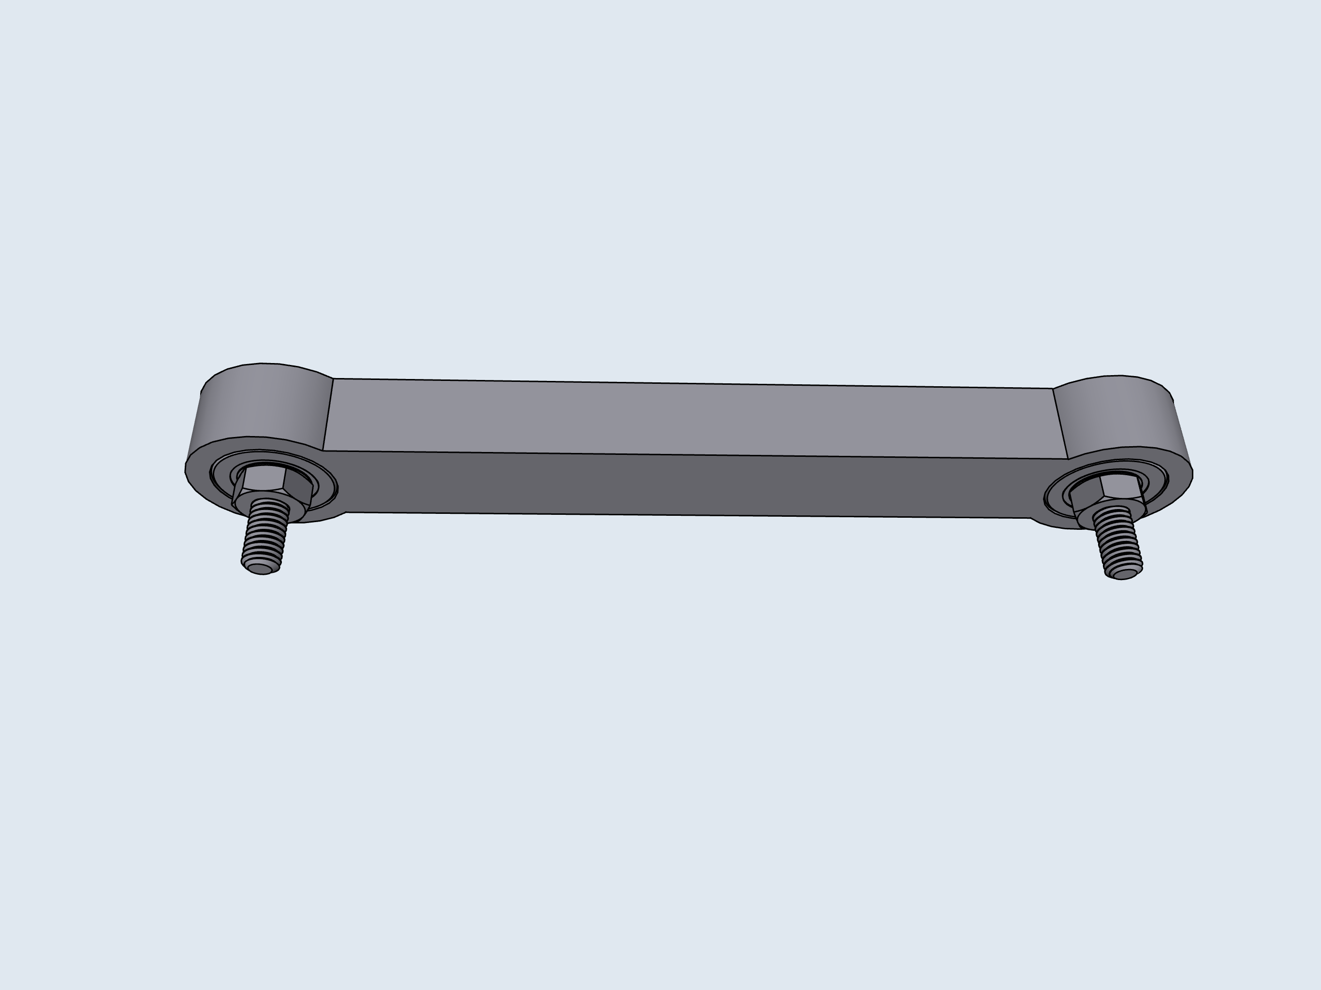
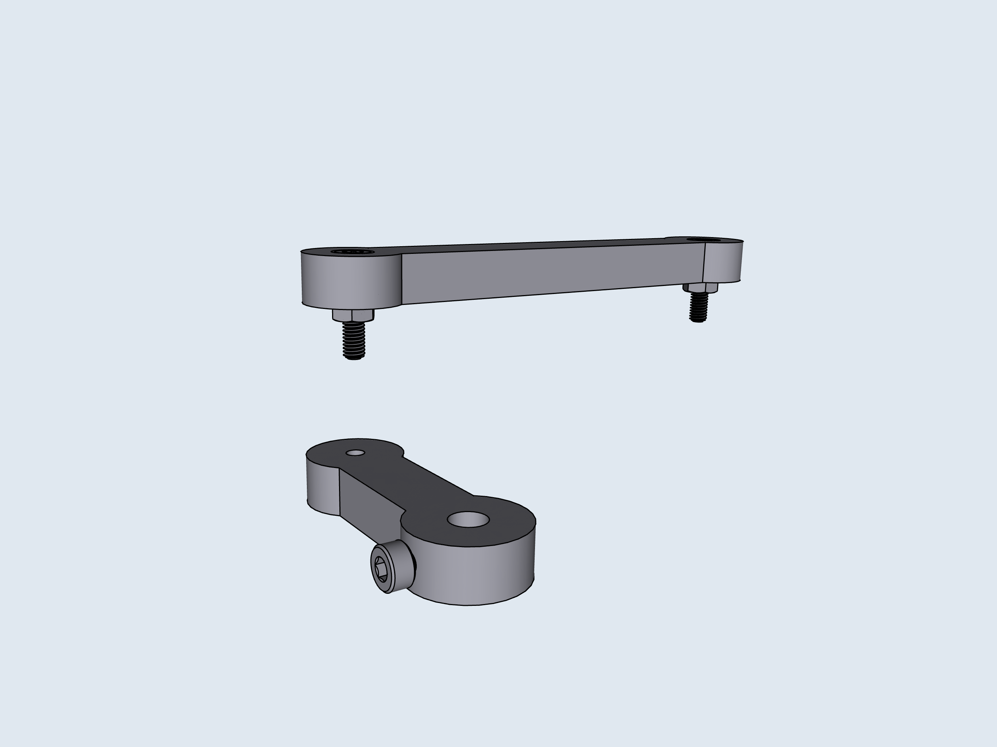
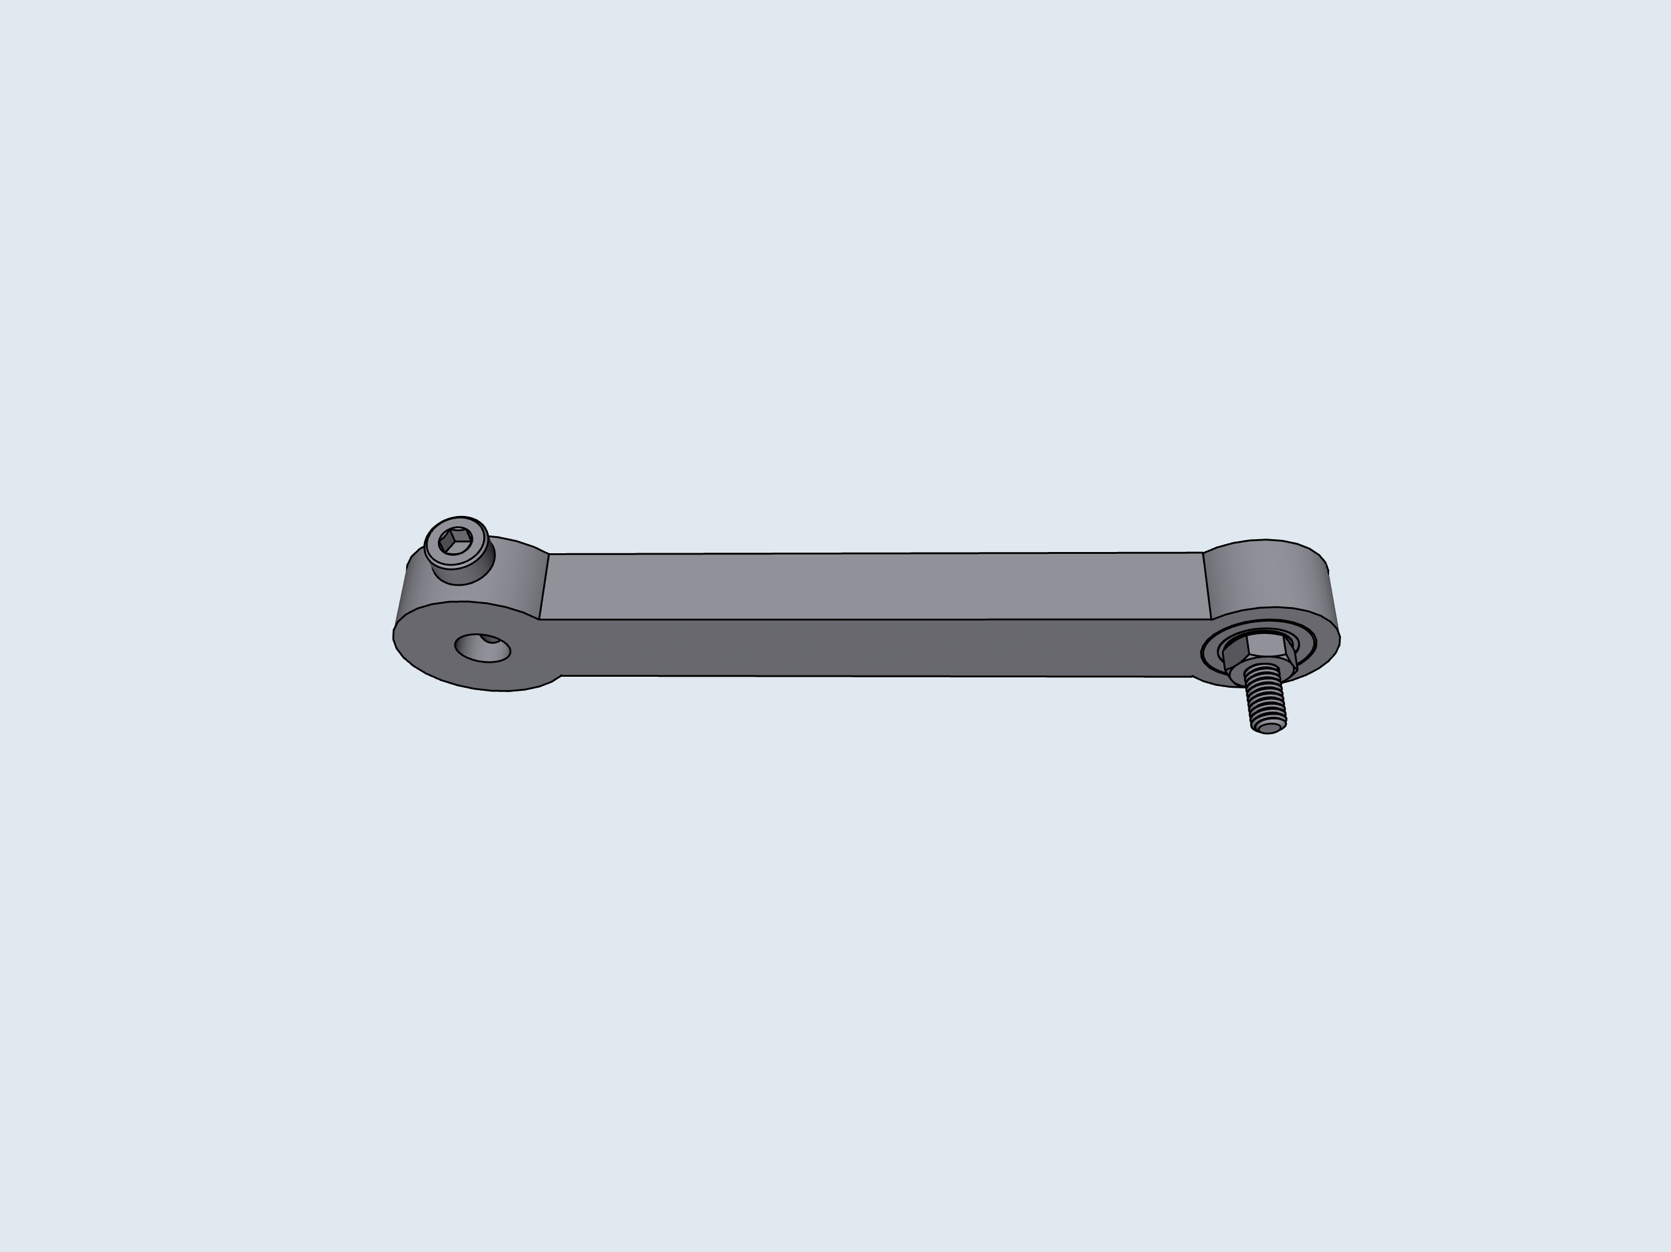
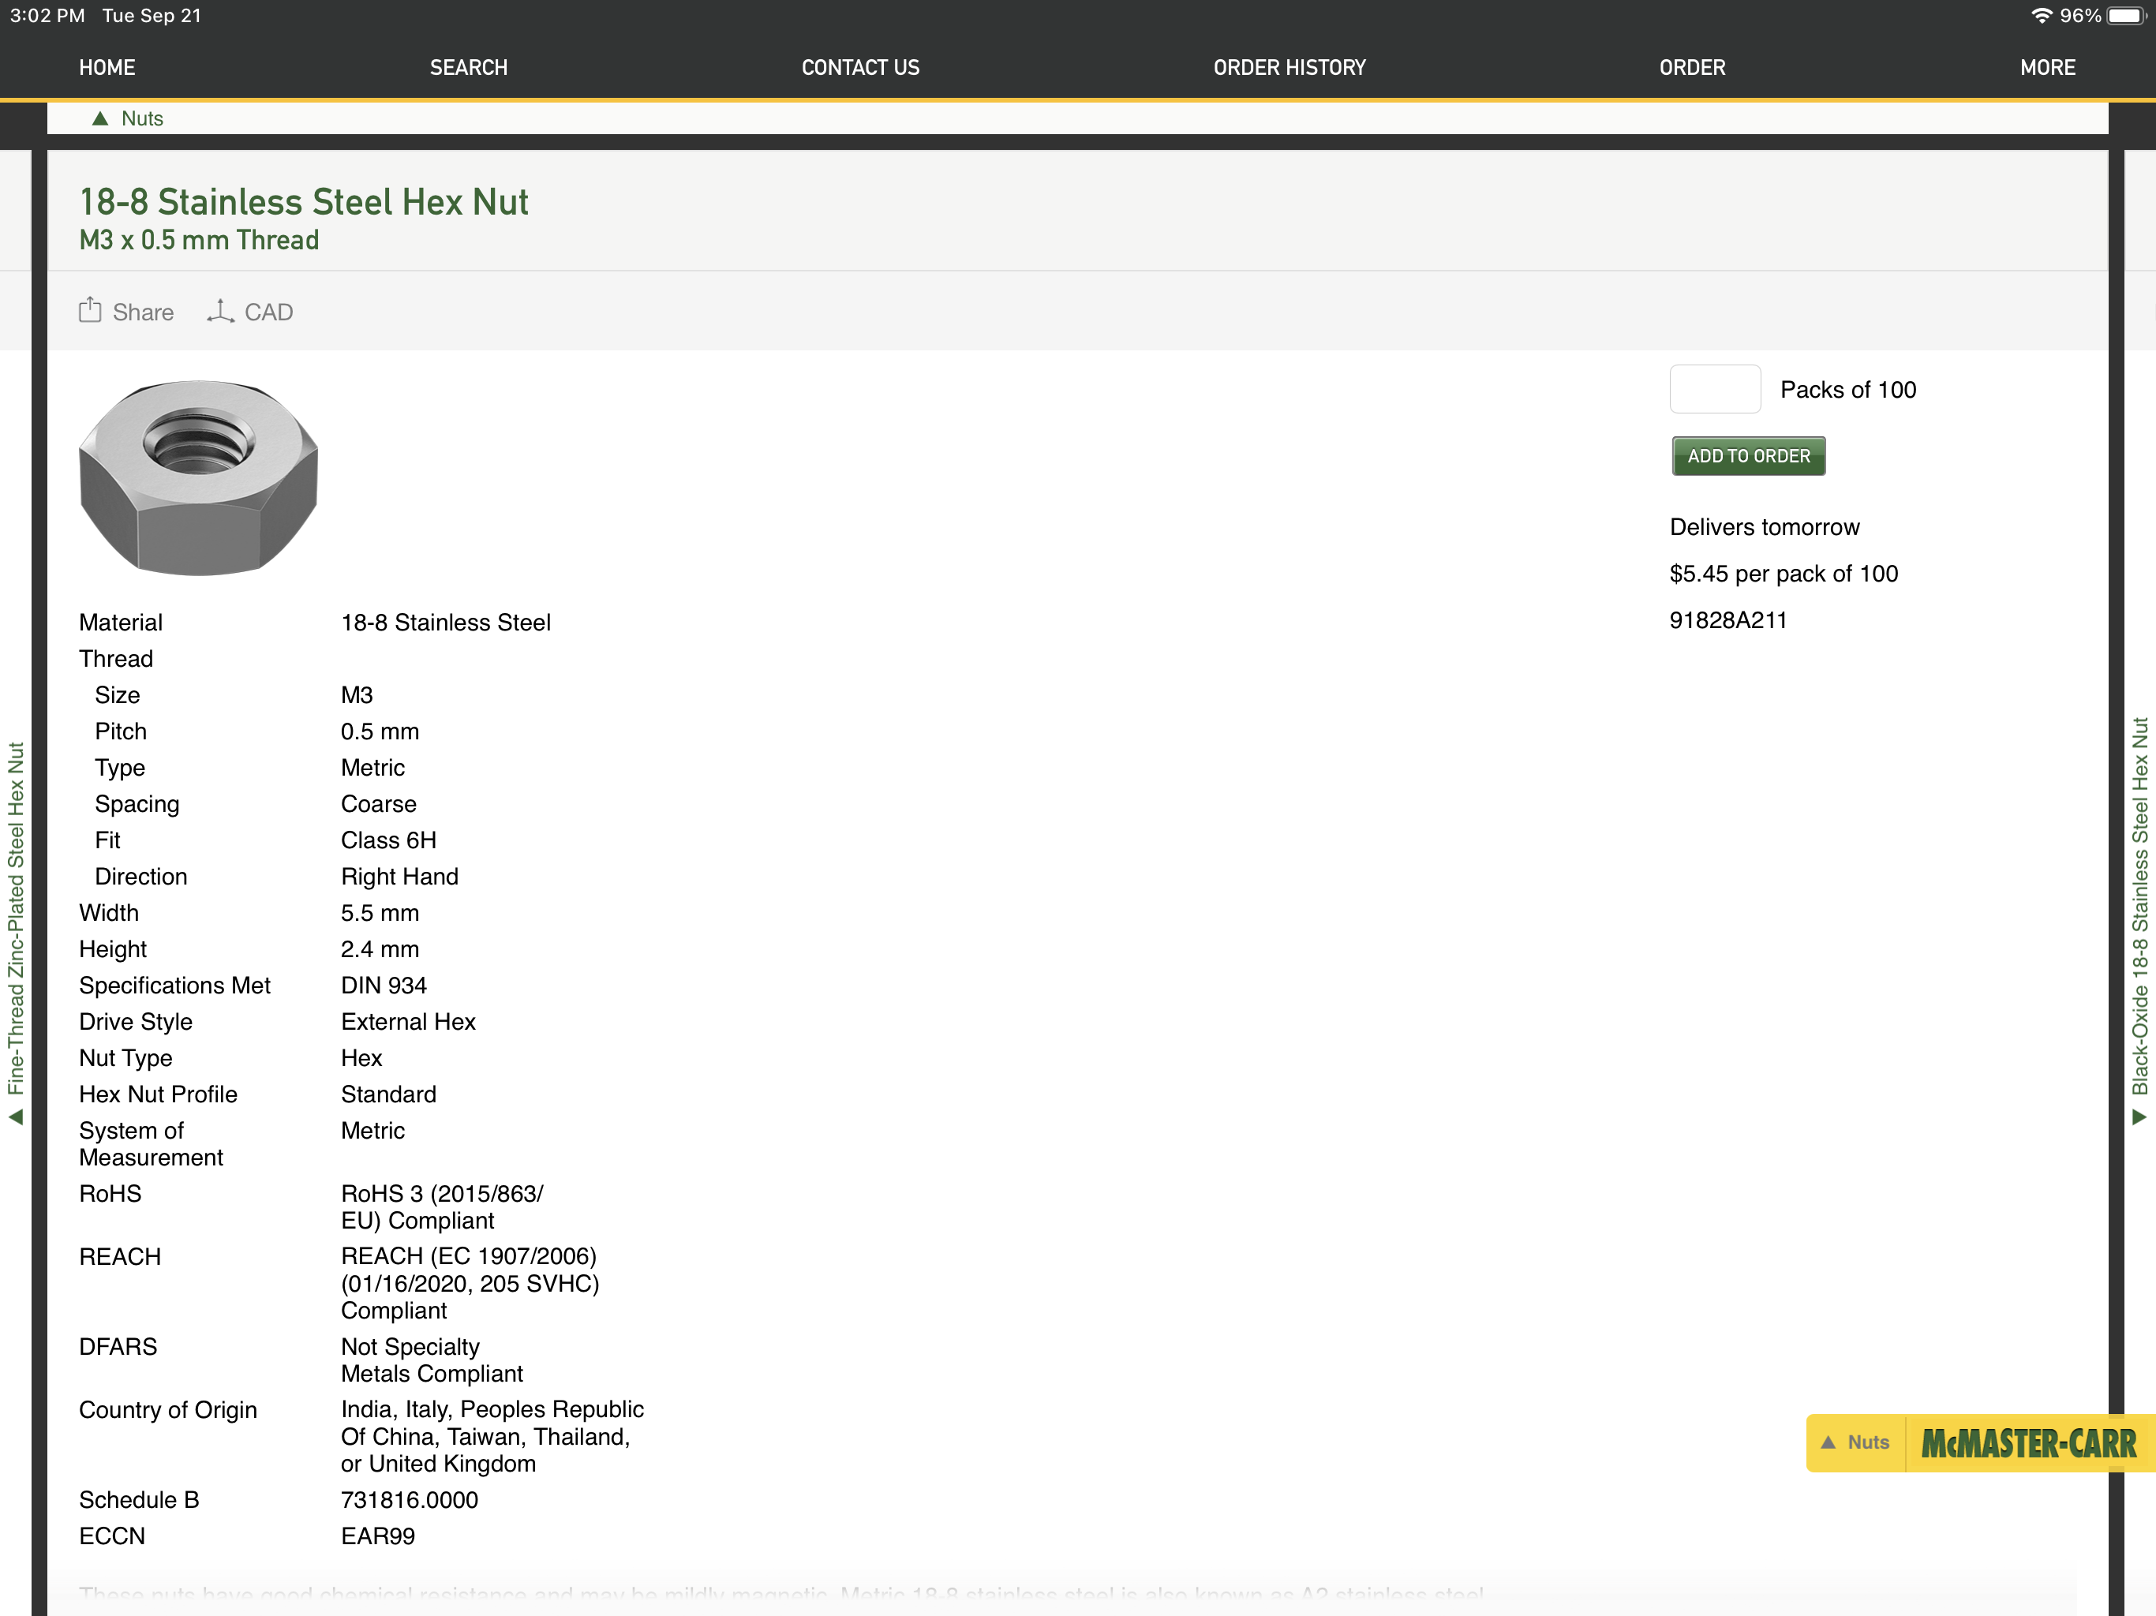
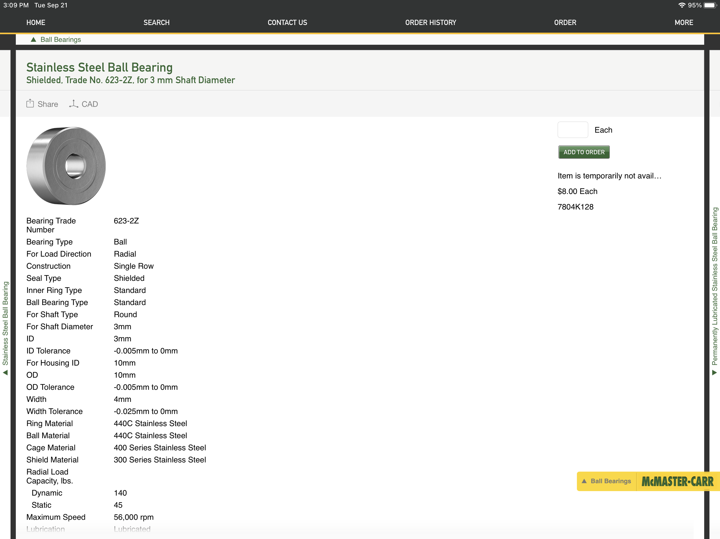
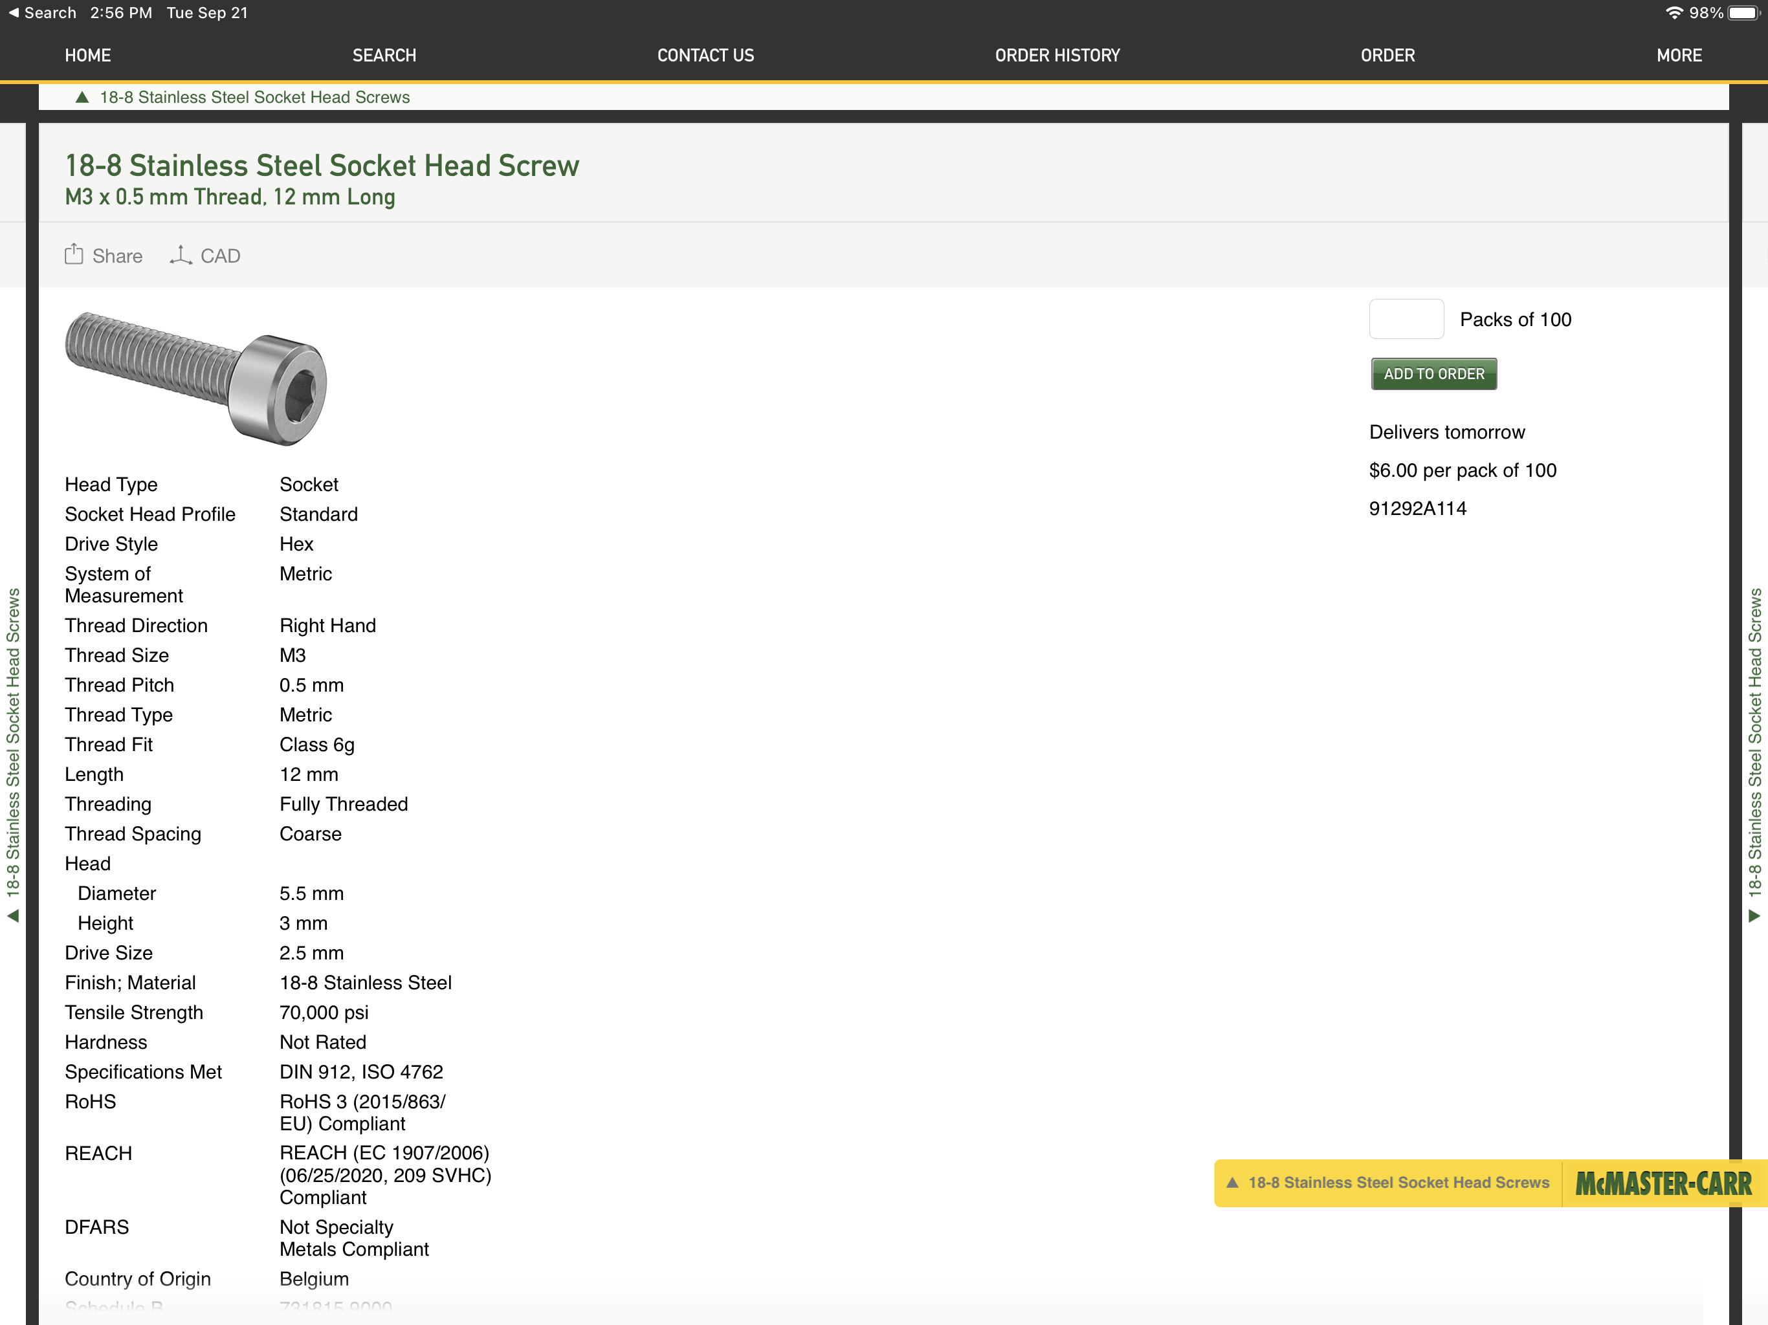
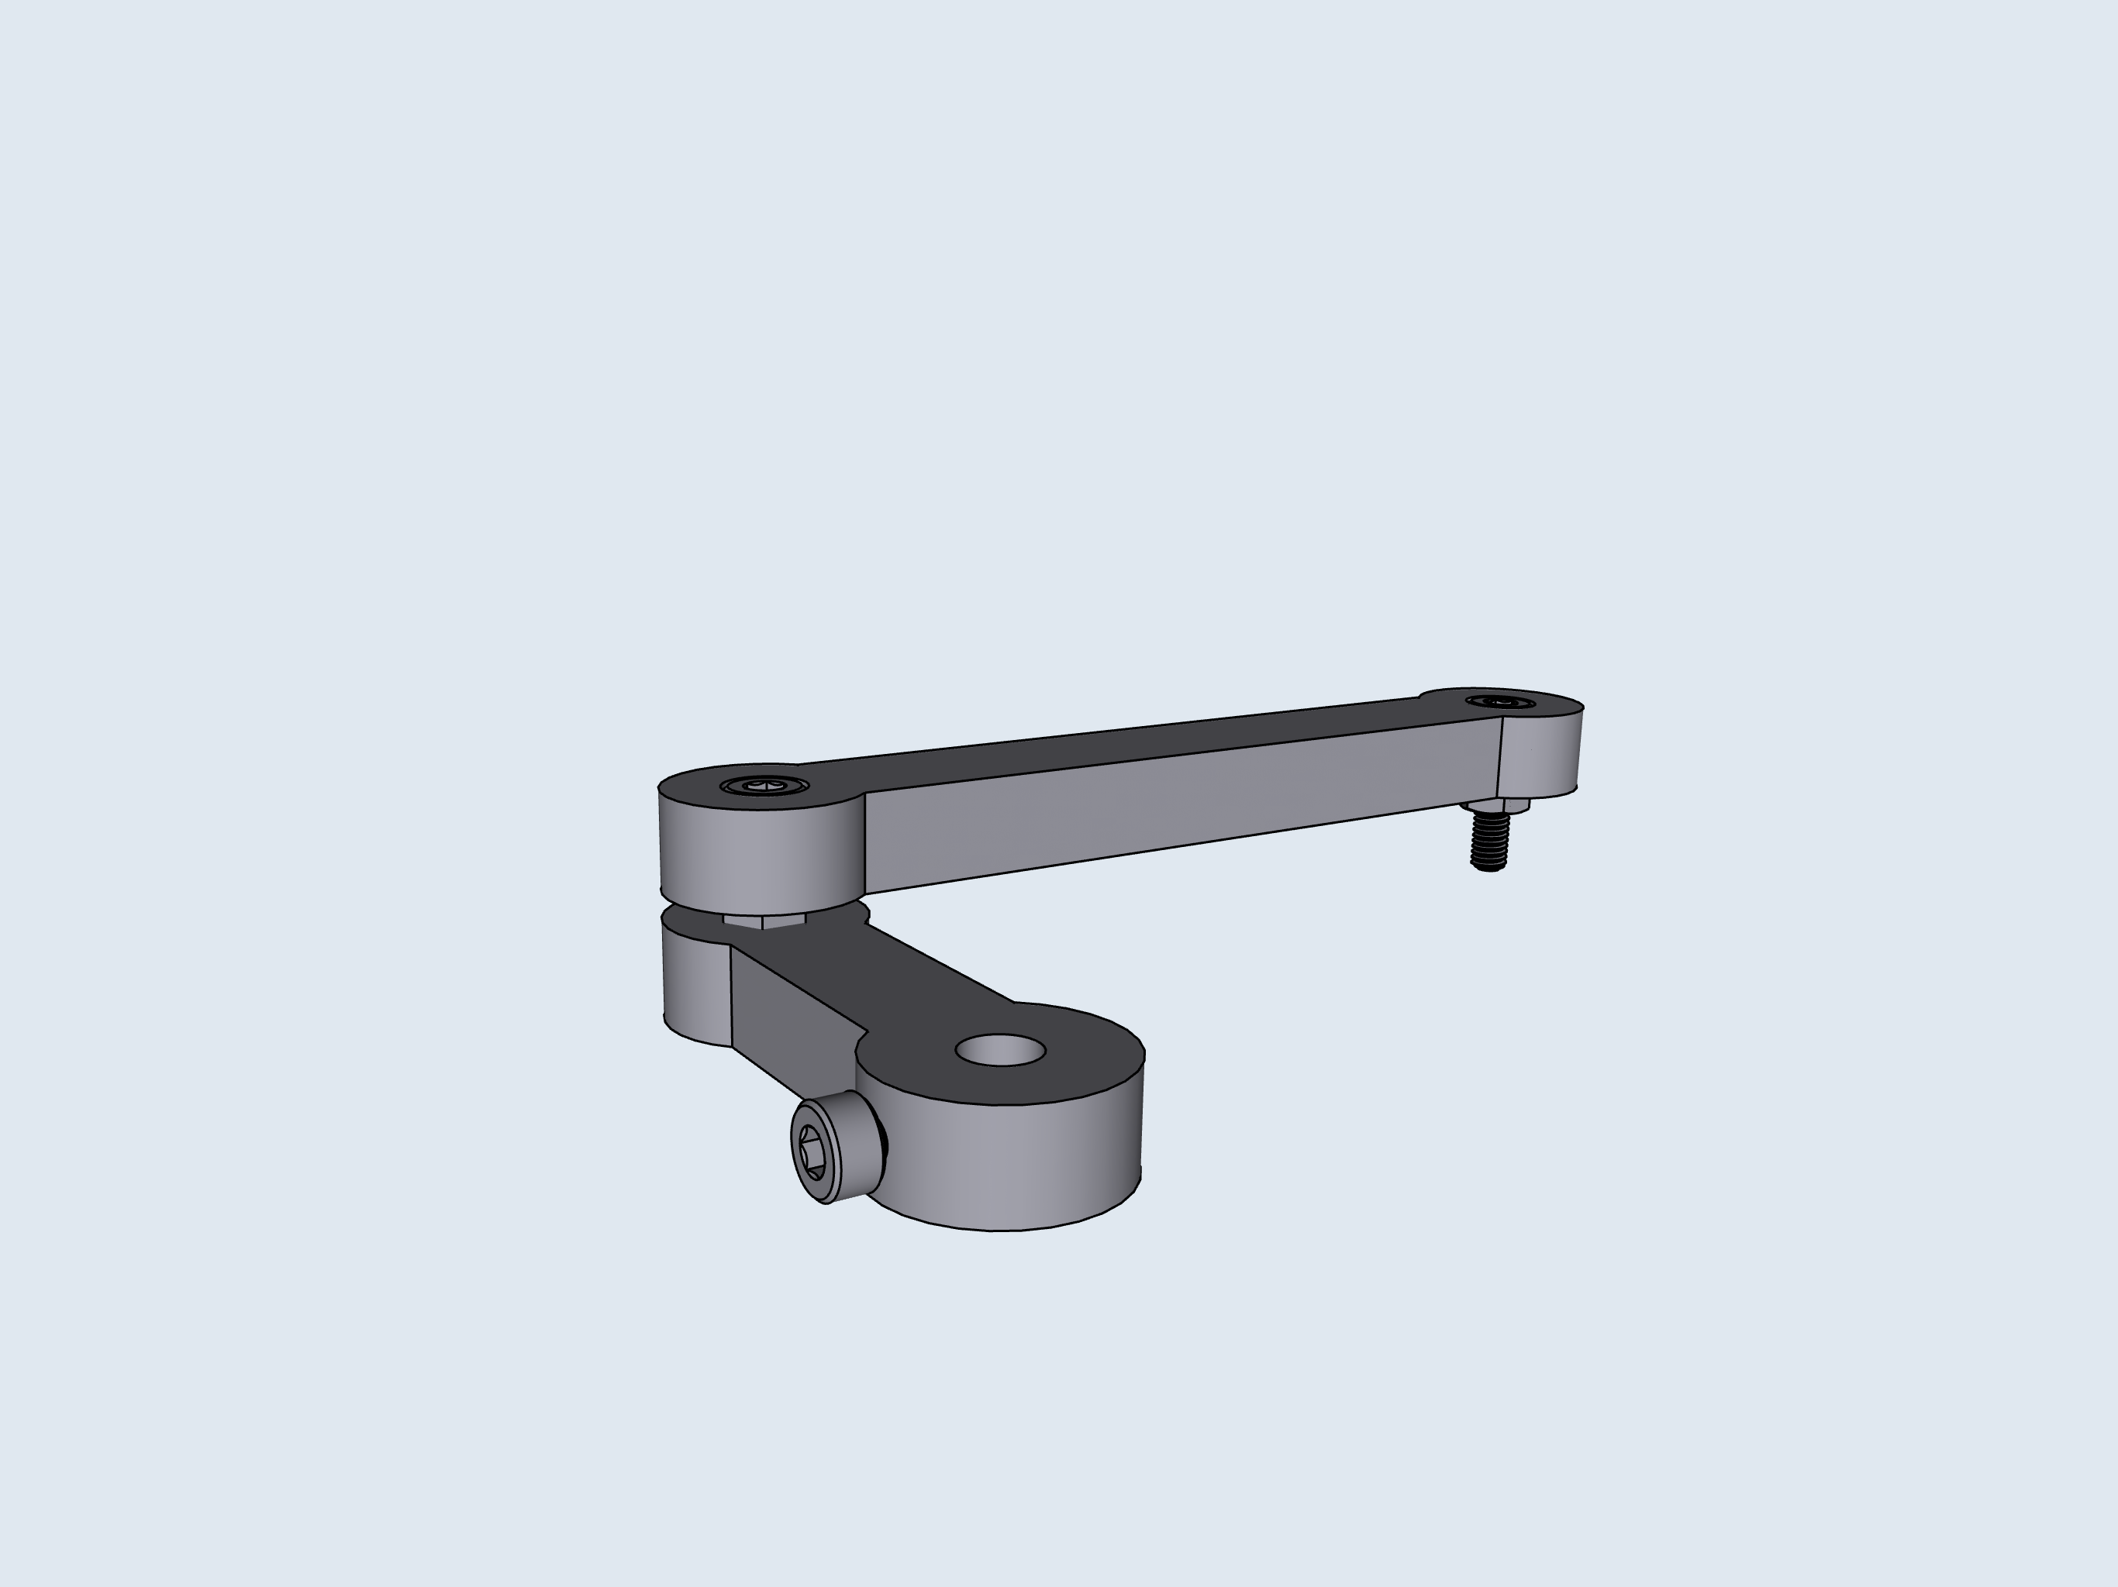
2
3
C: Armature
A
A
B
B
1
A
B
C
C
C
D
4
A
B
C
D
A
B
C

Slide 5
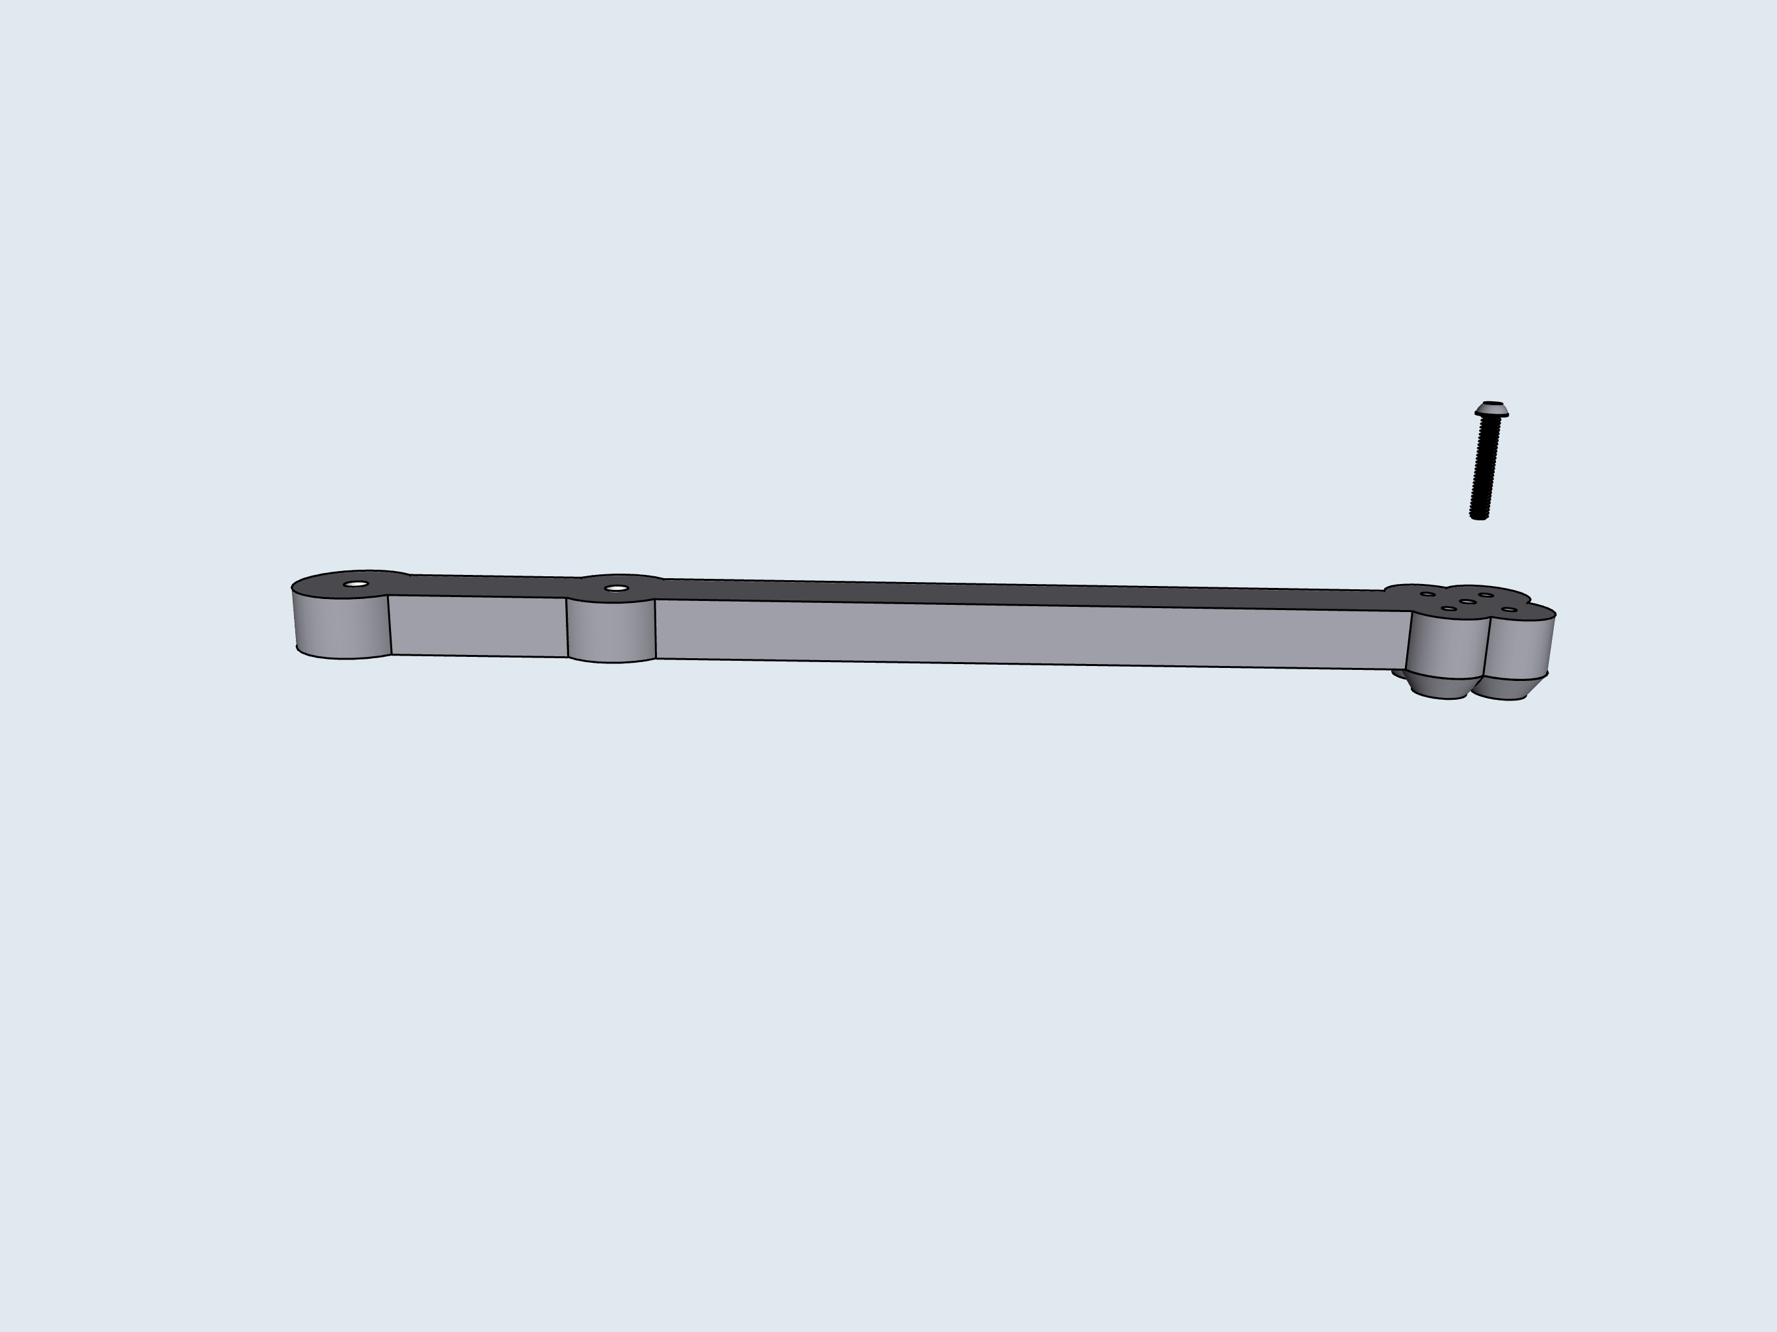
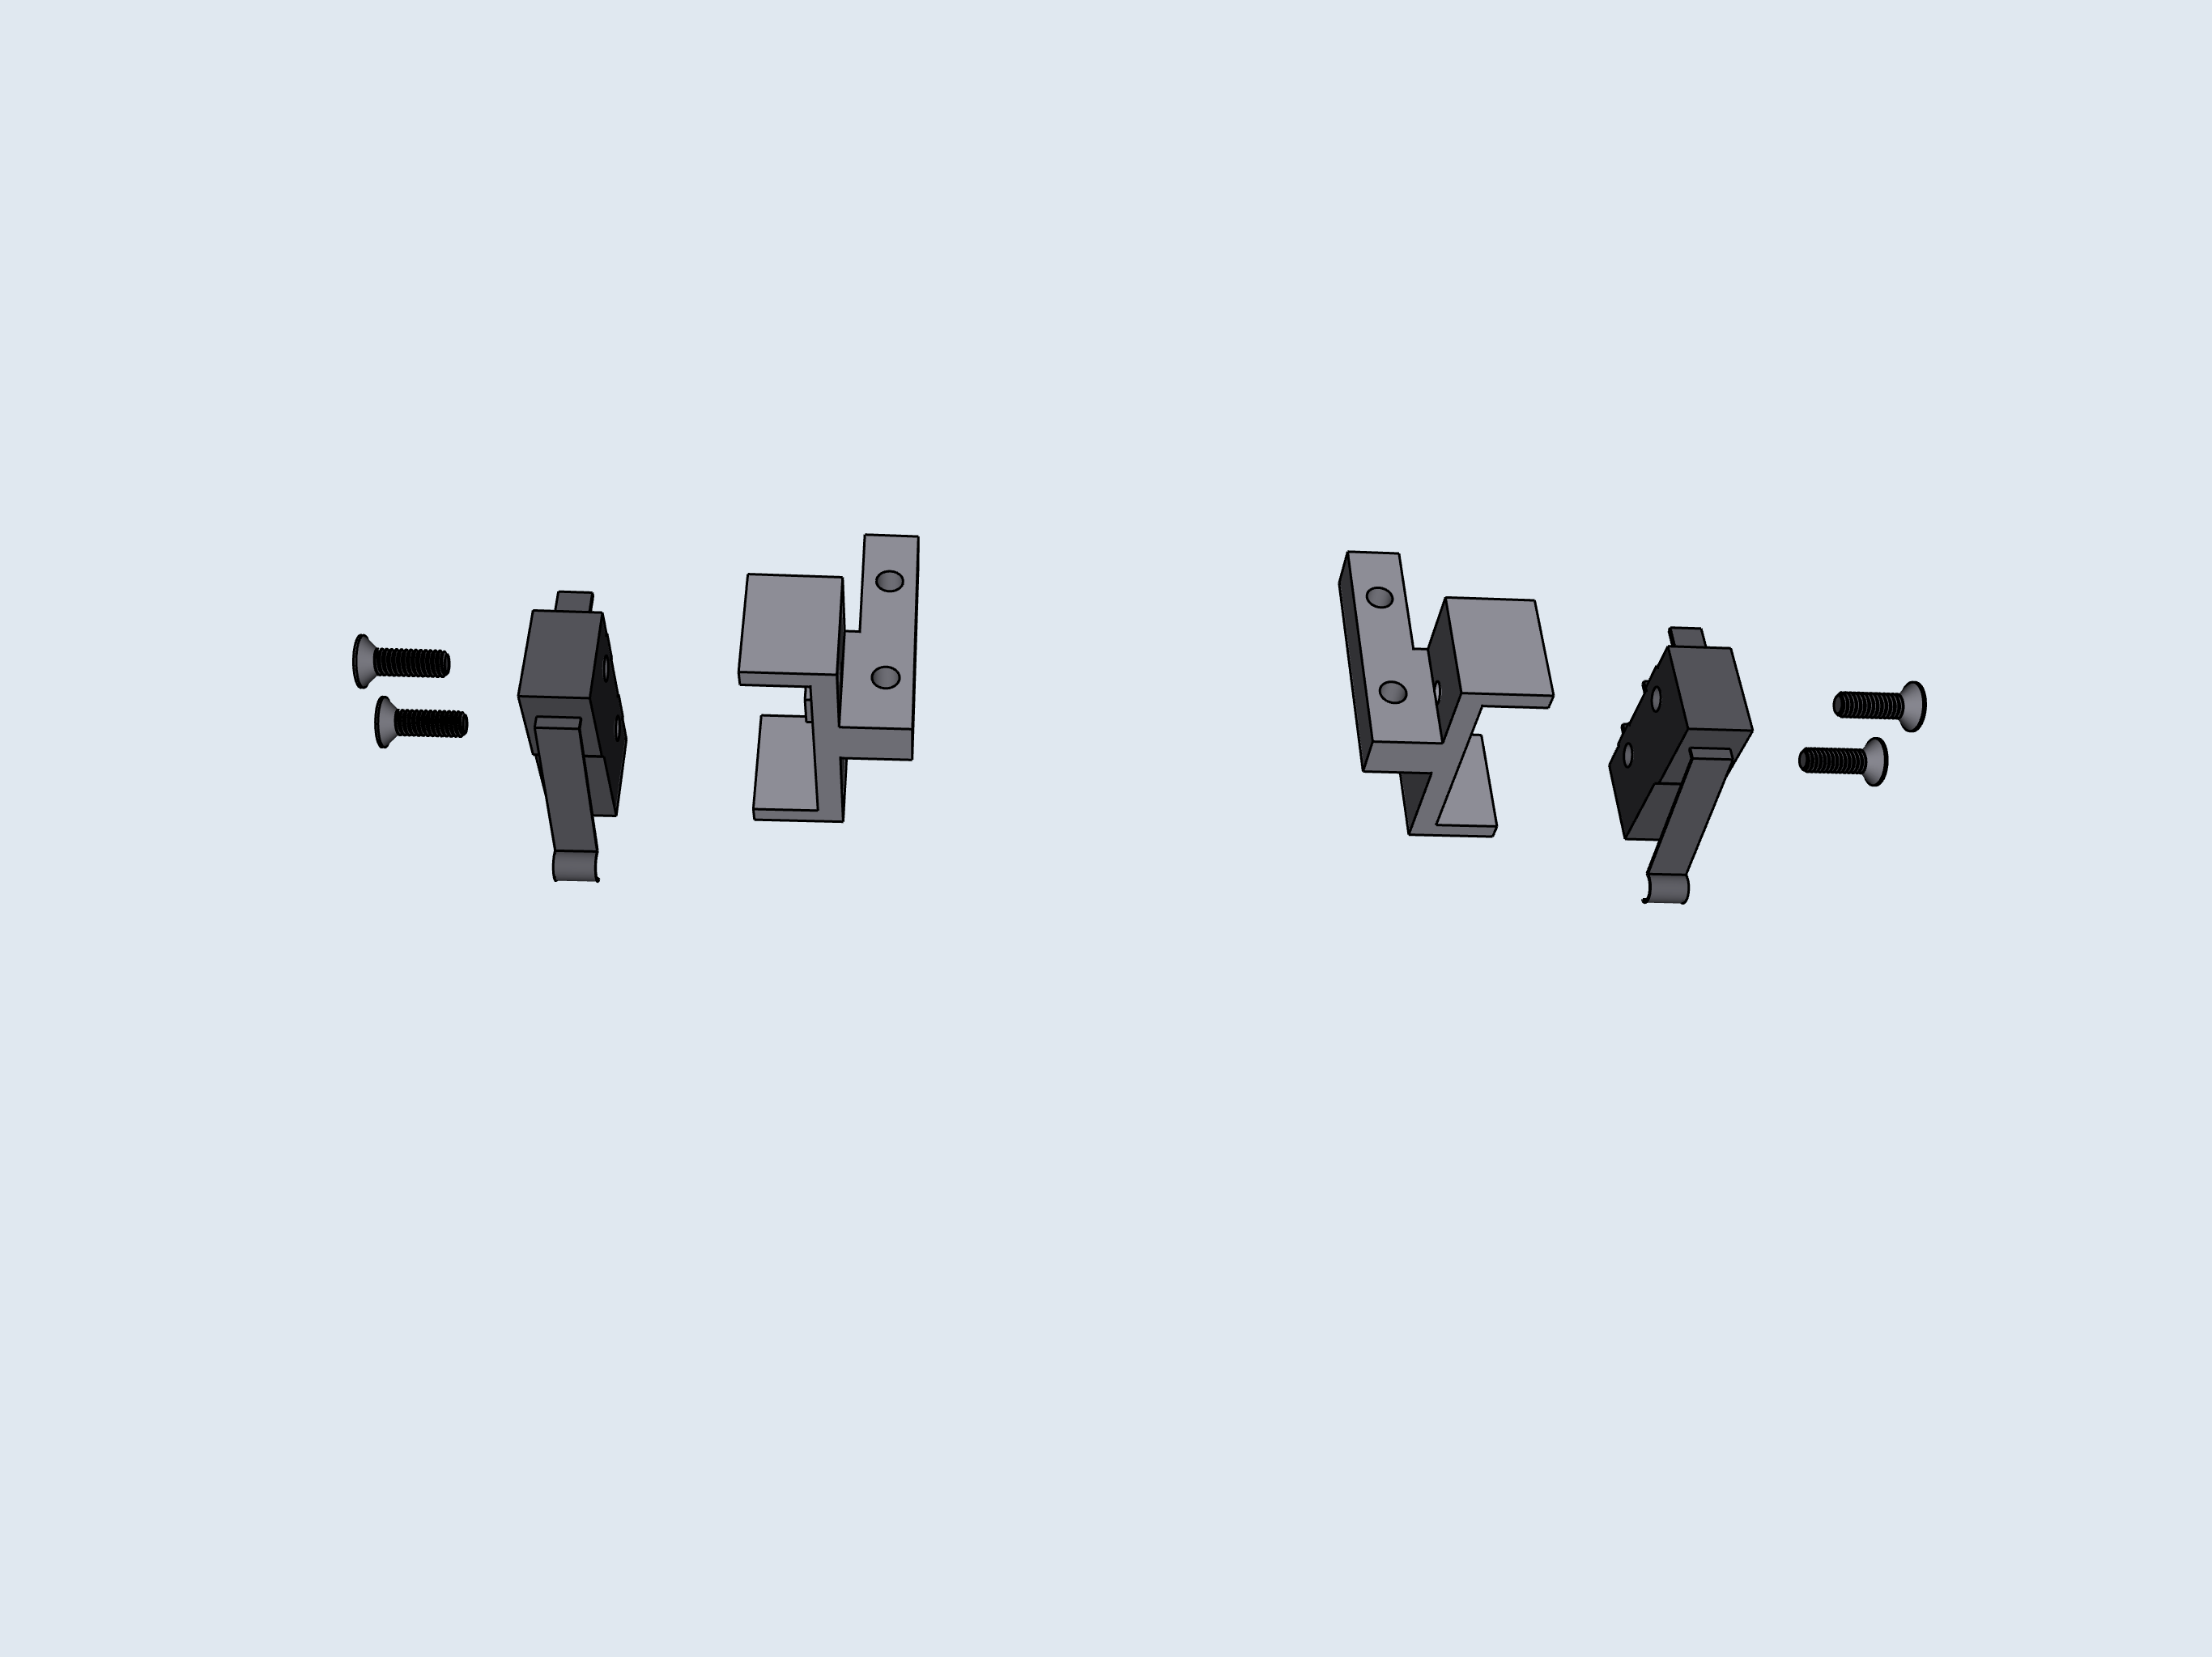
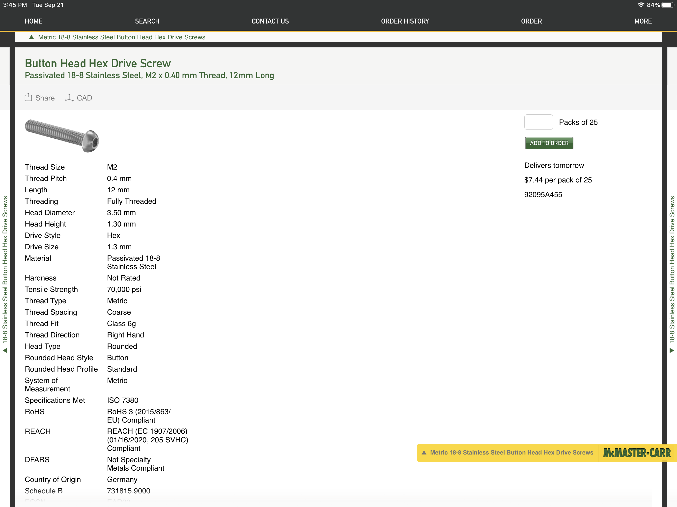
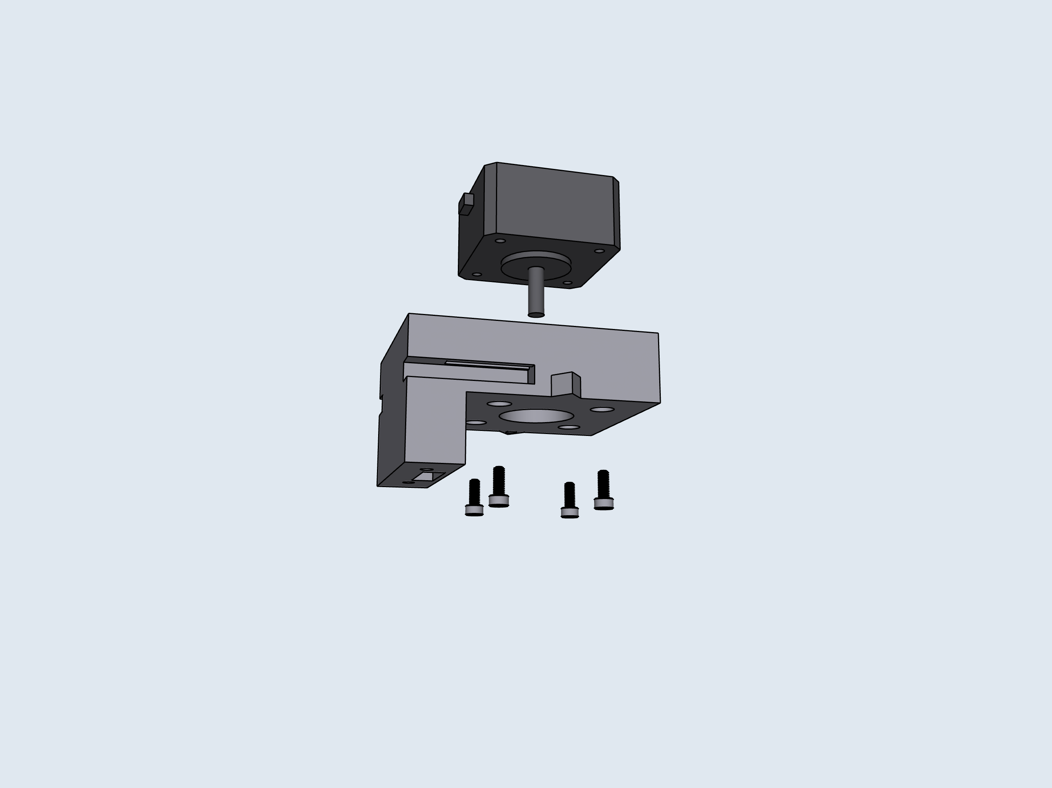
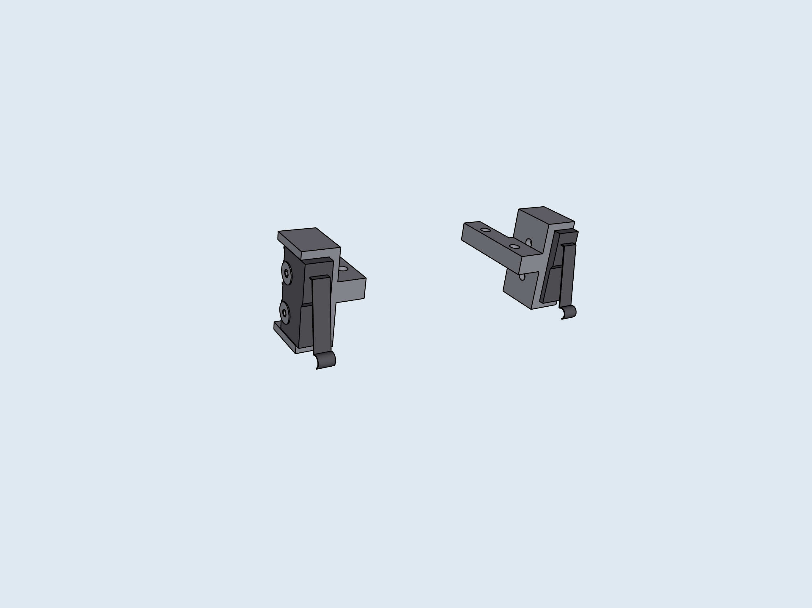
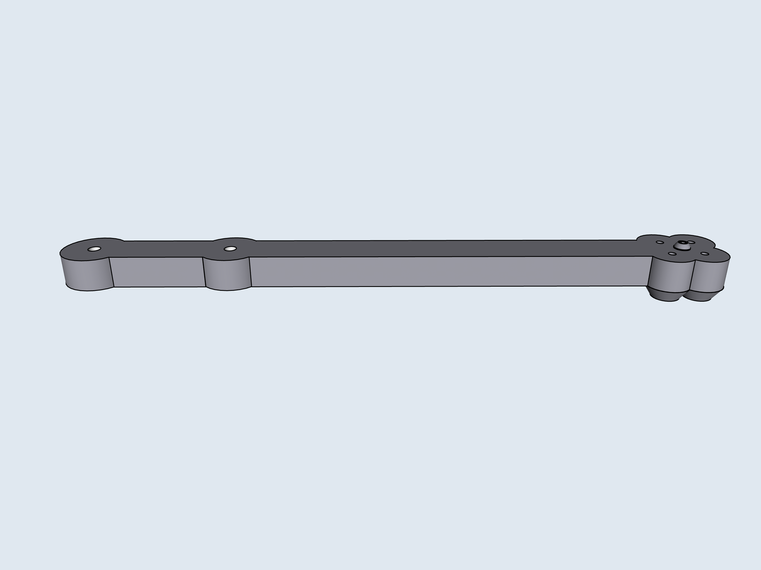
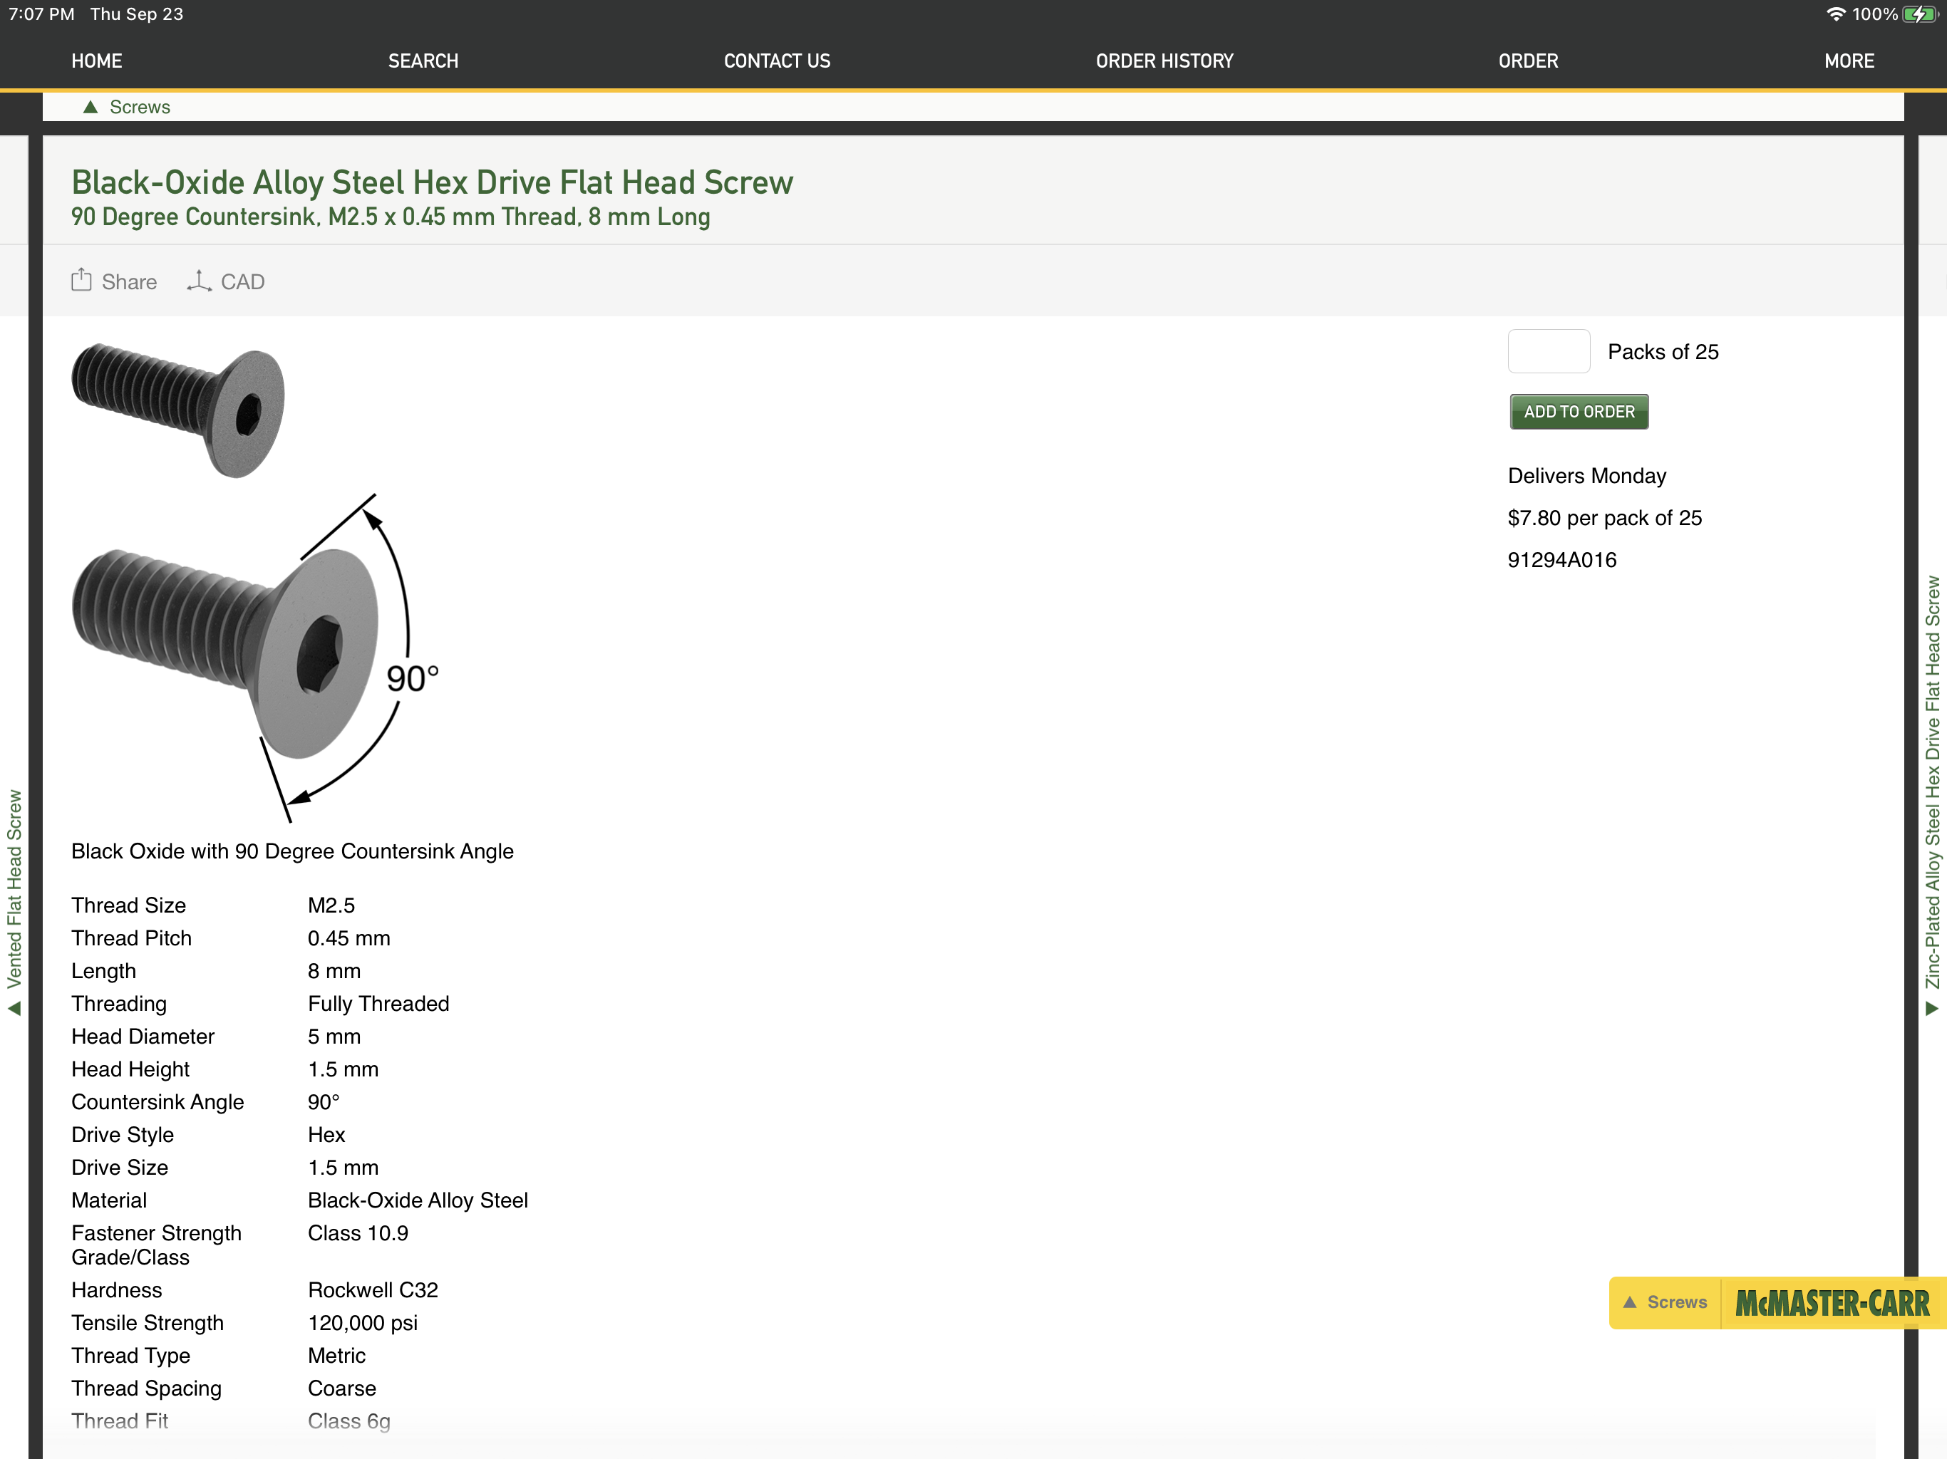
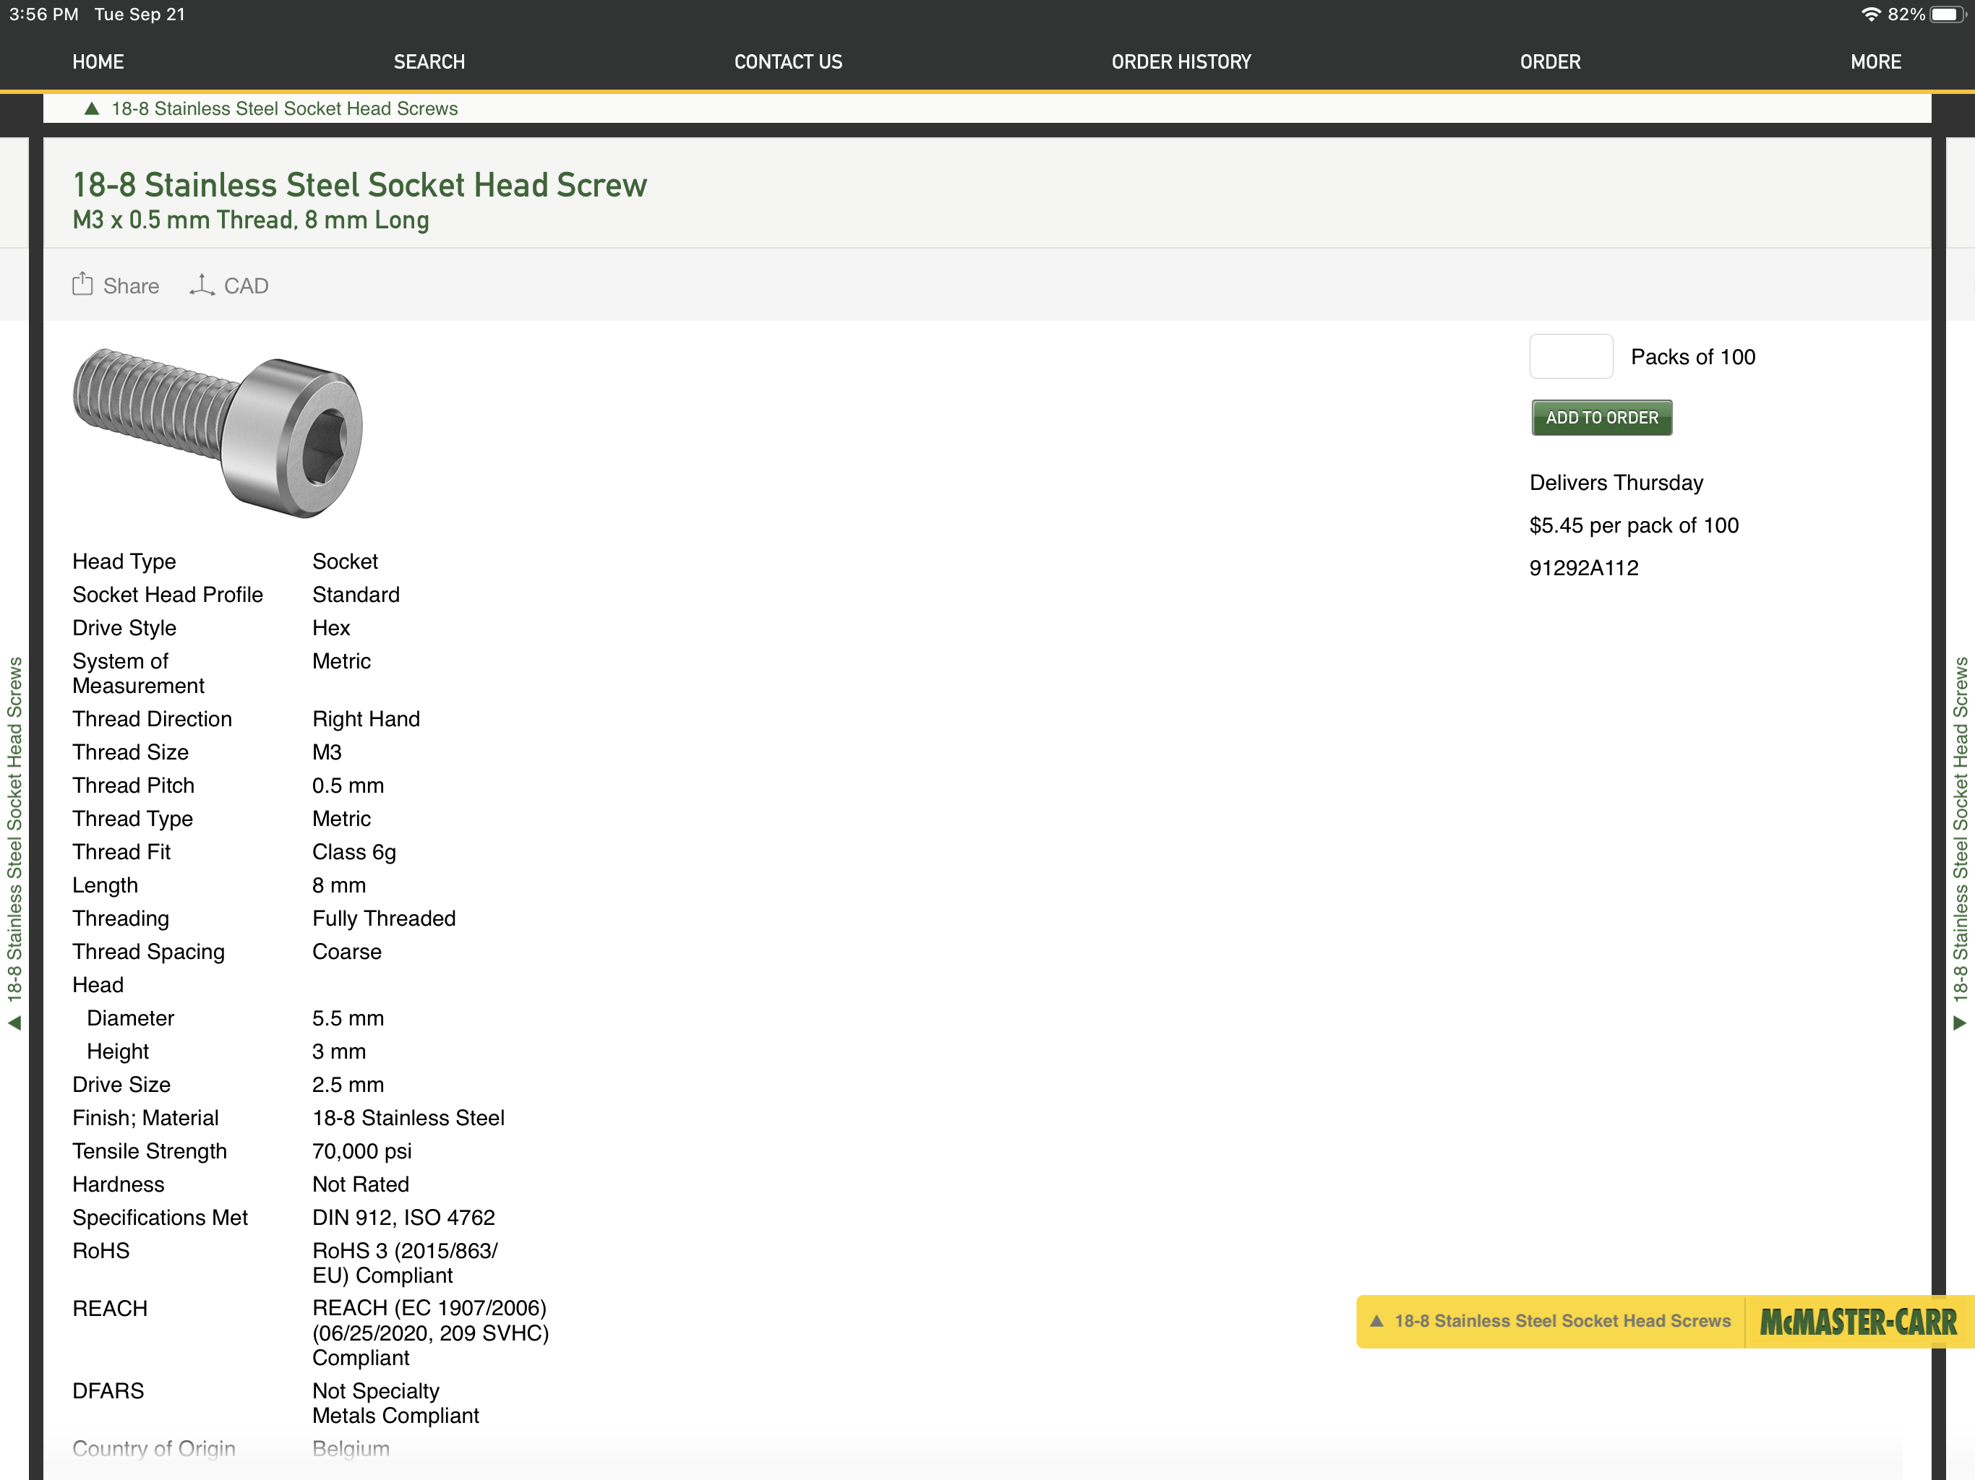
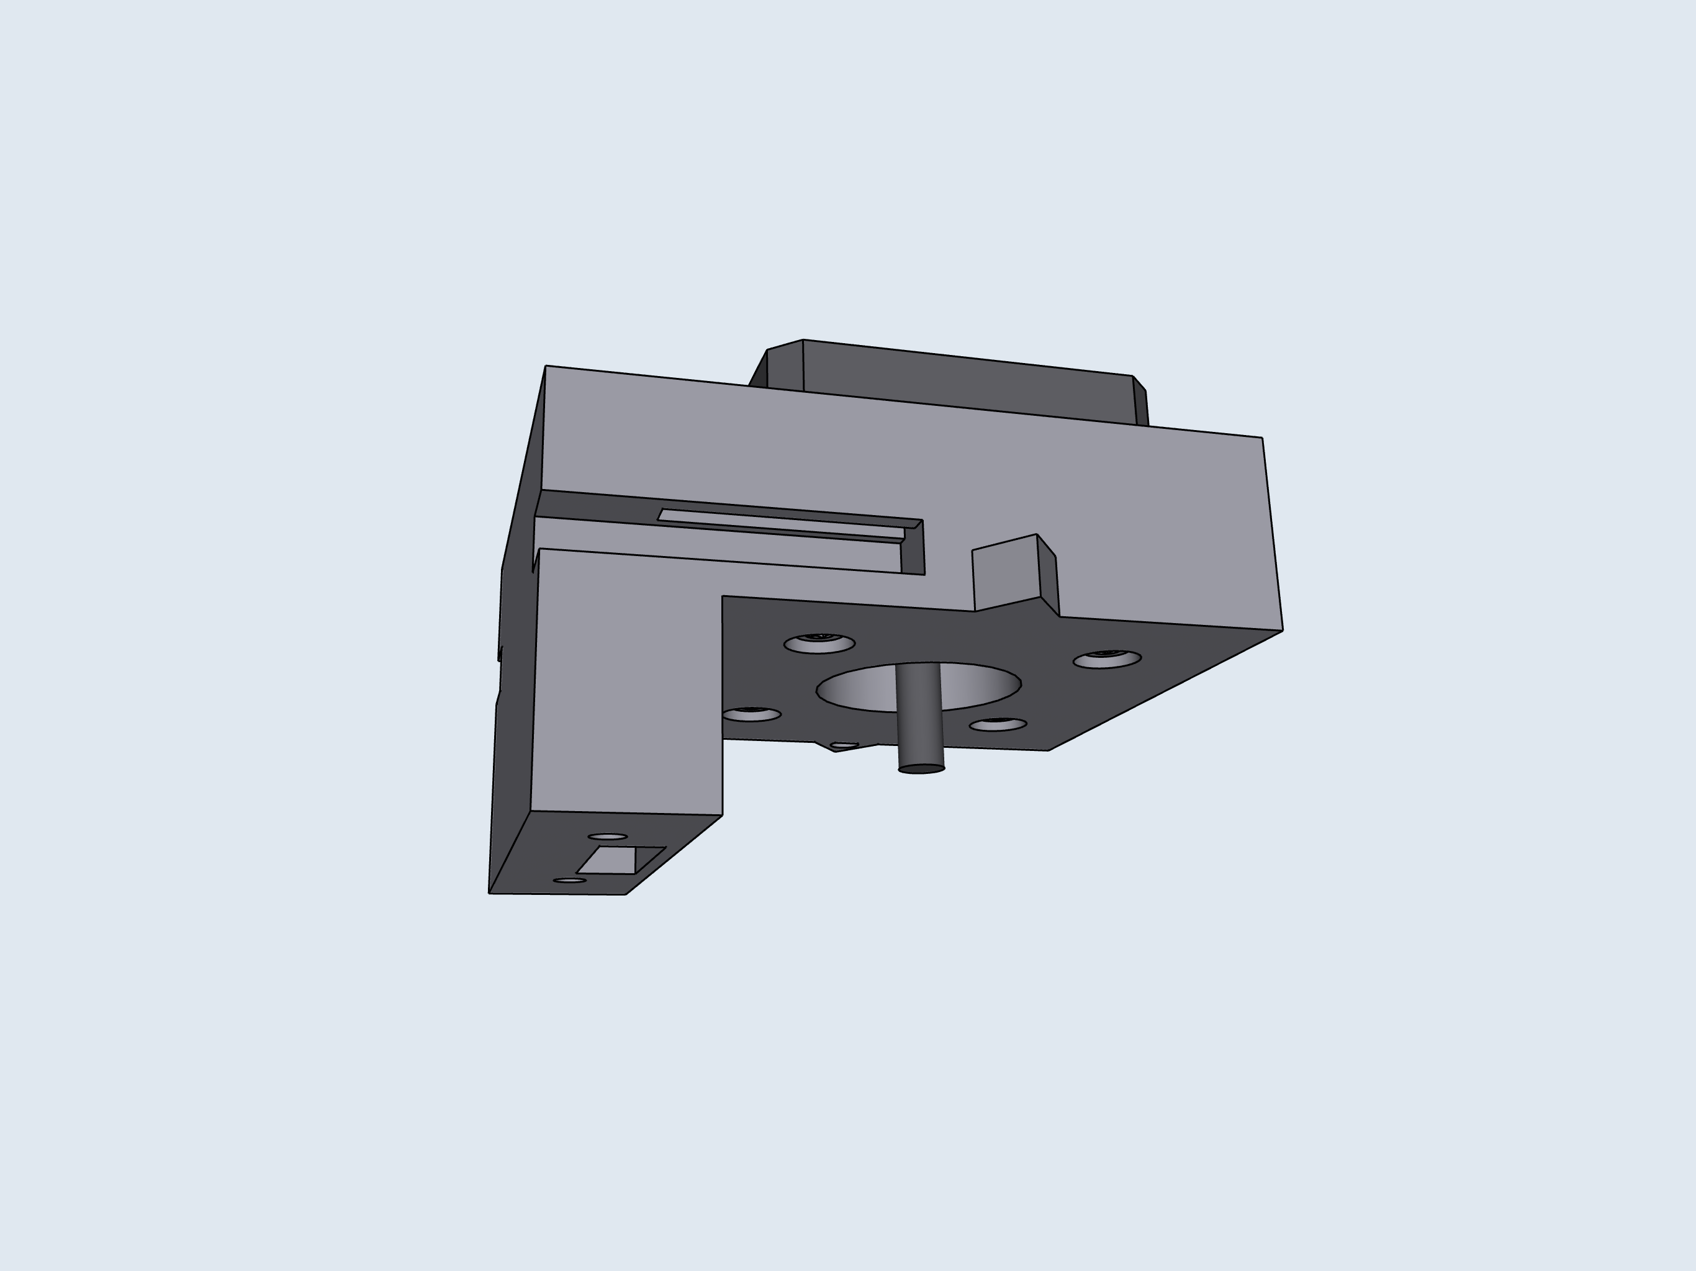
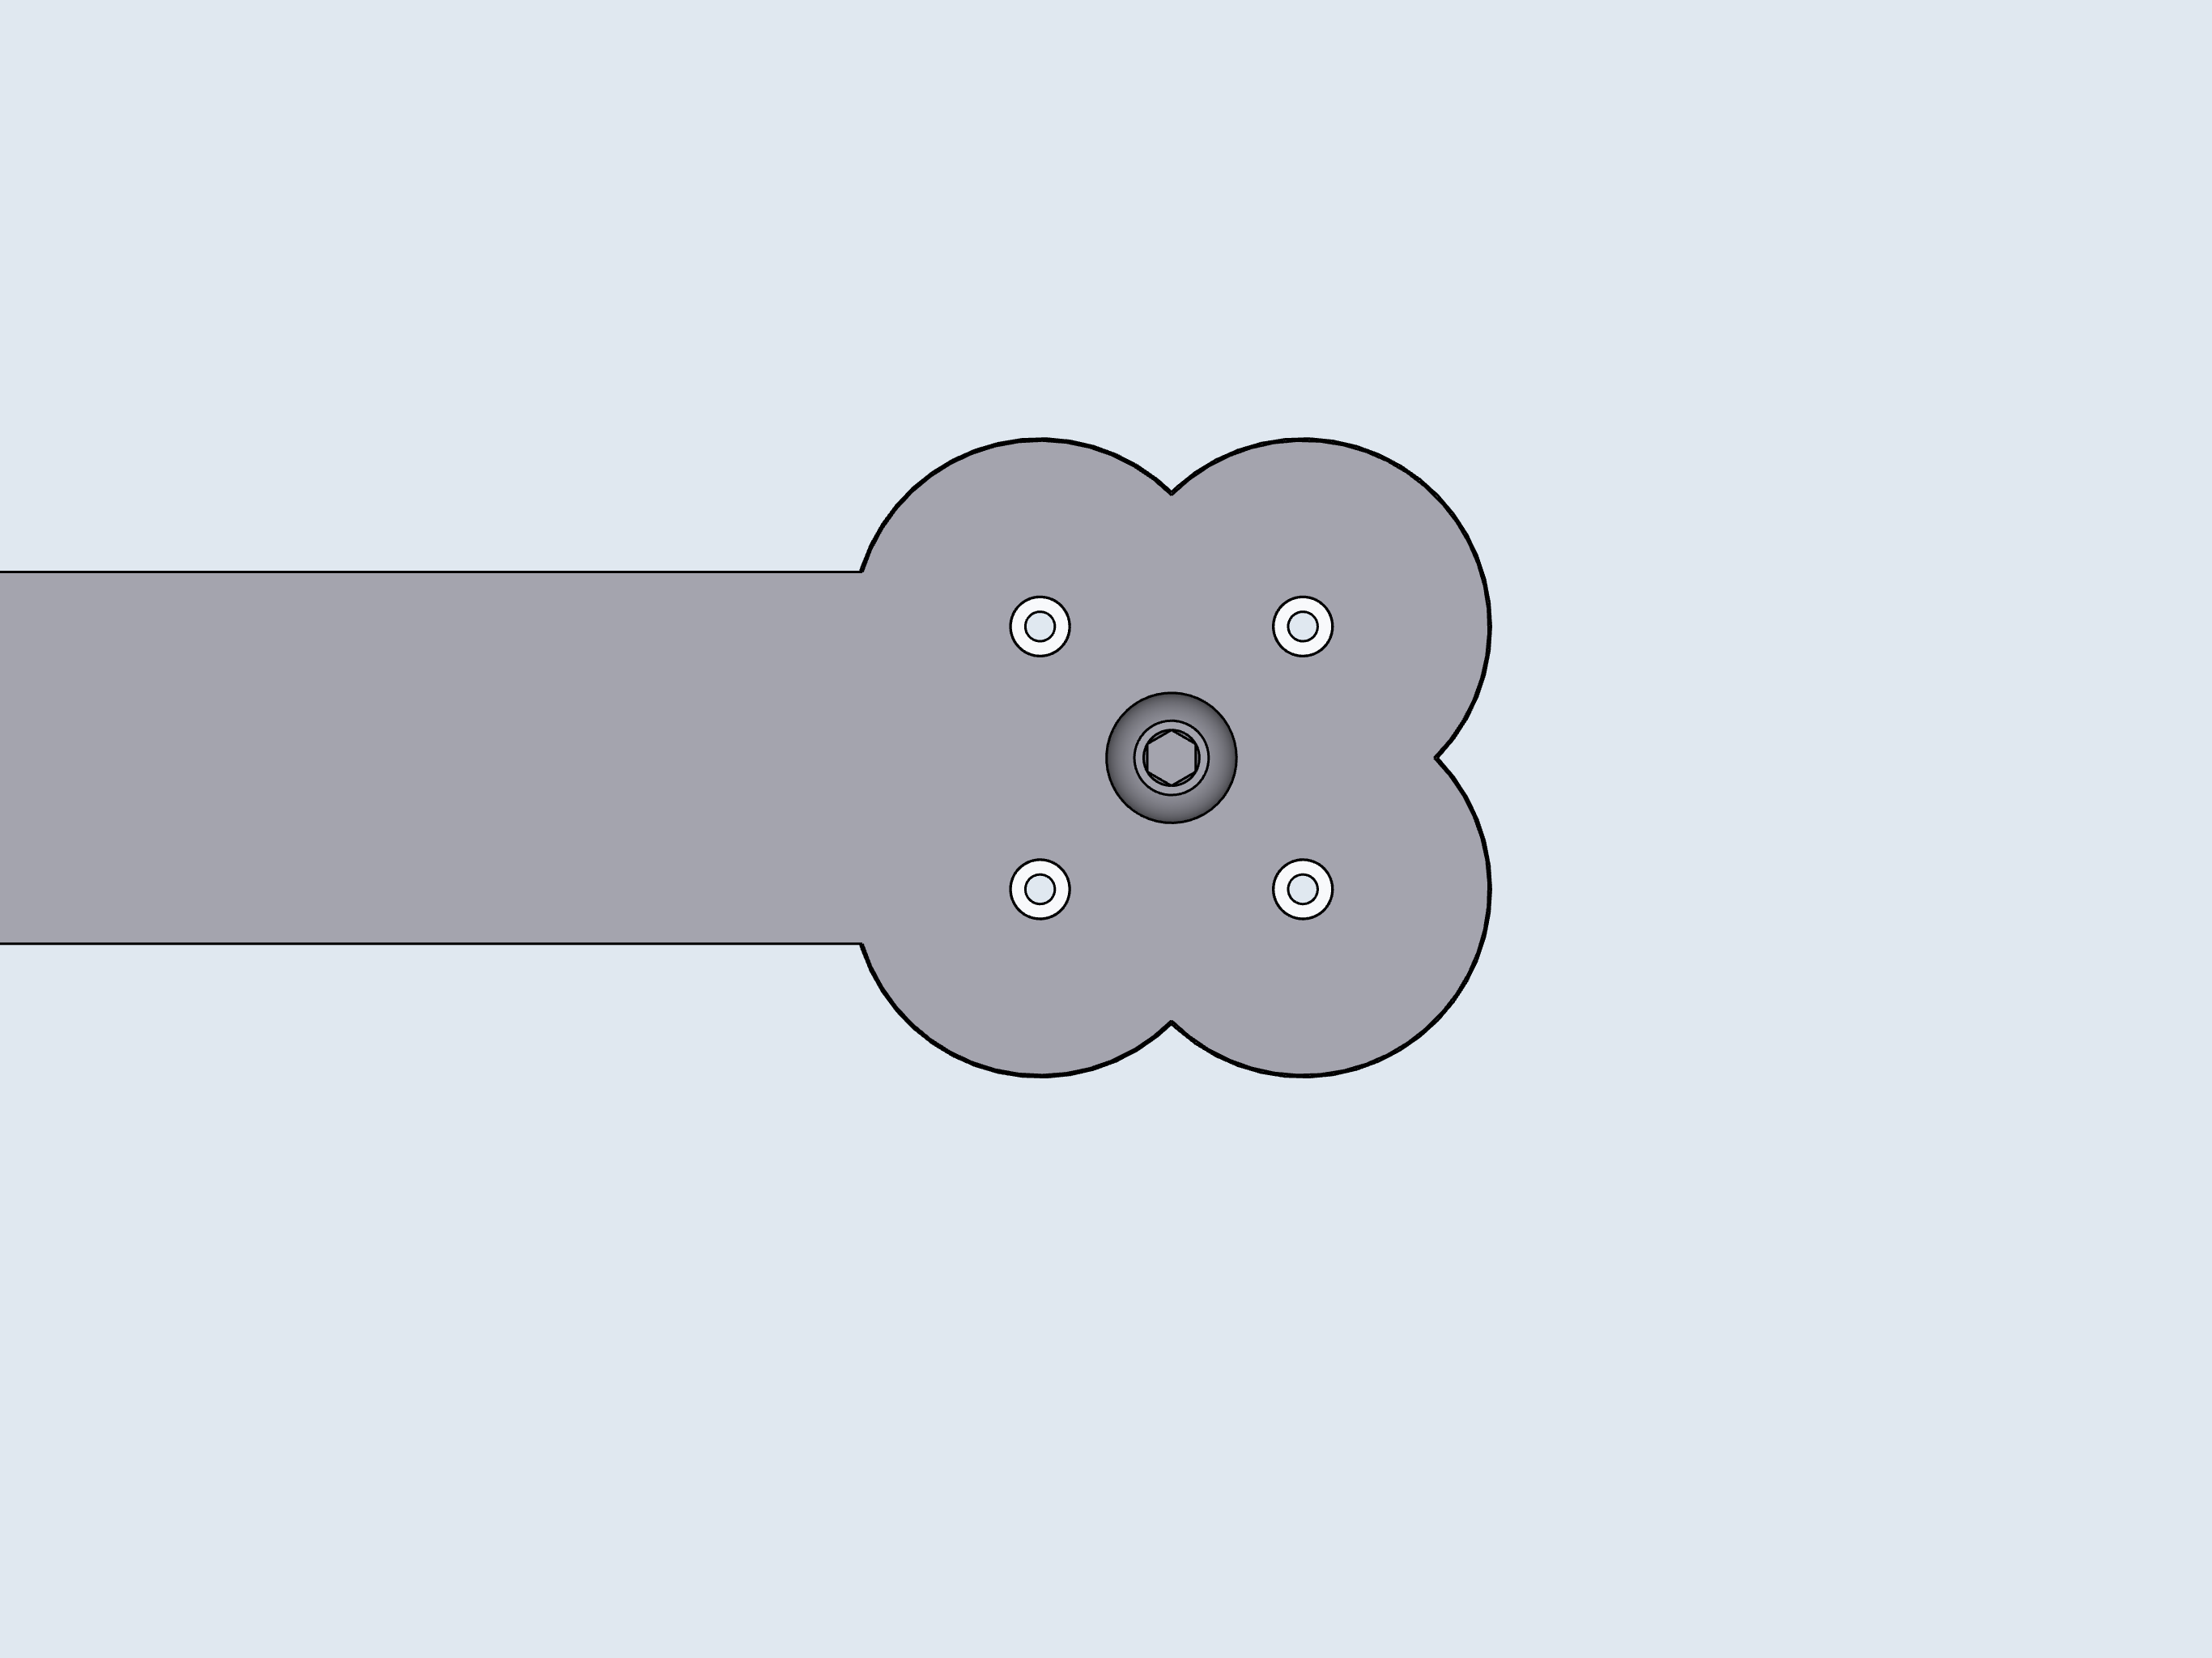
5
D: Motor Mounts
2
1
P1
P2
Pump Order
P3
P4

Slide 6
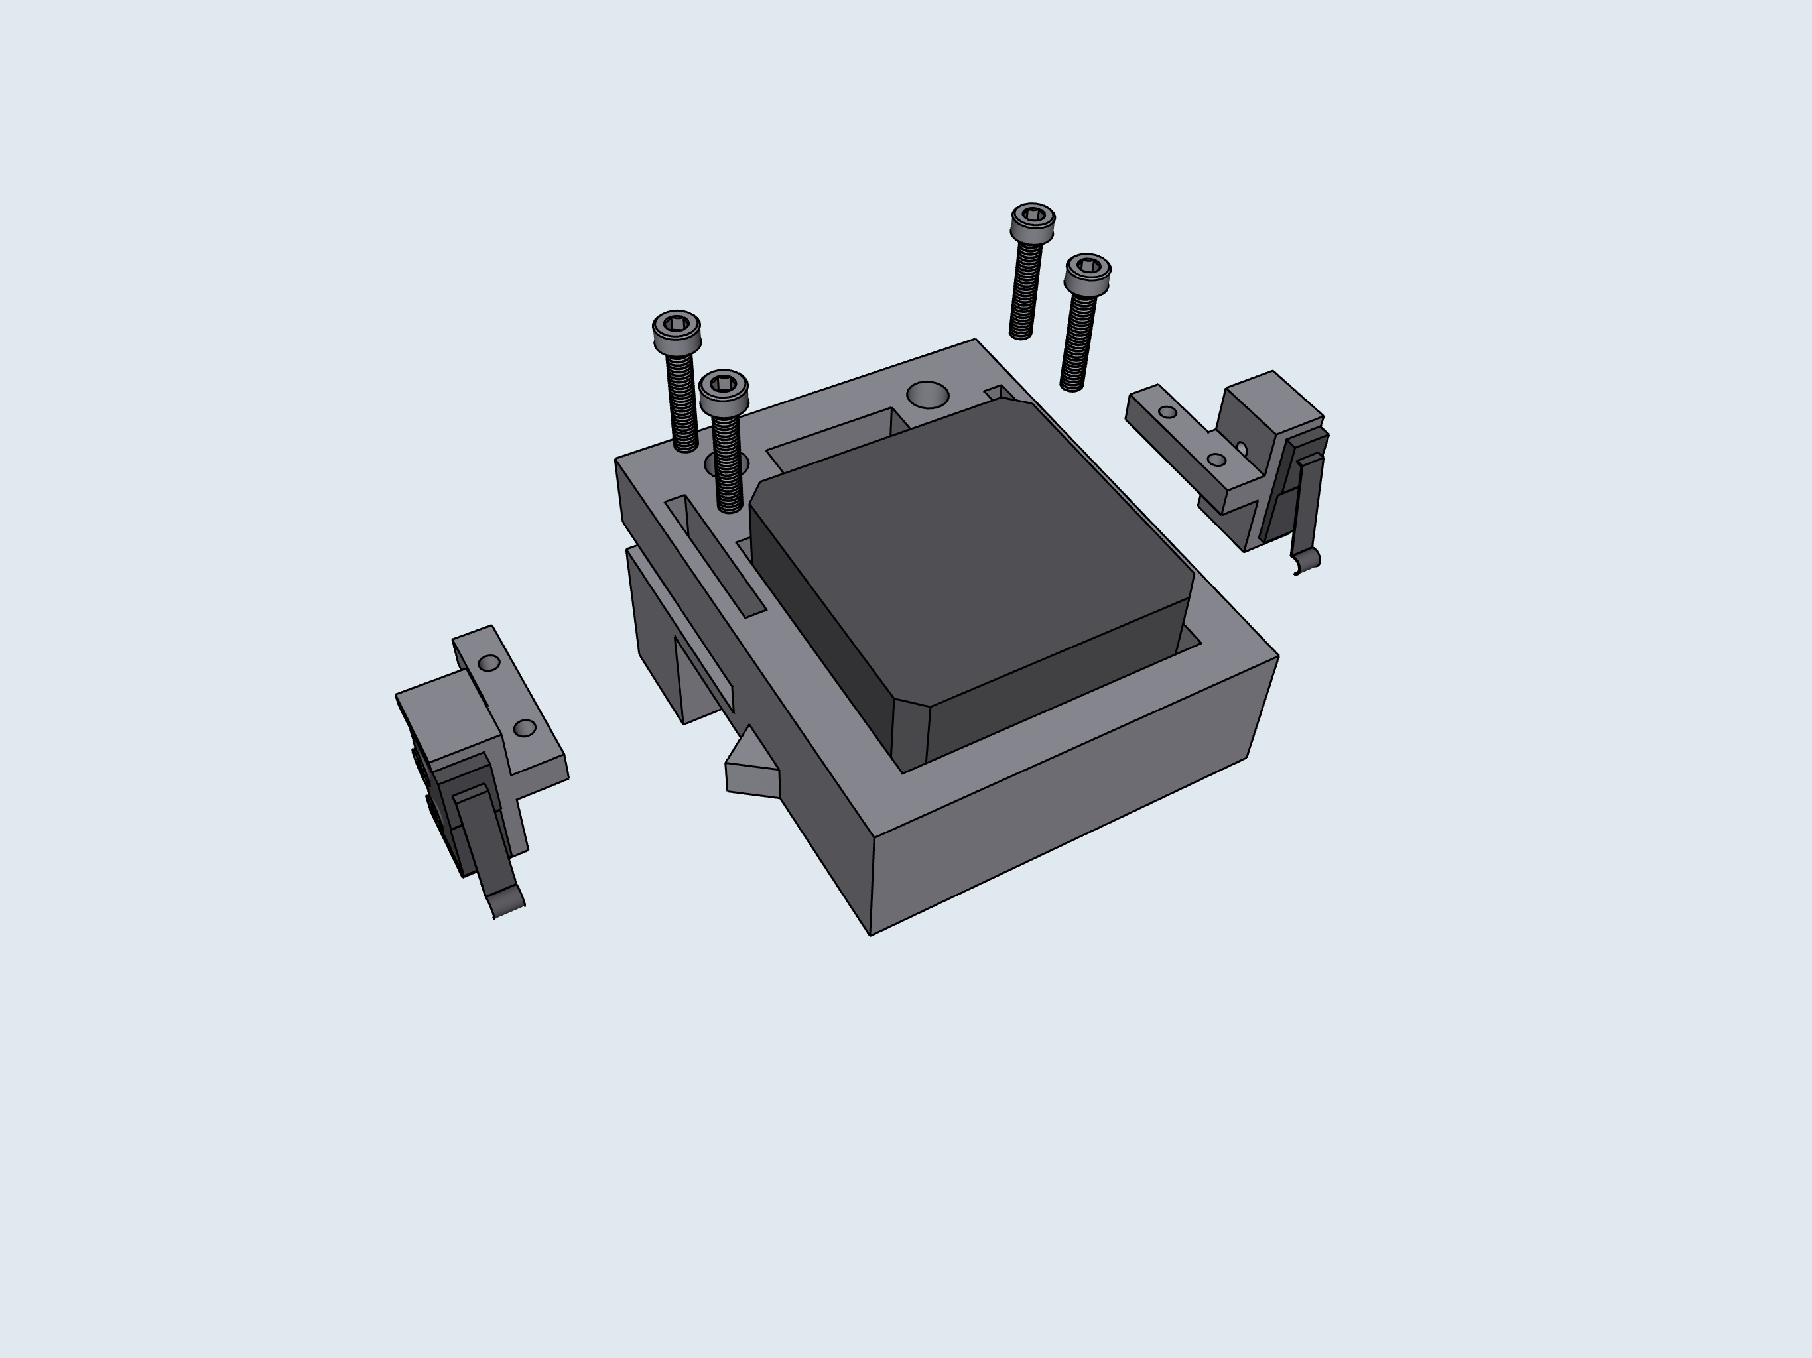
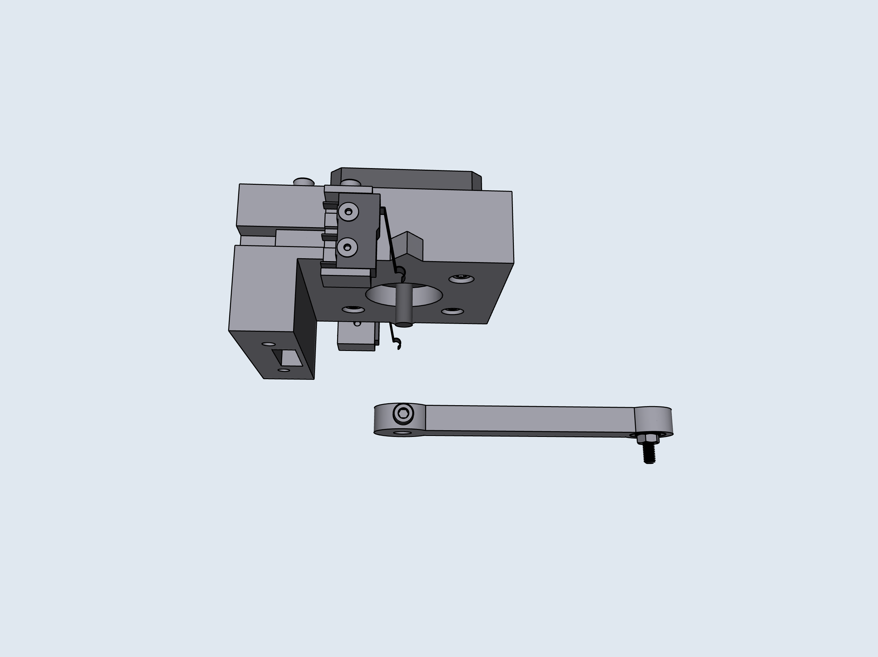
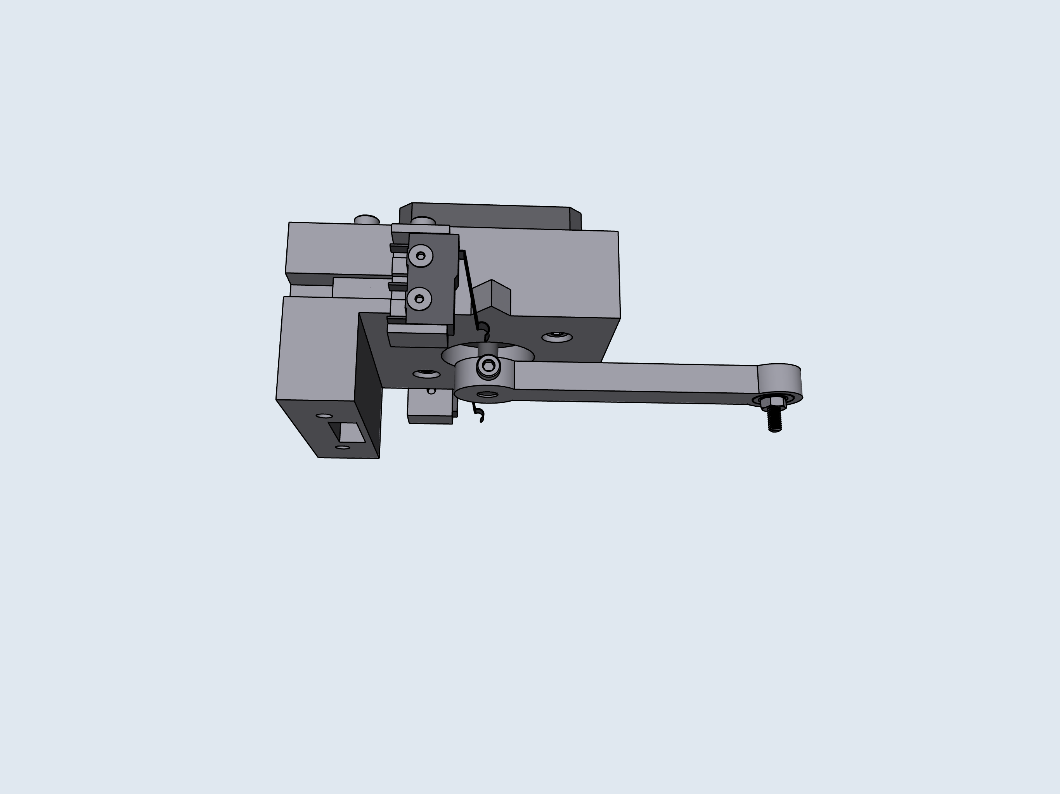
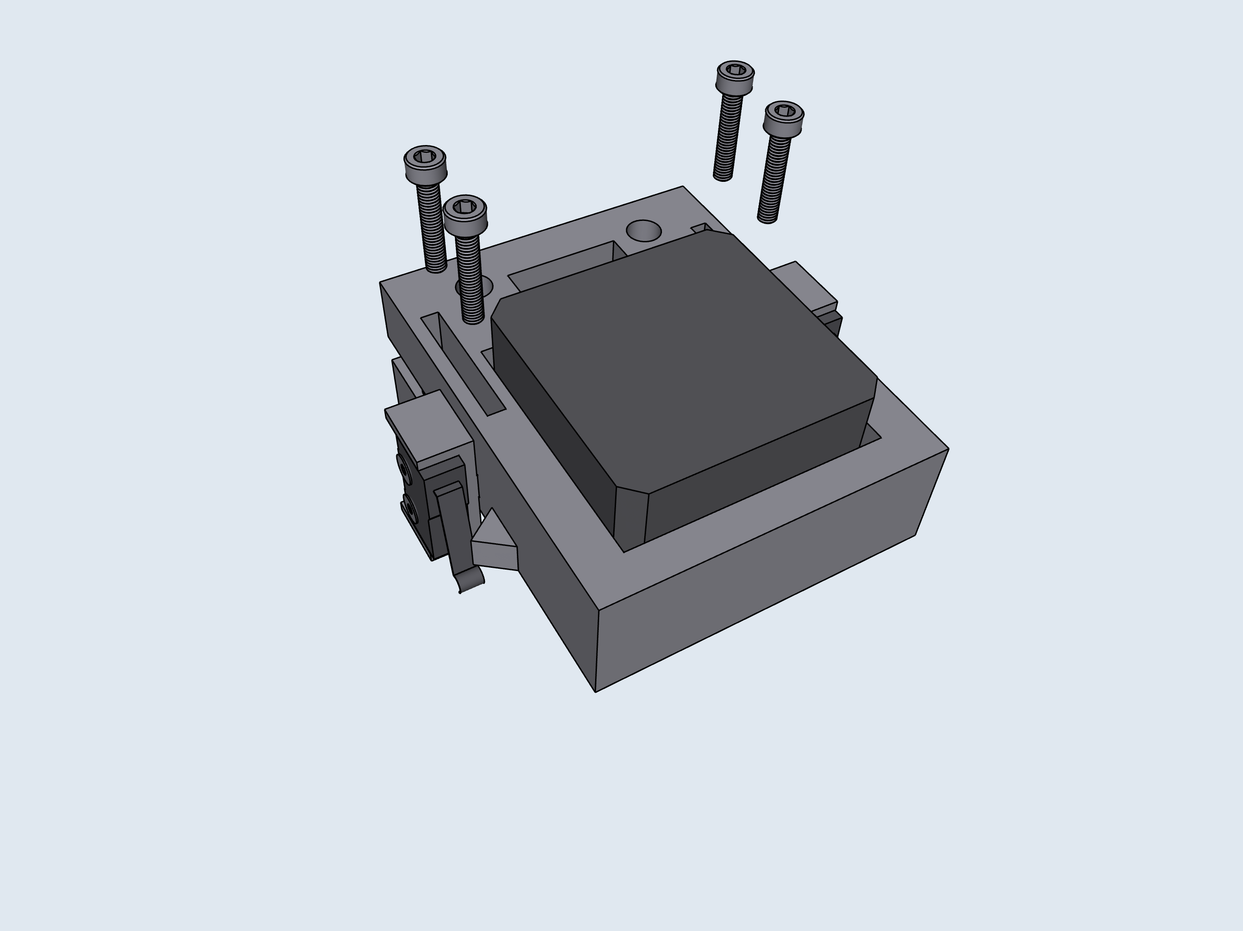
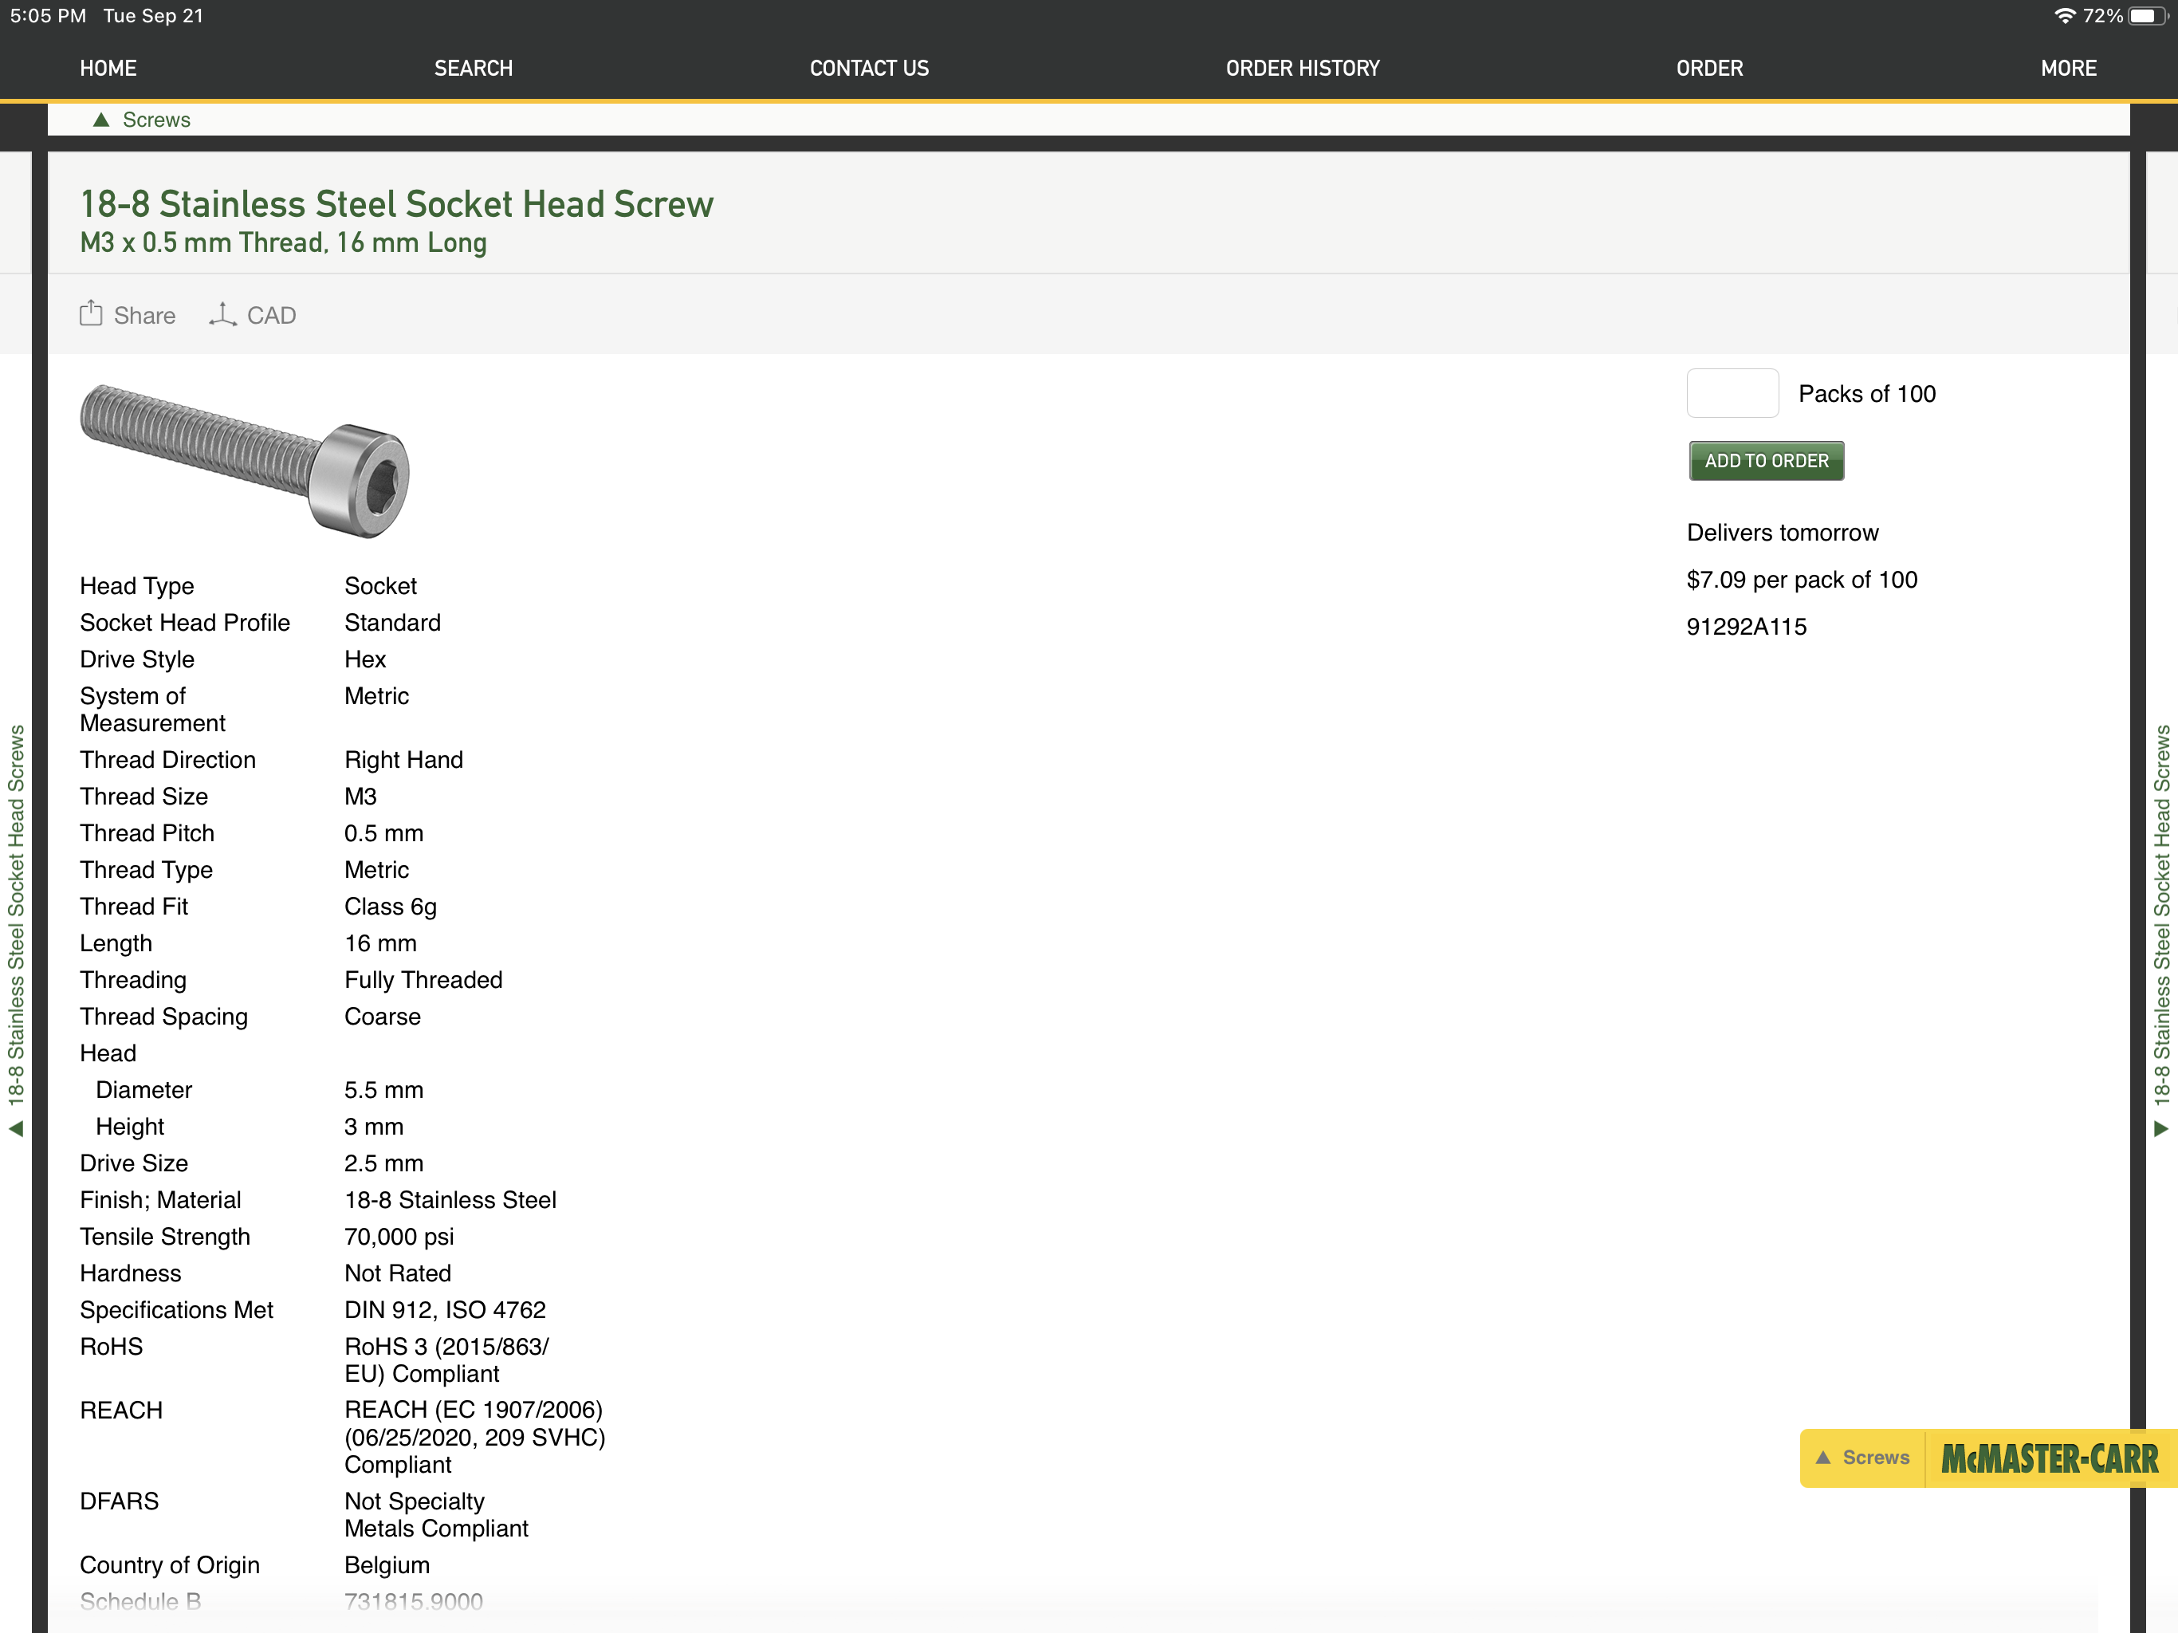
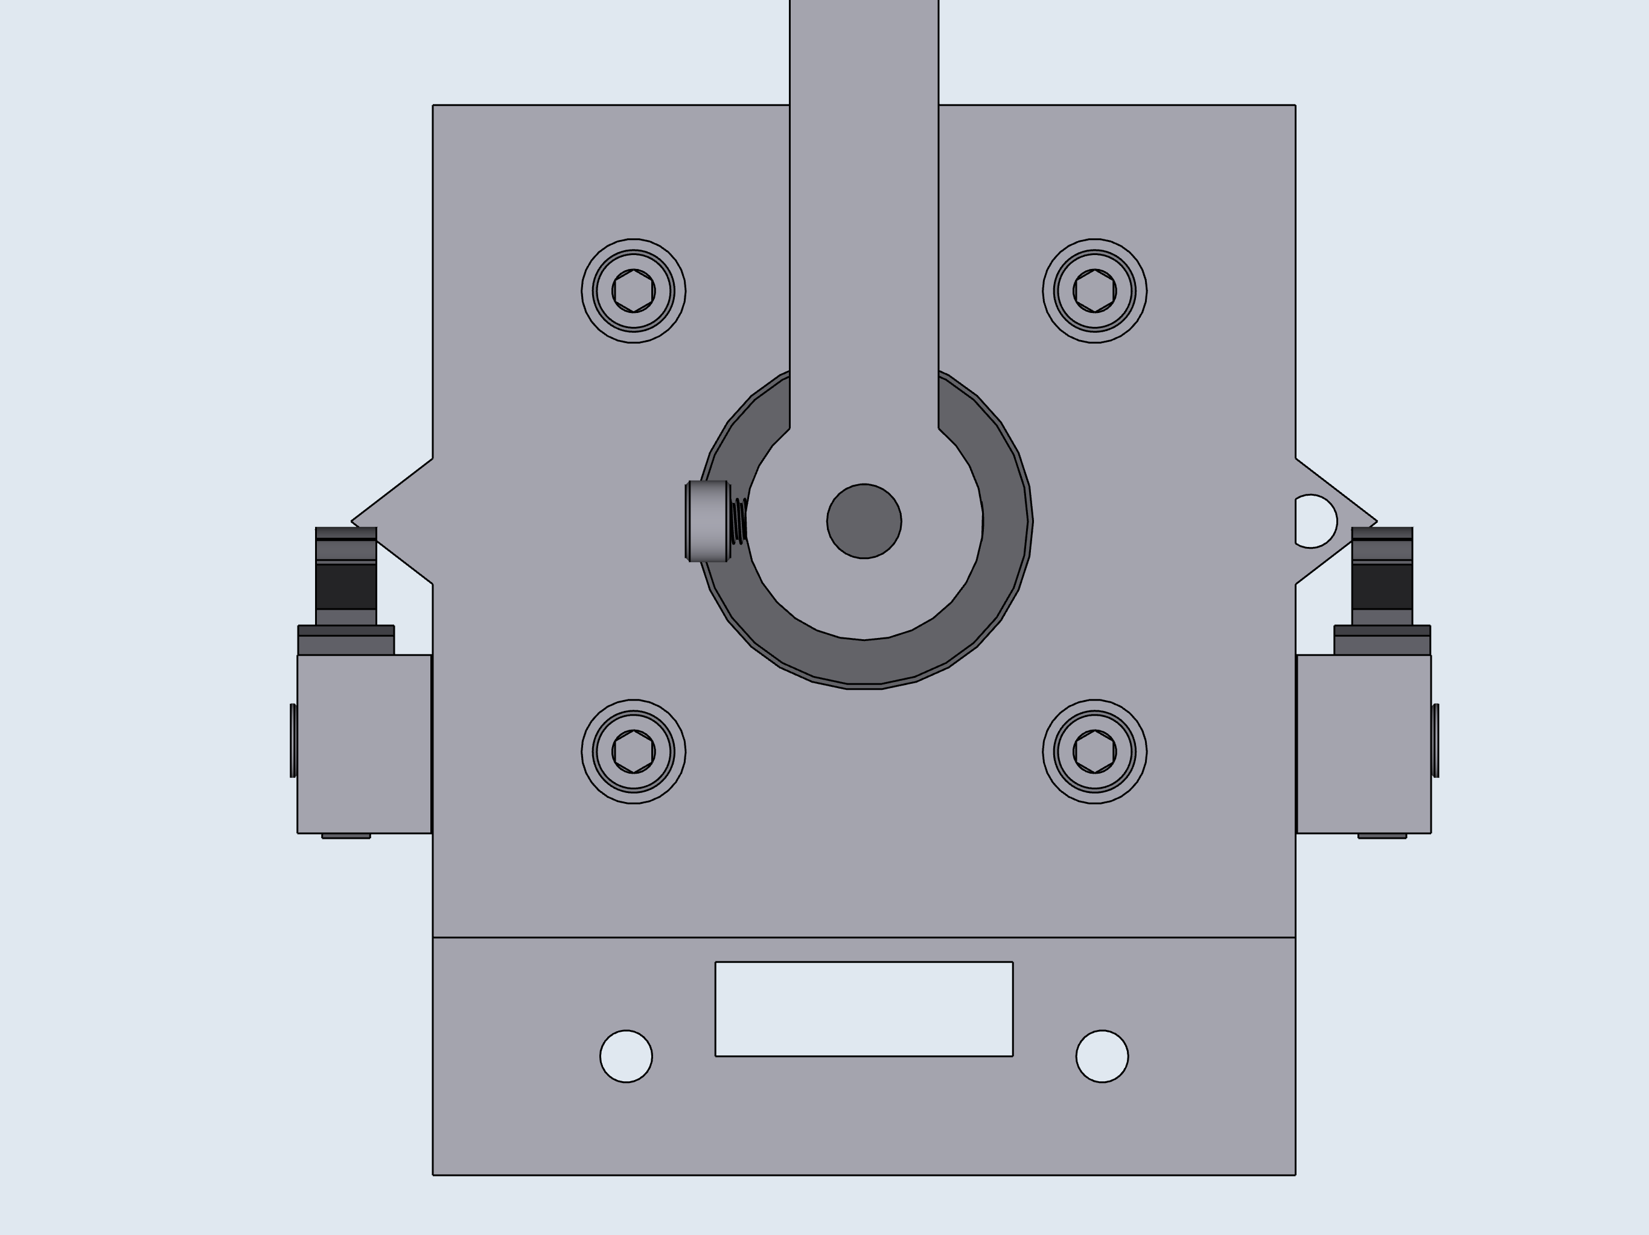
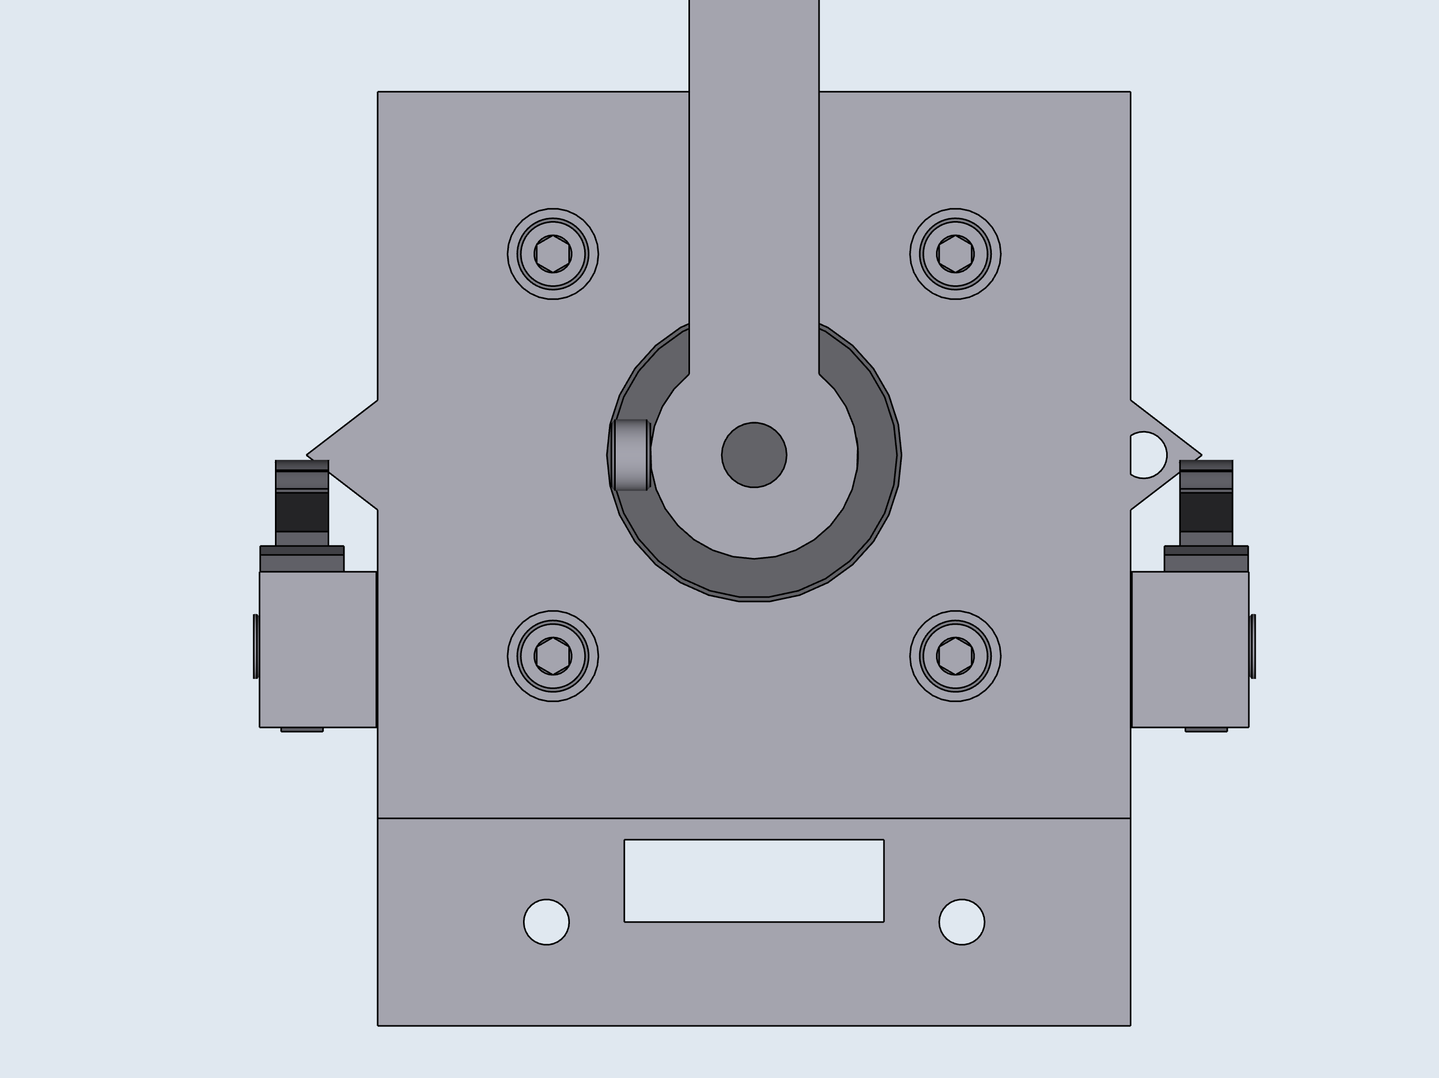
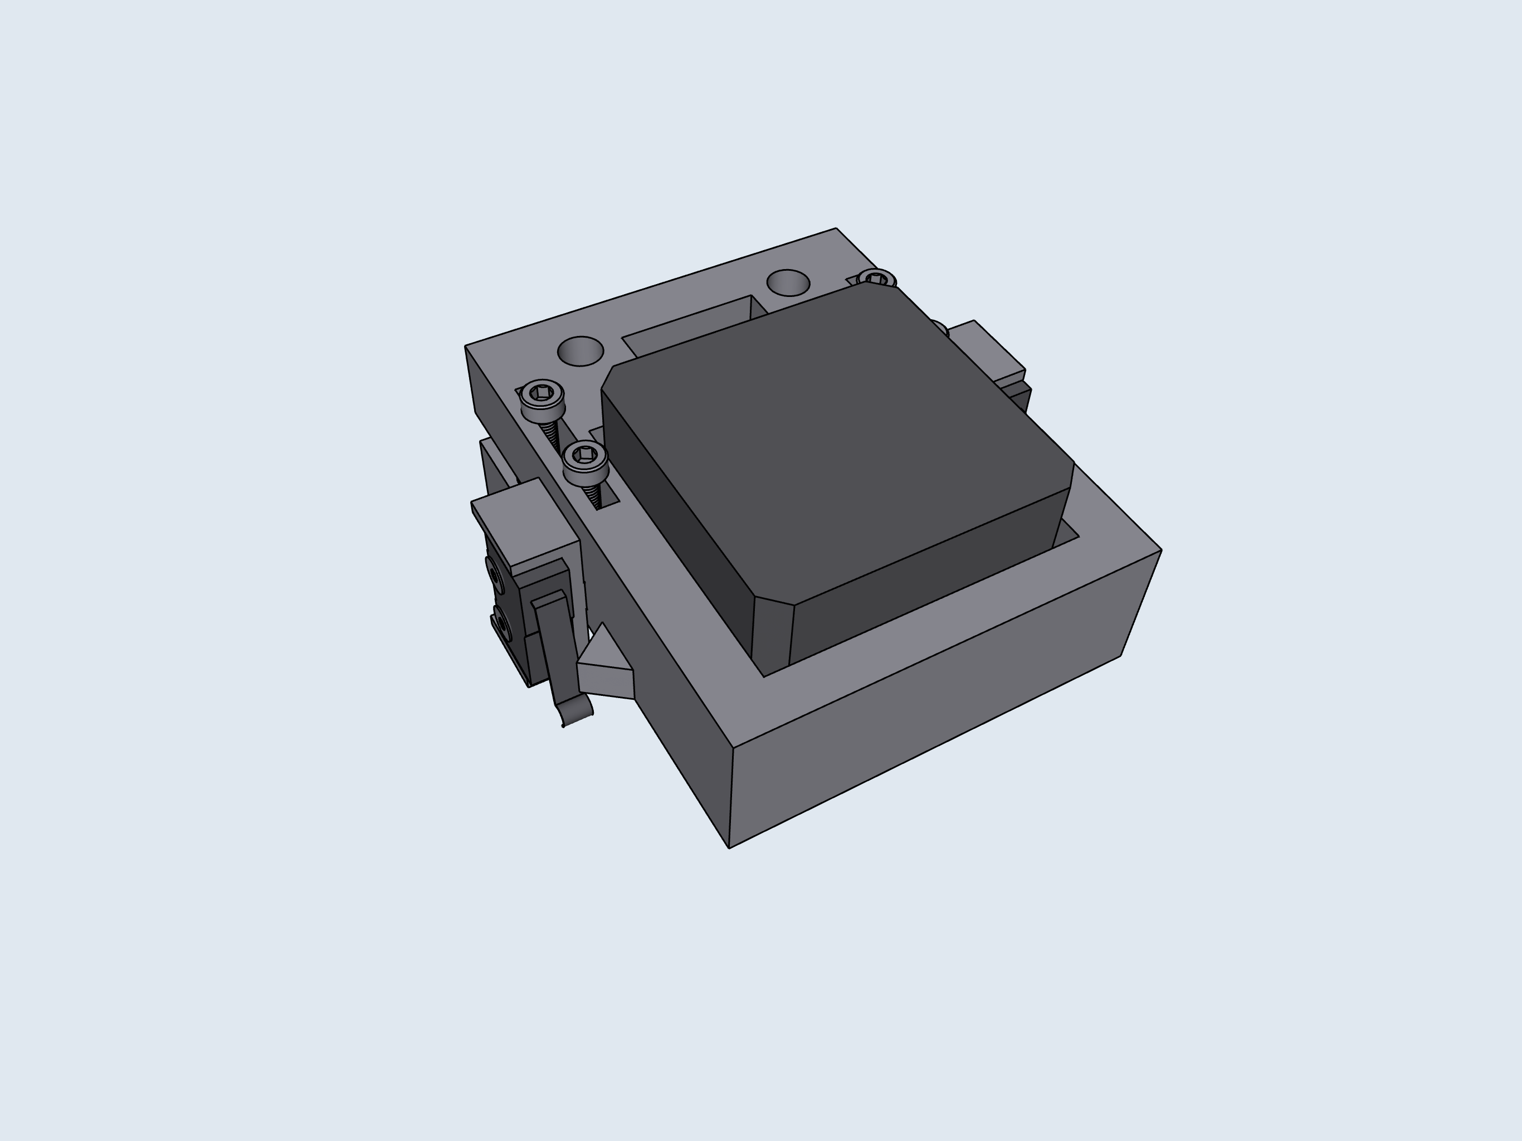
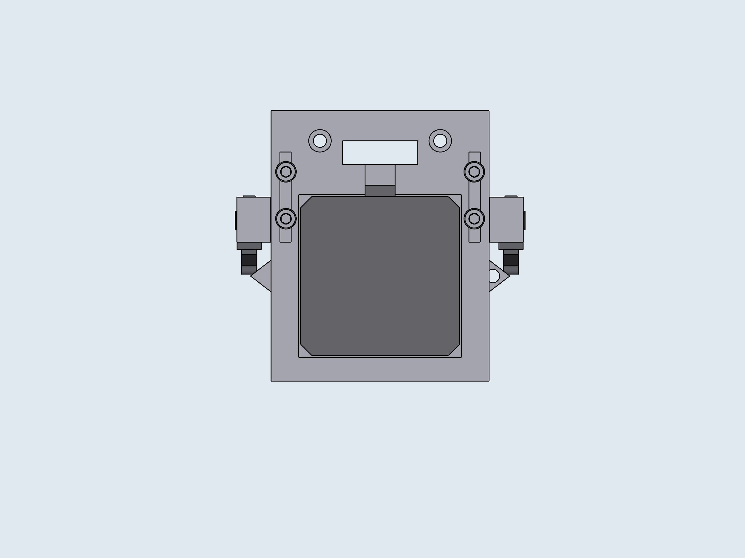
3
4
5

Slide 7
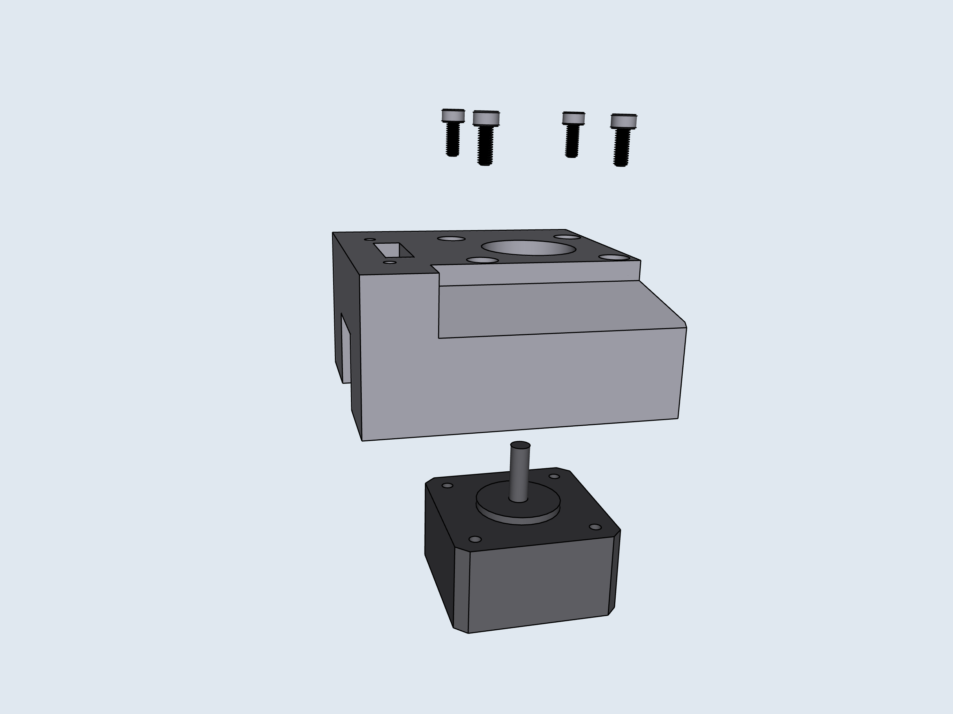
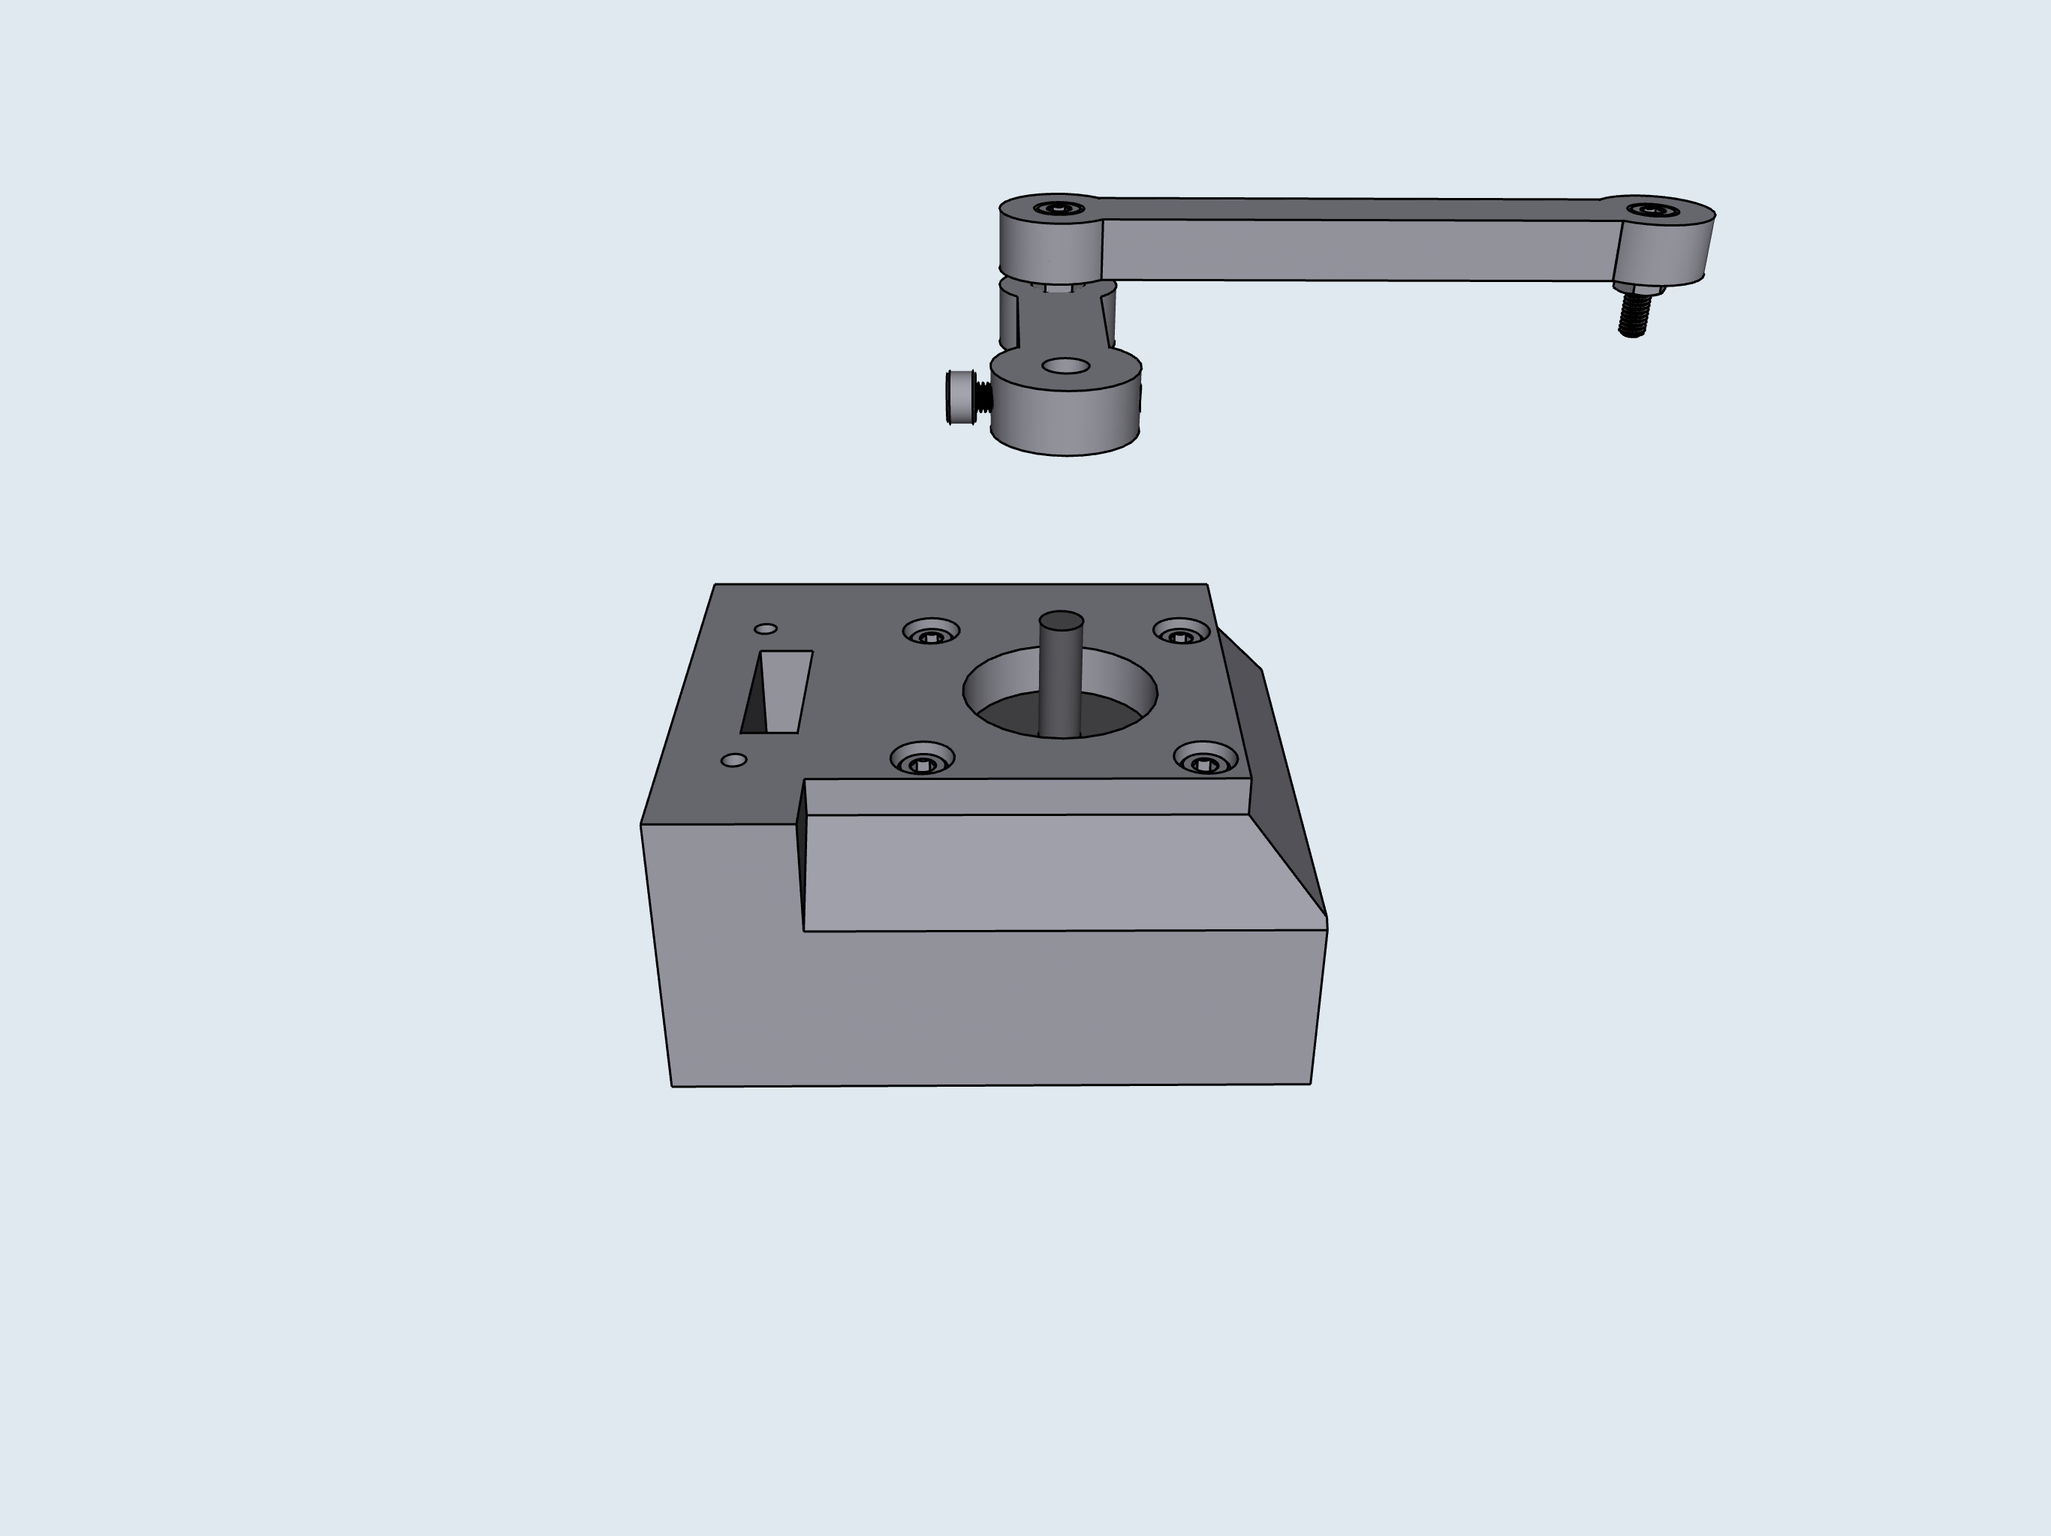
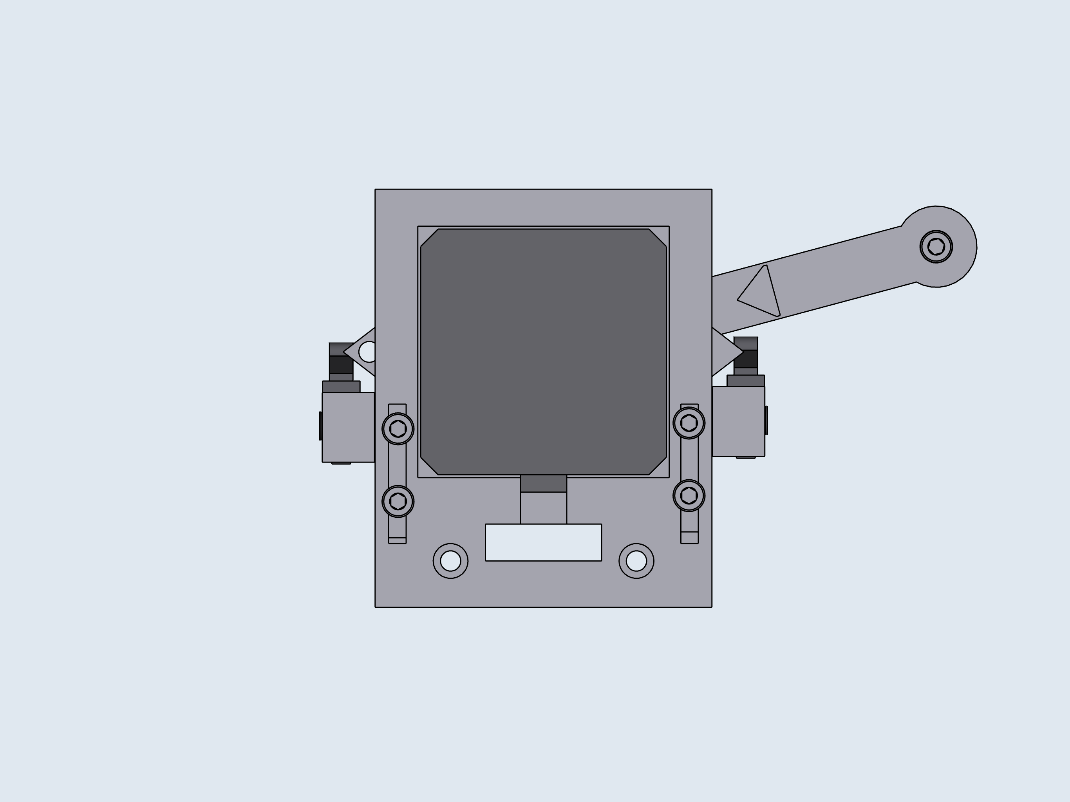
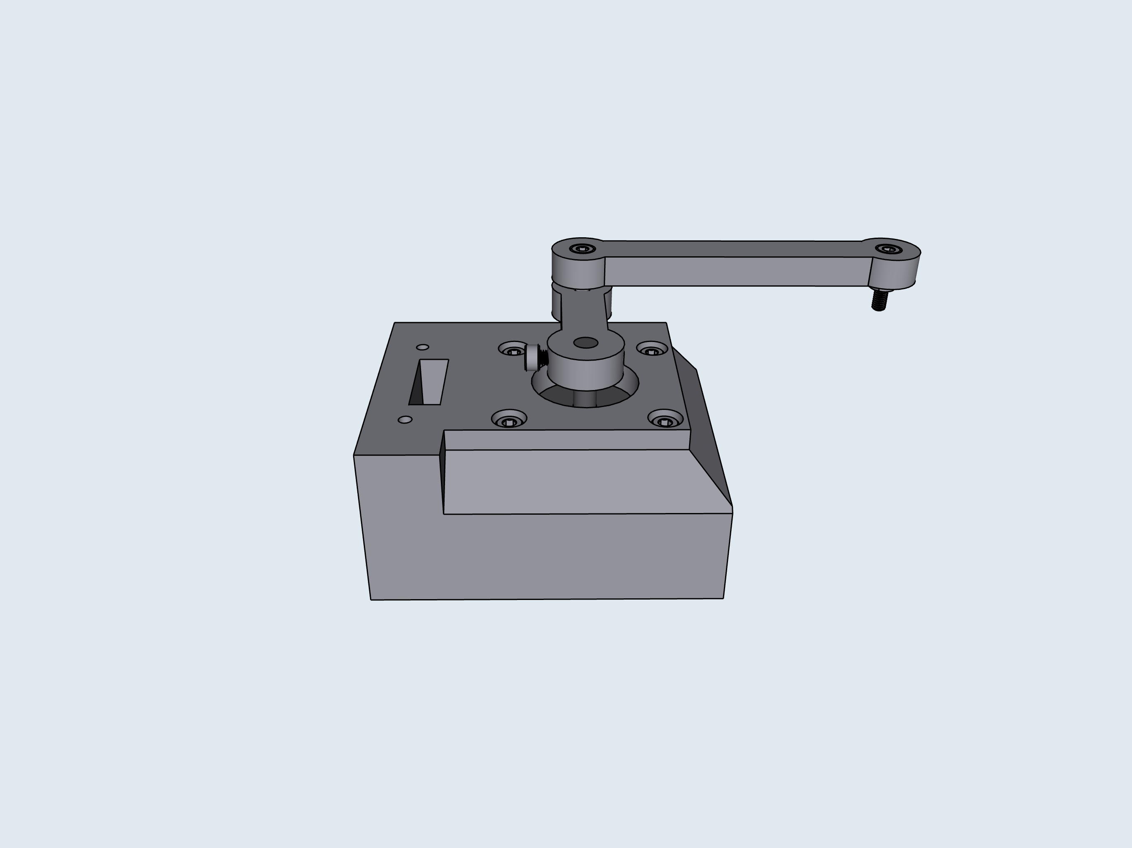
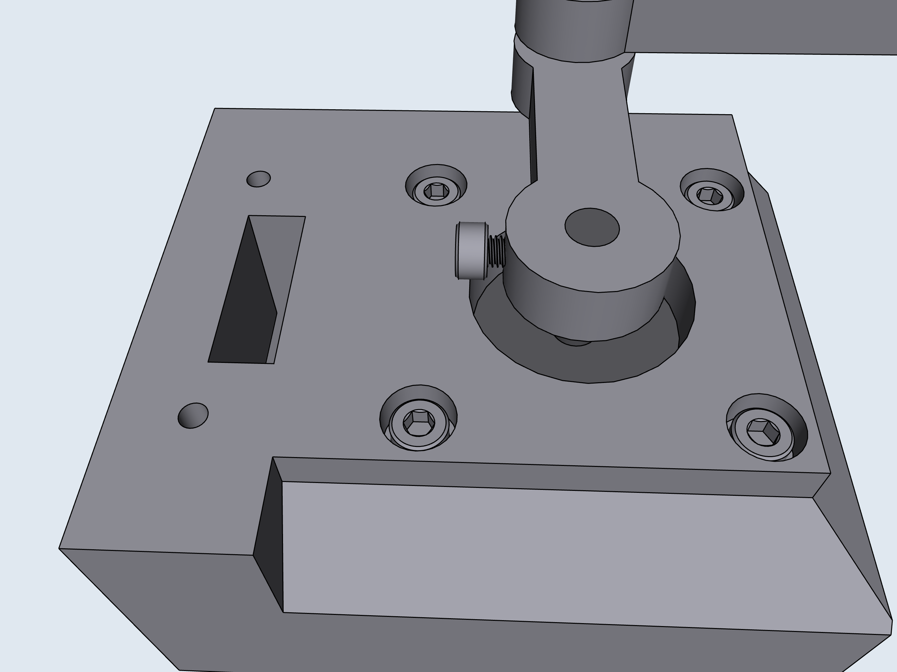
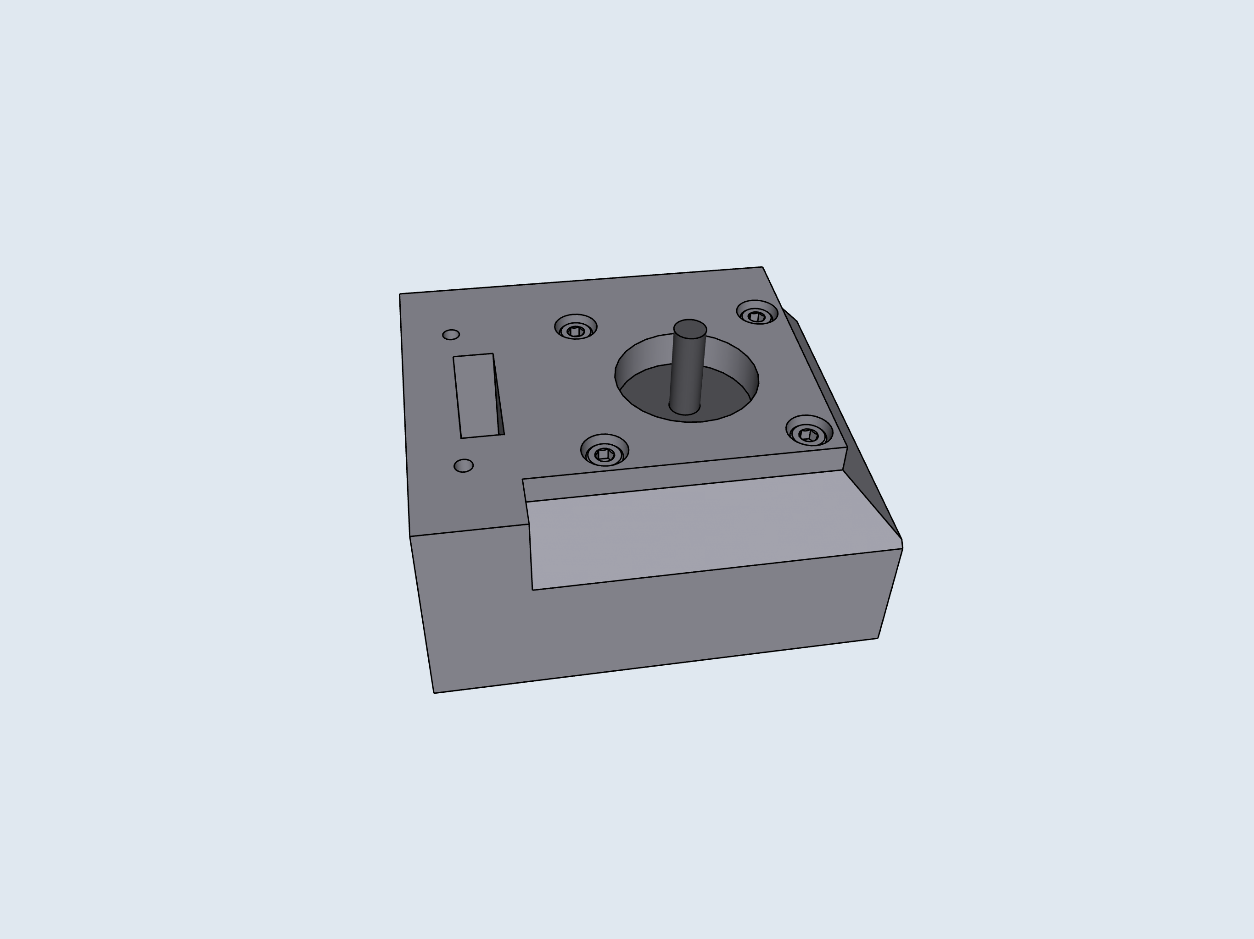


5
6
7
Limit switch position can be adjusted and fixed in place by tightening top mount screws.
8
Adjust limit position so that the limit switch triggers when the arrow on the arm is aligned with the arrow on the base.
*Click*
Once aligned, tighten screws.

Slide 8







9
10
11
Adjust limit position so that the limit switch triggers when the screw on the arm is aligned with the circle within the arrow on the base.
*Click*
Loosen the M3 screws tightening the legs to the stepper motor shaft. Raise or lower the legs until the gap between them is the same height as the M3 nut. Retighten the M3 screws.
Once aligned, tighten screws.

Slide 9







12
E: Base
2
1
3

Slide 10










F: Base, Final Assembly
2
P4
P3
P2
P1
1
3

Slide 11







G: PCB Wiring/Assembly
2
Cut the through pins of the Pico and stepper drivers, so that they are in line with the power barrel leads.
1
Set the VREF of your drivers to match your stepper motor’s recommended current. Adjust with the screw potentiometer, and a multimeter
P4
P3
P2
P1
3
Pumps
Upper Stepper Motor
Solder in the electrical components. Make note of the orientation of the Darlington Array, and the Pico.
Purge Button
Lower Stepper Motor
Rear Limit Switch
Front Limit Switch

Slide 12




4
5
Before continuing, make sure that all hardware is wired correctly. Plug in the PCB to power supply, and the USB to a computer. Once the Sidekick is plugged in, it should immediately start to home against the limit switches. If this does not occur, first check the wiring for the limit switches and motors, as the Sidekick will not continue if it cannot home properly. Next, open Thonny, and type into the command line, “hardware check”. The Sidekick should home against each limit switch, park the nozzle at a right angle, and then cycle through energizing each of the pumps. When a pump is energized, it will make an audible clicking sound. The Sidekick will then ask you to press the purge button. Once pressed, it will output “pressed” and when let go, it will output “released”. Once the correct wiring is validated, continue to step 6. If any of the components did not behave as properly, inspect their associated wiring.
6

Slide 13







H: Plate Holder
2
3
1

Slide 14







I: Pump Tubing
2
3
1
Note, one side of the clamp has a larger diameter. This is the side facing the washer. This allows the screws to clamp the tubing by threading onto the back plate.
Repeat 4x for outlet…
and 4x for inlet.
A
B
Sleeve the 1/16” OD tubing into the clamped 1/8” OD tubing. Slide the smaller tubing down until you can feel the resistance caused by the clamping force. Once you feel resistance, do not push the tubing down any further! Finish tightening the screws to securely clamp down the nested tubing. This is a critical step in reducing dead space and ensuring accurate dispensing.
B
A
Note how the clamps have been fully tightened and are flush against each other. This ensures an airtight seal between the inner and outer tubing.

Slide 15





4
5
Side Profile
P1
P2
Pump Order
P3
P4
Inlets
P4
P3
P2
P1
Repeat 4x for each pump.

Slide 16






2
3
4
Right click on the USB Serial Device. Click “Properties” in the drop down.
Now that we have the com port and the baud rate, we can use Putty to open a serial connection.
Download and install Putty:
https://www.putty.org/
Once Putty is installed, open the application. Hit the “Serial” option, and then input the correct com port we found in Step 1 under “Serial line”. Then input the baud rate we found in Step 3 under “Speed”.
After hitting open, the following command line screen will open.
J: Getting Started
1
First, congratulations on your assembly of the SideKick! Now that the SideKick is operational, let’s start on set up and commands.
The SideKick can be commanded via serial port. Any application that supports outputting via the serial port can communicate with liquid handler. We recommend using Thonny or Putty. If using Thonny, skip to Step 5. To use Putty, first find the SideKick’s com port, and baud rate. These are easy to find in Windows with the device manager.
Go to Device Manager -> Ports -> USB Serial Device
Type “initialize” to test communication with the SideKick. The SideKick should home against the limit switches, and output to the terminal.
Then click port settings. Make a note of the indicated bits per second, or baud.
Our SideKick is located at COM7. If you are unsure which port your SideKick occupies, unplug it, and see which port disappears.
The SideKick is now online and prepared to receive commands.
When all the proper settings have been entered, hit “open”.

Slide 17
5
Before doing anything with the SideKick, first set up the plate map and a purge location.
Setting up a plate map is important for locational accuracy. The SideKick comes preloaded with a map for a standard 96 well plate. However, depending on slight variations in assembly, this preset map may not be accurate. To calibrate the SideKick, load a 96 well plate into the tray. The type the command: “remap” and follow the prompts. You can remap as many times as you wish.
The purge location is any arbitrary place that you can use to purge the pump lines and dump excess liquid. The SideKick has been designed with a tray to accommodate small vials, but you can easily set up a purge location elsewhere. To set up a purge location, type the command: “set purge” then follow the prompts. The purge location can always be reset.
Once the purge location has been set, and the plate map recalibrated, your SideKick is all set for liquid handling duty!
Command Library
Command Library
Dispensing and Moving:
A dispense or move command should be a single line indicating four things:
Desired Pump: Ex. “Pump 1”
Desired Action: “dispense” or “move”
Target Location: Ex. “Well A6” or “purge”
Target Volume (if dispensing): Ex. “200 Microliters”
Ex: Pump 1 dispense 200 microliters into well A3
The order does not matter, so long as you indicate these four things. The following commands all mean the same thing.
Ex. Dispense 200 microliters from Pump 1 into A3
Ex. Dispense 200 Pump 1 well A3
Ex. Pump 1 Dispense 200 well A3
If moving to a well, no volume needs to be indicated.
Ex. Pump 1 move well A3
Things to note:
Make sure to type “well” if targeting a well. Ex. “well a6” not just “a6”.
Case does not matter.
Prepositions do not matter.
Order does not matter.
Volume is given in microliters.
Command List
Initialize: Homes the armature against the limit switches. Use if the SideKick has bumped against something and skipped steps.
Hardware check: Runs through all the hardware to validate that everything has been wired correctly. Use after wiring the SideKick, or for troubleshooting.
Free move: Allows the user to freely move the armature.
Sleep: De-energizes the motors, allowing the armature to move freely.
Wake: Re-energizes the motors so that the armature can move again. Use after the “sleep” command.
Return home: Returns the armature to the home location.
Manual purge: Used to purge the liquid lines. Use after swapping reagents, or for cleaning the lines.
Remap: Used to calibrate a new plate. Use if swapping in a plate with different well locations.
Set purge: Sets the purge location. Use if changing the location of the purge tray/vial.

